Slide 1
If you use anything from this presentation make sure to cite ME. The content in this document is the intellectual property of UBUNTU Research & Evaluation, created with the wisdom, labor, and lived experiences of Black people committed to justice, liberation, and transformation. This work is not for extraction, replication, or appropriation. Instead, it is shared in the spirit of collective learning and accountability.
We affirm Black people's right to define and protect our intellectual futures. If you wish to engage with or build upon the ideas presented here, you must do so with integrity, respect, and explicit permission. Any use of this material without acknowledgment or consent reinforces harmful systems of exploitation.
Liston, M. (2026, April 22). The People's Data Ending Data Violence Towards Marginalized Communities. [public presentation]. MKE Data Dive. Hosted by Data You Can Use. Milwaukee, WI, United States.

Slide 2
If evaluators aren’t intentional, their work reinforces the existing violence of the public health economy.
Instead we call for evaluators, evaluation commissioners, those who read and use the findings of evaluation to align with public health liberation.

Slide 3
The People's Data
Ending Data Violence Towards Marginalized Communities

Slide 4
Our Framing Questions
How did the Black Panther Party intentionally shift the power of data into the hands of the people?
What is data violence and how does it impact public health?
How does data violence happen?
How can Public Health Liberation (PHL) address data violence?
Why does this matter for evaluation and why should you care?

Slide 5
We need to respect, protect and fulfill a sense of dignity for everyone through public health.

Slide 6
All (data) power to the people is an homage to the Black Panther Party’s call for self determination, community power-building and addressing institutionalized state-sanctioned (data) violence against the people.
Notes:
We hold these truths to be self-evident, that all men are created equal; that they are endowed by their Creator with certain inalienable rights; that among these are life, liberty, and the pursuit of happiness. That, to secure these rights, governments are instituted among men, deriving their just powers from the consent of the governed; that, whenever any form of government becomes destructive of these ends, it is the right of the people to alter or abolish it, and to institute a new government, laying its foundation on such principles, and organizing its powers in such form, as to them shall seem most likely to effect their safety and happiness. Prudence, indeed, will dictate that governments long established should not be changed for light and transient causes; and, accordingly, all experience hath shown that mankind are more disposed to suffer, while evils are sufferable, than to right themselves by abolishing the forms to which they are accustomed. But, when a long train of abuses and usurpations, pursing invariably the same object, evinces a design to reduce them under absolute despotism, it is their right, it is their duty, to throw off such government, and to provide new guards for their future security.

Slide 7

The Free Breakfast for Children Program & Public Health Data
The BPP launched one of the first large-scale free breakfast programs for Black children, recognizing that hunger and poor nutrition were public health crises affecting academic performance and community well-being.
The program wasn’t just about feeding kids; it also collected data on how systemic neglect led to food insecurity. They used this data to prove the state’s failure in providing for Black children, forcing the U.S. government to later implement its own national school breakfast program.

Slide 8
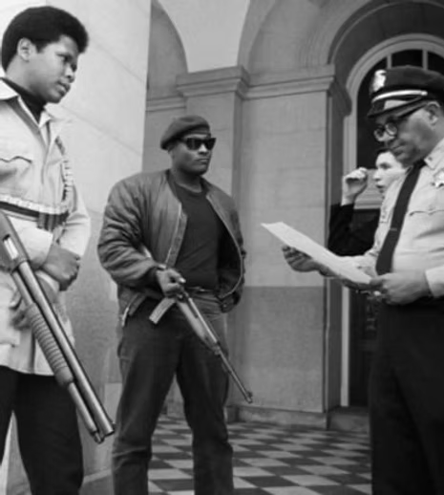
Community-Controlled Police Oversight & Copwatch Programs
The BPP recognized that the state used law enforcement data to criminalize Black people, so they collected their own counter-data to expose racialized violence and advocate for community control over policing.

Slide 9
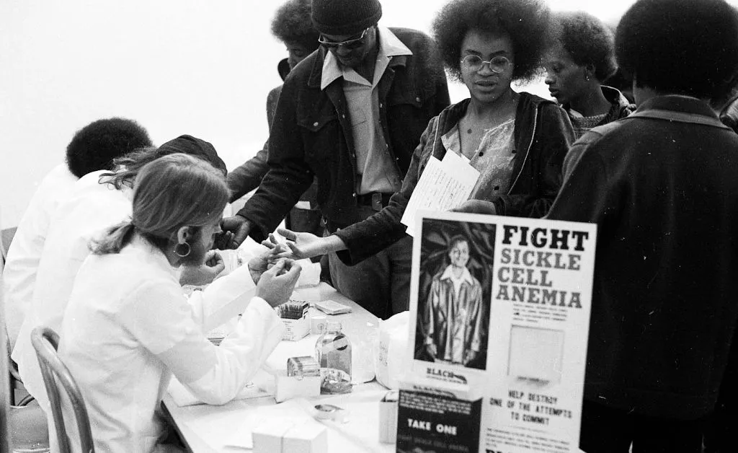
The People’s Medical Research & Sickle Cell Anemia Awareness Campaign
The BPP exposed the U.S. government’s failure to fund research on sickle cell anemia, a disease that disproportionately affected Black communities. They conducted independent screenings, launched educational campaigns, and provided free medical services in their community clinics.
The BPP collected its own medical data, raising awareness and demanding accountability from the healthcare system.
Their work led to increased federal funding for sickle cell anemia research, proving that data in the right hands can force systemic change.

Slide 10
We need to respect, protect and fulfill a sense of dignity for everyone through public health.

Slide 11
Data violence
The deceptive guise of objectivity in data-driven systems, where deeply embedded assumptions, prejudices, and structural hierarchies are coded into seemingly neutral measurements. These processes actively reproduce and amplify systemic oppression, entrenching discrimination under the false pretense of fairness and efficiency.

Slide 12
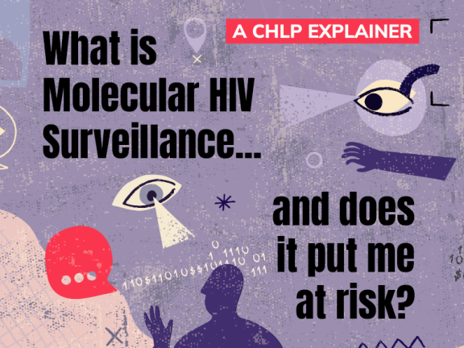
The myth of inclusion
On one hand, inclusion in public health data is framed as an effort to ensure that marginalized communities are counted, represented, and considered in decision-making. This can lead to targeted interventions that improve health outcomes for historically excluded populations. For example, increasing racial, gender, and socioeconomic categories in public health data collection allows for more nuanced insights into health disparities.
Inclusion within a biased system does not inherently challenge the foundations of public health data that have historically been used to control, surveil, and police marginalized communities.

Slide 13
Artificial intelligence
AUTHENTIC RACISM
2019
Black patients tended to pay for more active interventions such as emergency visits for diabetes or hypertension complications.
Among all patients classified as very high-risk, black individuals turned out to have 26.3 percent more chronic illnesses than white ones (despite sharing similar risk scores). Because their recorded health care costs were on par with those of healthier white people, the program was less likely to flag eligible black patients for high-risk care management.
When contacted about these results, eight of the top U.S. health insurance companies, as well as two major hospitals and the professional group the Society of Actuaries, declined to comment. The published study results did not name the algorithm or identify its developer.
Notes:
During the COVID-19 pandemic, AI-driven public health surveillance disproportionately targeted Black, Brown, and poor communities under the pretense of disease control. AI-powered systems were deployed to enforce lockdowns, monitor social distancing, and predict “hotspots” for disease transmission. However, these tools often relied on biased datasets that mapped racialized poverty as a risk factor, leading to increased policing in marginalized neighborhoods. Rather than ensuring equitable health protections, AI was weaponized to justify over-policing, criminalization, and public health interventions that ignored social determinants of health—such as inadequate housing, food insecurity, and underfunded hospitals. This is a classic case where data violence merged with public health and AI, resulting in increased surveillance rather than care.

Slide 14
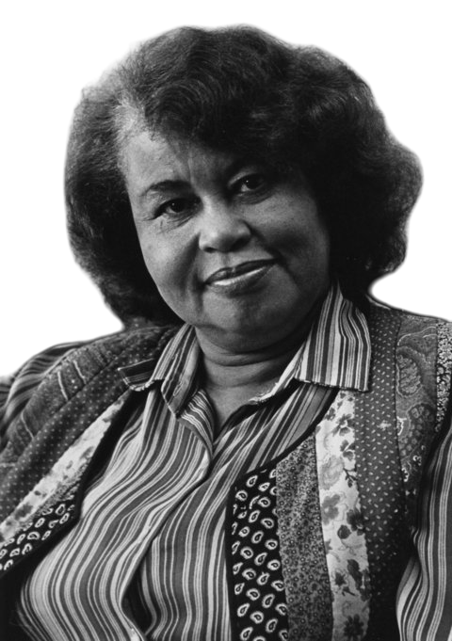
No humans involved
"The present global configuration of power is based on a conception of being human in which some are made to count as more human than others…Our silence, our indifference, our theoretical abstractions have contributed to this state of affairs."
Sylvia Wynter
An Open Letter to My Colleagues
May 1992

Slide 15


Slide 16
No Humans InvolvED
Medical Neglect & Experimentation: Historical abuses like the Tuskegee Study and forced sterilizations show how marginalized communities have been treated as research subjects rather than patients. Today, racial disparities in maternal mortality continue this pattern of dehumanization.
Lack of Data & Research: Many health studies exclude or underrepresented groups like Black trans people and incarcerated individuals, making them invisible in health policy and funding.
Disinvestment in Community Health: Black and brown neighborhoods often lack hospitals, primary care, and mental health services, leading to preventable health crises. Government responses to health emergencies in these communities are often slow and inadequate.
Criminalization Instead of Care: Rather than providing harm reduction for drug users or mental health support, policies prioritize policing and punishment, leading to more violence against Black and Indigenous people in crisis.

Slide 17
We need to respect, protect and fulfill a sense of dignity for everyone through public health.

Slide 18
How does data violence occur?
“Capitalism is a world system that thrives on the violence of the oppressed.” Frantz Fanon – The Wretched of the Earth (1961)
“The history of capitalism is a history of brutal violence—whether through slavery, colonialism, or the prison-industrial complex.” Angela Davis – Are Prisons Obsolete? (2003)
“Racial capitalism relies upon violent dispossession, exploitation, and the dehumanization of entire peoples.” Cedric J. Robinson – Black Marxism: The Making of the Black Radical Tradition (1983)
“The violence of capitalism is epistemic, economic, and existential—it decides whose lives are valued and whose are expendable.” Sylvia Wynter – Unsettling the Coloniality of Being (2003)

Slide 19
The Public Health Economy
The public health economy is a complex interplay of economic, political, and social forces that shape the health and well-being of communities that highlights the ongoing competition for resources and power, where morality and self-interest often collide, perpetuating health inequities.

Slide 20
THE PUBLIC HEALTH ECONOMY
…IS RACIST
If public health is shaped by violence and the violence is capitalism and the capitalism is racist then racism is a public health issue.
…PROTECTS POWER IMBALANCES
Public health institutions control access to health data and decision-making, excluding marginalized communities through gatekeeping practices like high costs and restricted participation, keeping power in the hands of elite institutions.
…COMMITS EPISTEMICIDE
The public health economy is fragmented and competitive, with institutions prioritizing funding and self-interest over collaboration, leading to redundant research, inefficient interventions, and data misuse that fails to serve affected communities.

Slide 21
Epistemicide is the killing, silencing, annihilation, or devaluing of a knowledge system. We argue epistemicide happens when epistemic injustices are persistent and systematic and collectively work as a structured and systemic oppression of particular ways of knowing.

Slide 22
We need to respect, protect and fulfill a sense of dignity for everyone through public health.

Slide 23
Public Health Liberation is an emerging framework aimed at advancing health equity by addressing systemic inequities within the public health economy.
Reframing Structural Violence: PHL critiques how public health research often ignores the historical and racial roots of health inequities and aims to integrate these realities into analysis.
Challenging Economic Biases: PHL argues that the public health economy is disorganized and driven by dominant forces that ignore structural inequities, advocating for community-driven solutions.
Inclusive Representation: PHL supports integrating both grassroots and institutional efforts to ensure marginalized communities shape public health agendas and data is used for empowerment.
Creating Liberation Spaces: PHL promotes safe spaces where communities can challenge the misuse of health data and build advocacy based on lived experiences and resistance.
Williams MPH, C., Birungi MSc, J., Brown, M. P. H., Deutsch, M. D., Williams PhD, M. P. A., Perkins MA, P. S., ... & El-Bayoumi MD, J. (2022). Public Health Liberation–an emerging transdiscipline to elucidate and transform the public health economy. Advances in Clinical Medical Research and Healthcare Delivery, 2(3), 10.

Slide 24
Theory of Health Inequity Reproduction (THIR) explains how health disparities persist through biased policies, funding models, and institutional structures.
To change things we must:
Recognize that health equity must square with the economic reality that capitalism itself is at odds with achieving health equity.
Acknowledge Structural Barriers
Increased Social Mobilization: Greater advocacy and calls for change, especially from affected populations and allies.
Stronger Constraints on Harmful Conduct: Implementing policies to limit actions that contribute to disparities.
Williams MPH, C., Birungi MSc, J., Brown, M. P. H., Deutsch, M. D., Williams PhD, M. P. A., Perkins MA, P. S., ... & El-Bayoumi MD, J. (2022). Public Health Liberation–an emerging transdiscipline to elucidate and transform the public health economy. Advances in Clinical Medical Research and Healthcare Delivery, 2(3), 10.

Slide 25
The Challenge
Maintaining the Status Quo vs. Challenging It
Extracting Data vs. Redistributing Power
Epistemicide vs. Protecting Multiple Ways of Knowing
Tools of Justification vs. Liberation
Enabling Fragmentation and Competition vs. Collaboration, Collectivity and Community
Reinforcing Carceral Findings and Approaches vs. Abolition and Transformative Justice

Slide 26

Afrofuturist Evaluation | UBUNTU Research and Evaluation
Afrofuturist Evaluation, developed by UBUNTU Research and Evaluation, centers Black imagination, liberation, and dignity in public health research by challenging traditional, white-dominant evaluation frameworks. It addresses data violence by recognizing how racist systems shape public health outcomes and prioritizes culturally rooted, community-driven evaluation methods.
Wingate, L. A., Boyce, A. S., Becho, L. W., & Robertson, K. N. (Eds.). (2024). Core Concepts in Evaluation: Classic Writings and Contemporary Commentary. SAGE Publications.

Slide 27
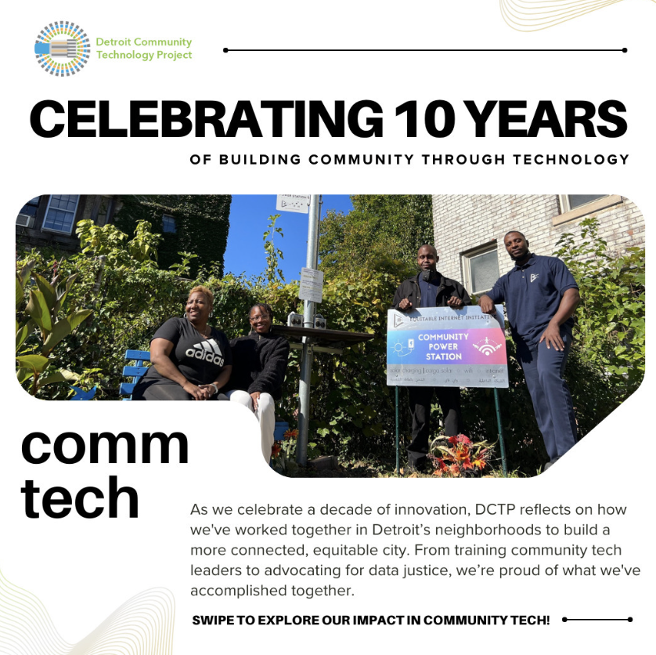
Community Data Cooperatives | The Detroit Community Technology Project (DCTP)
Community Data Cooperatives, led by DCTP, empower communities to own and control their data rather than being exploited by external institutions. By addressing data violence, they challenge extractive data practices that often marginalize Black and brown communities in public health research. These cooperatives promote dignity by ensuring that community members define how their data is collected, used, and protected, fostering self-determination and equity in public health decision-making.

Slide 28

Participatory Action Research | The Harlem Youth Justice Board
The Harlem Youth Justice Board uses Participatory Action Research (PAR) to involve young people in investigating and addressing issues that impact their health and well-being. This approach counters data violence by shifting research power from institutions to the communities directly affected, ensuring their voices shape policies and solutions. By valuing lived experiences and promoting co-ownership of knowledge, PAR upholds dignity in public health by centering youth as experts and change agents.

Slide 29
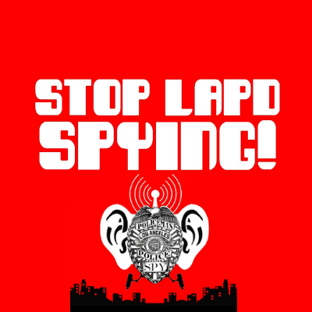
Critique Digital Surveillance | Stop LAPD Spying Coalition
The Stop LAPD Spying Coalition exposes and challenges the harmful impact of government surveillance on marginalized communities, particularly in the context of public health. By highlighting how digital policing and data collection disproportionately target Black and brown populations, they reveal the ways surveillance reinforces systemic oppression and health disparities. Their advocacy for community-controlled data and policy change promotes dignity in public health by protecting privacy, resisting criminalization, and affirming the right to exist free from state violence.

Slide 30
We need to respect, protect and fulfill a sense of dignity for everyone through public health.

