Slide 1
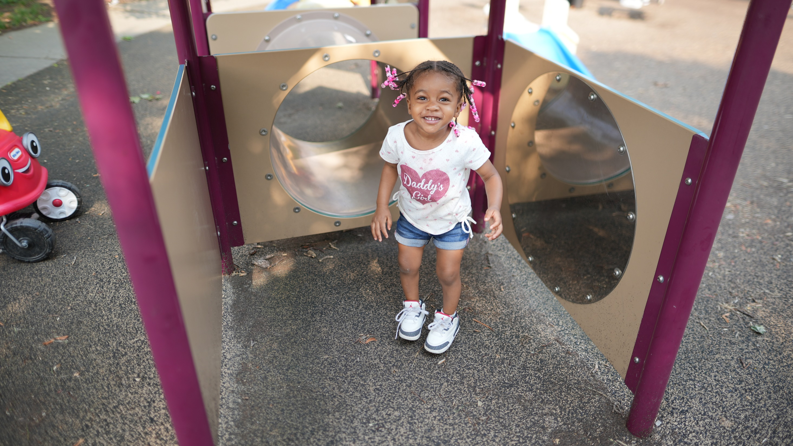


Centering Community Voice to Influence Systems & Policy
April 2026
Notes:
SR: Hello and welcome to our session: Centering Community Voice to influence Systems & Policy for Early Childhood Education. We’re so excited that you’re here and thrilled to be presenting at today’s Data Dive!
I’m Samantha Reynoso, the Research and Evaluation Manager at Milwaukee Succeeds.
I’m Kristin Kappelman, the director of research at Milwaukee Succeeds. Together we are part of the data team at Milwaukee Succeeds, a collective impact organization focused on education equity in Milwaukee.

Slide 2
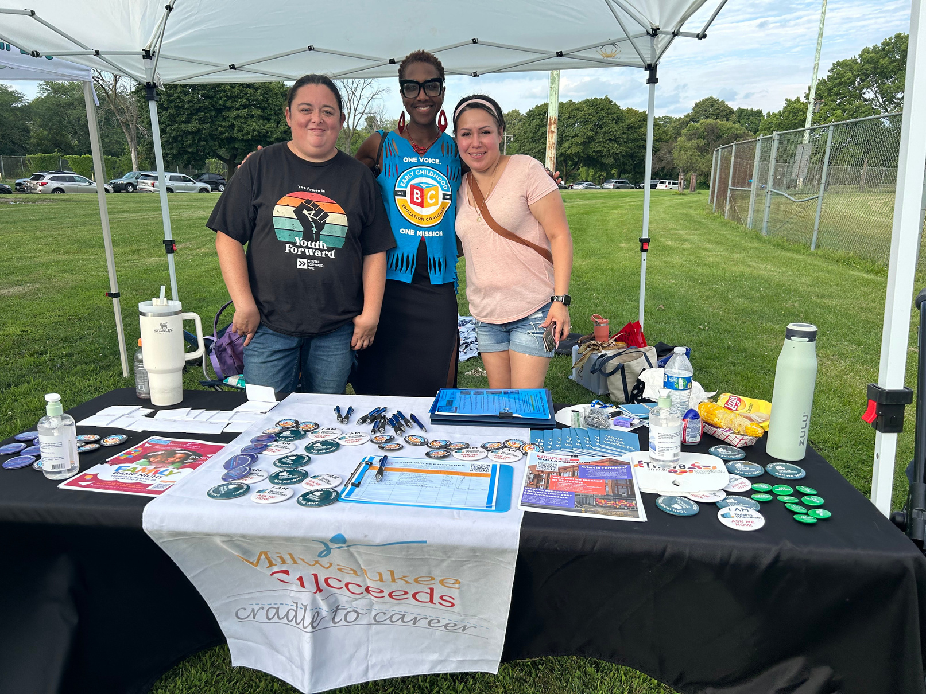

LEARNING OBJECTIVES AND AGENDA
LEARNING OBJECTIVES
Learn concrete strategies for designing community-guided evaluations that influence systems, resonate with policymakers, and stay grounded in the voices of those most impacted.
AGENDA
Data equity acknowledgment
Introductions and icebreaker
Boring background stuff
Case studies
Our strategies
Q & A
Notes:
SR: We want to start with our learning objectives and agenda.
LEARNING OBJECTIVES
Learn concrete strategies for designing community-guided evaluations that influence systems, resonate with policymakers, and stay grounded in the voices of those most impacted. AGENDA
Data equity acknowledgment
Introductions and icebreaker
Boring background stuff
Case studies
Our strategies
Q & A

Slide 3
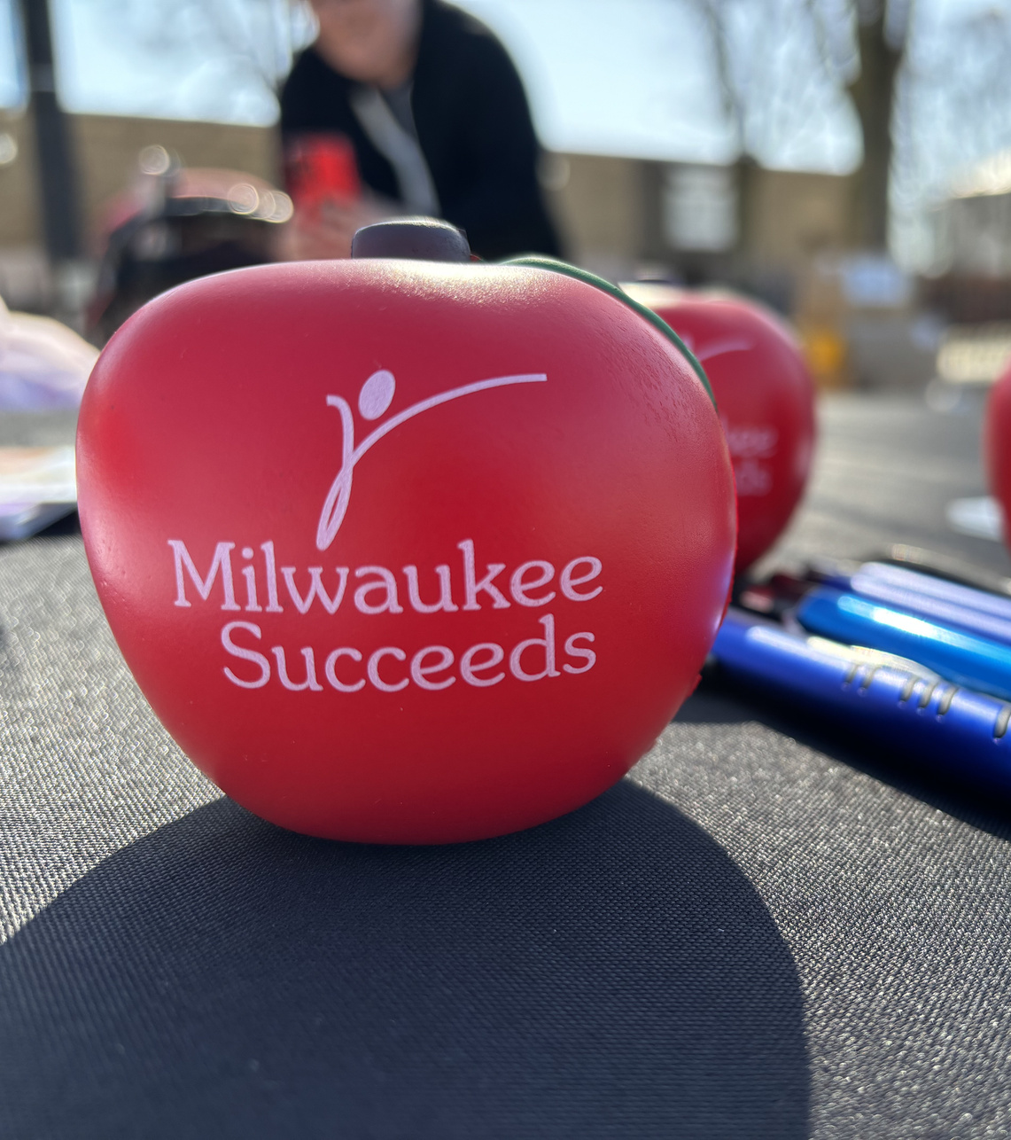
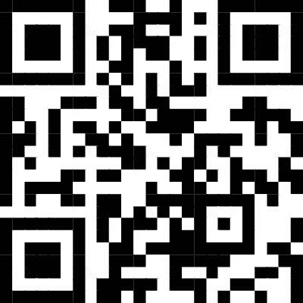
DATA EQUITY ACKOWLEDGEMENT
Notes:
SR
Before we begin, we would like to start with our data equity acknowledgement.
Milwaukee Succeeds and the data, evaluation, and research team take pride in our work and consistently strive to provide high-quality data, evaluation, and research to the greater Milwaukee community. Milwaukee has a long history of systemic racism, which touches every aspect of our work. We know that systemic racism and other historical contexts impact health, economic, employment, housing, and other outcomes. We understand that inequities are worse for communities that experience injustice. We know that while data can be used for the good, it has also been used for the bad.
We strive to ethically collect and share our data, research, and evaluation work, with our community as a guide, knowing that we cannot right the wrongs that have occurred but in the hope that we can make amends for the future. I invite you to scan the QR code to learn more about our data work, including our complete data equity standards and data biography.
We start all of our major presentations with this acknowledgement in order to ground our work and our presentation immediately in data equity, which has become more important in the past year.

Slide 4


ICEBREAKER
Equity spectrum
Select where you see your work on the spectrum.
Notes:
KK
We want to start with an activity called the Equity Spectrum. If we were doing this in-person, we’d have you moving around the room. Instead, we’re going to use zoom polls.
A friendly reminder, this is all voluntary, so only participate if you’re comfortable in doing so.
After each question, ask folks on different parts of the spectrum to share and discuss why they positioned themselves where they did and how it could be improved

Slide 5


WHERE DOES YOUR WORK SIT?
What percent of time do you pay participants for their time and expertise?
How often do you have lived-experience partners truly at the table where decisions are being made?
How often do you tailor the format of findings to be accessible to those most impacted?
How often do you use trusted messengers?
Notes:
KK
After each question, ask folks on different parts of the spectrum to share and discuss why they positioned themselves where they did and how it could be improved
Discussion Questions:
Where did most people stand on the spectrum? Why?
What actions can we take to achieve a more equitable balance of power?

Slide 6



MILWAUKEE SUCCEEDS
3 STRATEGIC PRIORITY AREAS:
Data, Research, & Evaluation
Early childhood education (ECE)
High school success (HSS)
Notes:
KK
Sam and I work for an organization called Milwaukee Succeeds, which is the education department of the Greater Milwaukee Foundation, the largest community foundation in the state of Wisconsin. Milwaukee Succeeds was formed in 2011, as part of the StriveTogether cradle to career network. We’re one of 4 partnerships like this in Wisconsin and have about 70 organizations like this across the nations.
Ultimately, we aim to influence how systems work and change using a continuous improvement mindset - as we shift from trying to program our way out of complex, longstanding, systemic community challenges to a more proactive stance.
We currently have 3 strategic priority areas of data, research, and evaluation, early childhood education, and high school success.

Slide 7



TWO EVALUATIONS
Both center the experiences of those most impacted—parents, caregivers, and early childhood educators—while informing decisions at the agency and legislative level.
UNLOCKING WISCONSIN SHARES
Explored 331 Milwaukee families’ experiences with the state child care subsidy program.
The Department of Children and Families is using findings to improve internal program practices.
STILL MAKING EVERY DOLLAR COUNT
Examined the impacts, uses, and remaining needs of federal-relief funding on 663 of Milwaukee early childhood education providers.
Released in alignment of biennial state budget.
Notes:
SR
We want to focus on two of our evaluations in the ECE space as examples of how our work centered the experiences of those most impacted and helped inform decisions at the state and agency level but this information can be used for projects in other areas as well.
Across both evaluations, the findings were used by partners. The Department of Children and Families (DCF) made changes to their program, and the state invested in ECE for the first time. In addition, our findings fed into bigger policy conversations.
Across both, our role was connecting community experience to decision makers — communicating data in ways that policy and program staff could act on.

Slide 8
WHAT IS WISCONSIN SHARES?
Child care subsidy program
Eligible families may have part/all child care costs covered
Over half of the Milwaukee population is eligible for Shares but not participating.
55%
Notes:
SR
We’ll start with a bit of level setting on our first evaluation. Wisconsin Shares is the state’s child care subsidy program, overseen by DCF. It helps eligible parents and caregivers cover part of or all of their regulated child care costs.
Child care is incredibly expensive, so Shares is crucial for families in Milwaukee to access quality care. Care for one infant in Milwaukee is more than $18,000 a year, over a 1/3 of the city’s median income, more than housing, and more than twice in-state college tuition.
Yet, 55% of income-eligible families do NOT use Wisconsin Shares, meaning that over half of our community is eligible for Shares, but for some reason, is not participating.
We set out to evaluate the program from families’ perspectives to understand barriers and identify opportunities for improvement.
Because parents are busy and often hard to reach, we worked through trusted messengers like the Child Care Resource & Referral Agency (4C) and our Early Childhood Education Ambassadors—compensated lived-experience partners.
We also told families why we were asking; we wanted to know so we could make recommendations to make Shares better for them and others.
Everyone who participated, received a $15 Amazon gift card for the 10-minute survey.

Slide 9

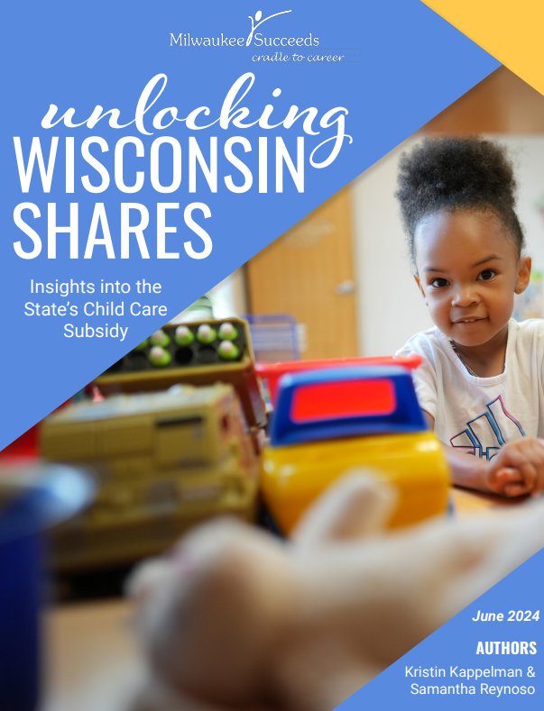



UNLOCKING
WISCONSIN SHARES
Released in 2024
Surveyed 331 parents/caregivers in Milwaukee
RECOMMENDATIONS
Offer virtual and in-person support
Increase multilingual capabilities
Expand service hours
One point of contact
Notes:
SR
In total, 331 Milwaukee parents and caregivers completed the survey. Key findings included:
Families reported long hold times when calling, poor customer service, difficulty scheduling appointments, and confusion about the two-step process between multiple agencies.
Many also said that even with Wisconsin Shares, child care still costs too much.
Yet, most families said the program is essential. It lets them work, attend school, and afford safe, reliable child care.
About three-quarters said, even with all the challenges, they’d recommend the program to others.
With participant consent, open ended responses were included in the report appendix so parent’s voices could be read in their own words.
Findings were shared with the partners and DCF as opportunities for improvement, not criticism– the framings were about shared goals.
This work is relational, not only with community, but with our other partners. We recognize it’s not easy to hear when a program isn’t working.
We translated the report into Spanish and shared it widely—on Milwaukee Succeeds website, via social media, and emailed our partners and everyone who participated in our focus groups and survey.
We think about use at two levels- little p and big p policy.
Little p is about program level use. These findings helped DCF identify where changes were needed- things like offering virtual meeting options and exploring adding more staff. DCF leadership report that they are still using these findings to guide internal process improvements.
Big P is the broader policy impact. Our findings on affordability added to the evidence base that helped inform state budget discussions. In the 2025-27 budget, reimbursement rates for Wisconsin Shares were raised from the 41st to the 75th percentile. That change means subsidy dollars now go further. Providers are reimbursed at higher rates, so families face smaller gaps and more programs can afford to accept Shares.

Slide 10





CHILD CARE COUNTS
Disburse federal COVID relief funds to child care providers
March 2020 to June 2025
Kept providers open and support workforce, high-quality care
Over
$166 million
awarded to
ECE providers
2,300
Notes:
KK
Our next evaluation takes us from families to ECE providers—looking at how COVID relief funding supported the early care and education workforce.
The State of Wisconsin created Child Care Counts to distribute federal COVID-relief dollars so providers could stay open, keep staff employed, and continue offering quality care.
In Milwaukee alone, more than 2,300 providers received over $160 million through Child Care Counts.
Our first study, Making Every Dollar Count (2022), was the first of its kind in Wisconsin—documenting how stabilization funds were used and what needs remained. That report was cited by the Institute for Research on Poverty and by the Wisconsin Legislative Fiscal Bureau.
As the program was set to sunset in 2025, we launched Still Making Every Dollar Count in late 2024 to capture provider experiences in time for the state budget-advocacy season. The turnaround was quick because timing mattered for influence.
We were transparent about why we were collecting data: to help decision-makers understand why a sustained public investment in ECE mattered.

Slide 11
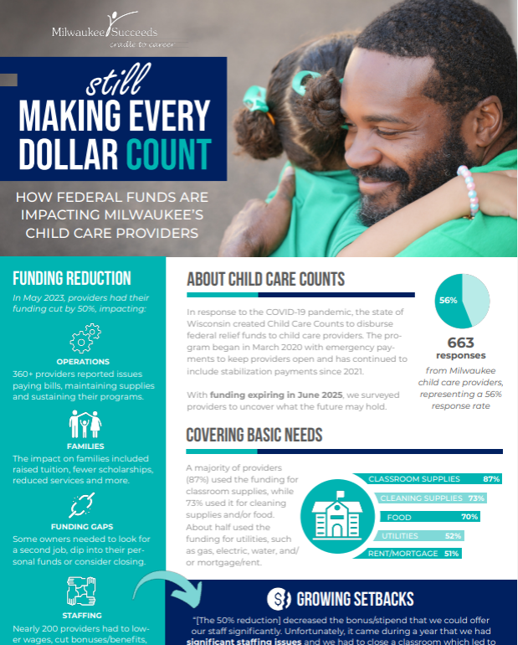



STILL MAKING EVERY DOLLAR COUNT
Released March 2025
Surveyed 663 ECE providers in Milwaukee (56% response rate)
Results found funding used for basic needs
Classroom supplies
Cleaning supplies
Food
Utilities
Rent/mortgage
~100 providers are in danger of closing
Notes:
KK
We heard from 663 Milwaukee child care providers (a 56 % response). Most used CCC funds for wages and benefits, rent or mortgage, utilities, classroom and cleaning supplies, and food—the essentials that kept programs running.
About 100 providers said they might have to close once payments ended, putting 1000’s of child-care slots at risk.
Both the report and infographic were translated into Spanish and published publicly on Milwaukee Succeeds’ website.
Findings were shared back with every participant who provided an email address, as well as with partners and DCF.
We intentionally placed findings in the hands of lobbyists and legislators ahead of the budget hearings.
And Families and ECE providers attended budget listening sessions and wrote letters to legislators using the data from the findings.

Slide 12


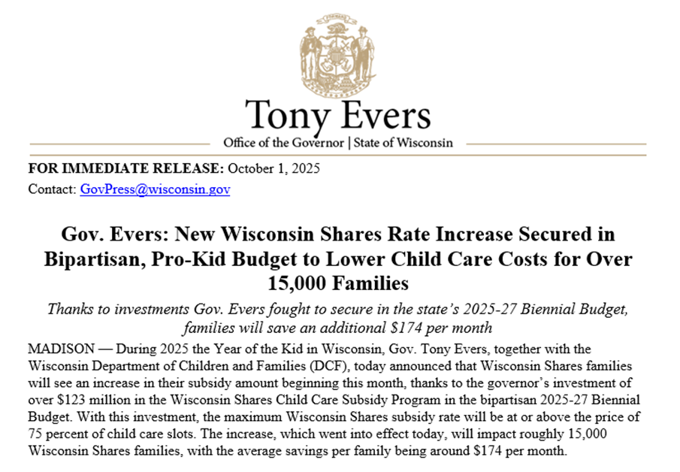
POLICY IMPACT
The 2025–27 Wisconsin budget included the state’s first direct public investment in ECE—$330 million statewide—including an $123 investment to Wisconsin Shares and the creation of a one year Child Care Bridge Payment Program to extend stabilization funding after Child Care Counts ended.
Notes:
KK
All of this work — from Unlocking Shares to Still Making Every Dollar Count — was designed for use and systems change.
When the 2025–27 Wisconsin budget passed, it included the state’s first direct public investment in early care and education — $330 million statewide. That included a $123 million investment to Wisconsin Shares and the creation of the Child Care Bridge Payment Program, which extended stabilization funding for another year after Child Care Counts ended.
We don’t attribute the historic state investment to just our evaluations— policy wins like this come from many voices and years of advocacy. But our evaluations contributed timely, local evidence that helped make the case.

Slide 13






STRATEGIES
Relationships
Everything begins with trust.
Community Voice Shapes what we study, how we ask, and how findings are interpreted.
Compensation People are paid for their time and expertise.
Transparency We state why we’re collecting data, how it will be used, and share it back.
Accessibility & Language Use plain language, visuals, and translation.
Responsiveness Adapt tools, methods, and timelines as conditions change. Use feedback loops with partners.
Timing Align timelines with purpose.
Notes:
SR
We have 7 key strategies that inform our work, and we’ll go into more detail for each of these on upcoming slides. We’ll also provide a QR code at the end of the presentation where you can download this as a resource. We’ll share a copy of the slide deck and resources with everyone who signed up for this presentation.

Slide 14
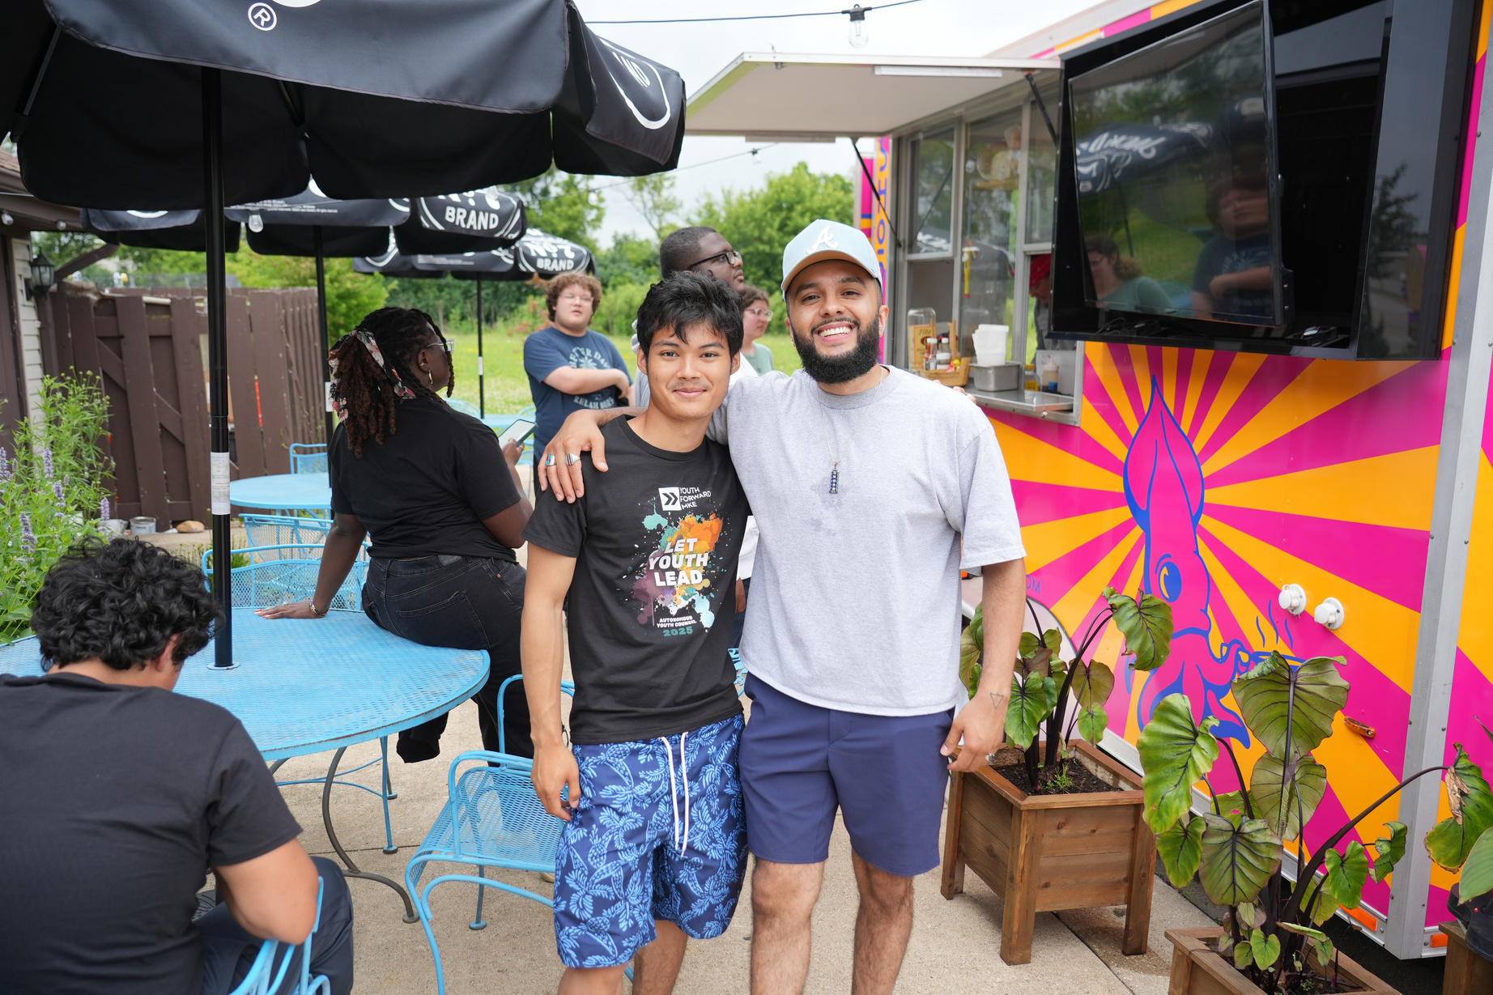

Our work is relational
RELATIONSHIPS
We build and maintain strong relationships with families, early educators, youth, state agencies, and community organizations.
Long-standing relationships with ECE Coalition members.
Shared accountability and respect in our work with Ambassadors and Youth Council members.
Open, ongoing partnership with DCF that supports access, honesty, and shared learning.
Notes:
SR
Relationships are at the heart of everything we do. We hold relationships across levels—from families and early educators to partner organizations and state agencies. Community partners trust us with their data and experiences, and we owe them transparency and follow-through in return. Our ongoing relationship with DCF allows secure access to non-public data and open, honest dialogue about findings—even when results are hard to hear. They’ve even shared that they see us as their research department.

Slide 15
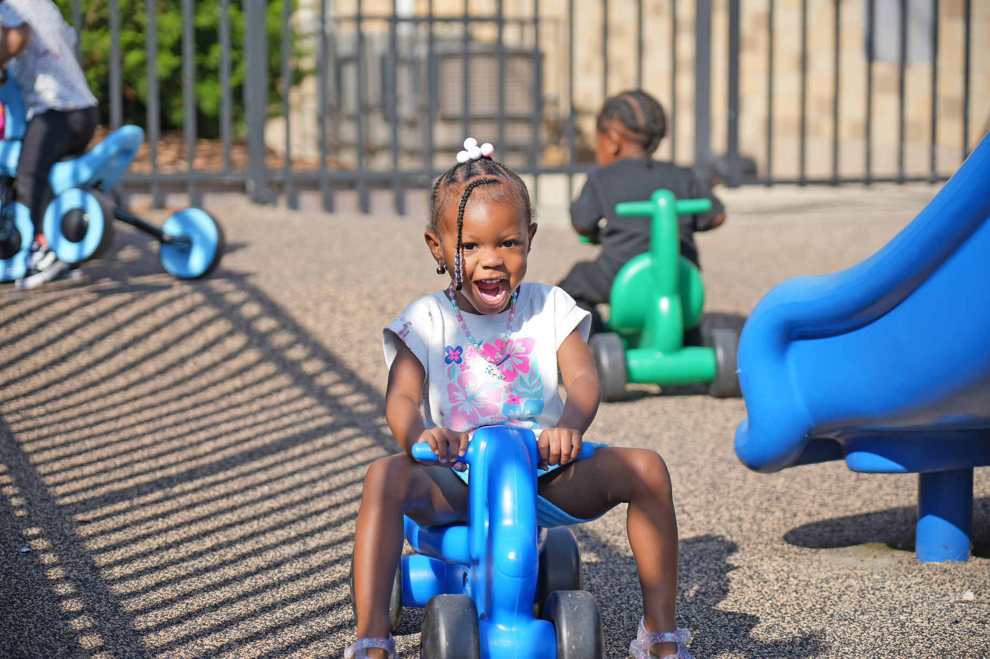
COMMUNITY VOICE
Community guides the direction of our work. They shape how data is collected, and how findings are shared.
Priorities come from community.
Qualitative data are always incorporated.
Lived experience partners feedback shapes the work.
Data advisory committees co-design infographics and messaging.
Notes:
SR
Community guides the direction of our work.
Both of the evaluations we talked about today were built around priorities that we heard from the community. Unlocking Wisconsin Shares focused on affordability for families, and Still Making Every Dollar Count looked at workforce stability.
Qualitative data are always incorporated to add context and reflect lived experience.
Lived experience partners provide feedback that shapes the work, especially via our data advisory committees. These groups ensure that the work reflect community priorities.

Slide 16


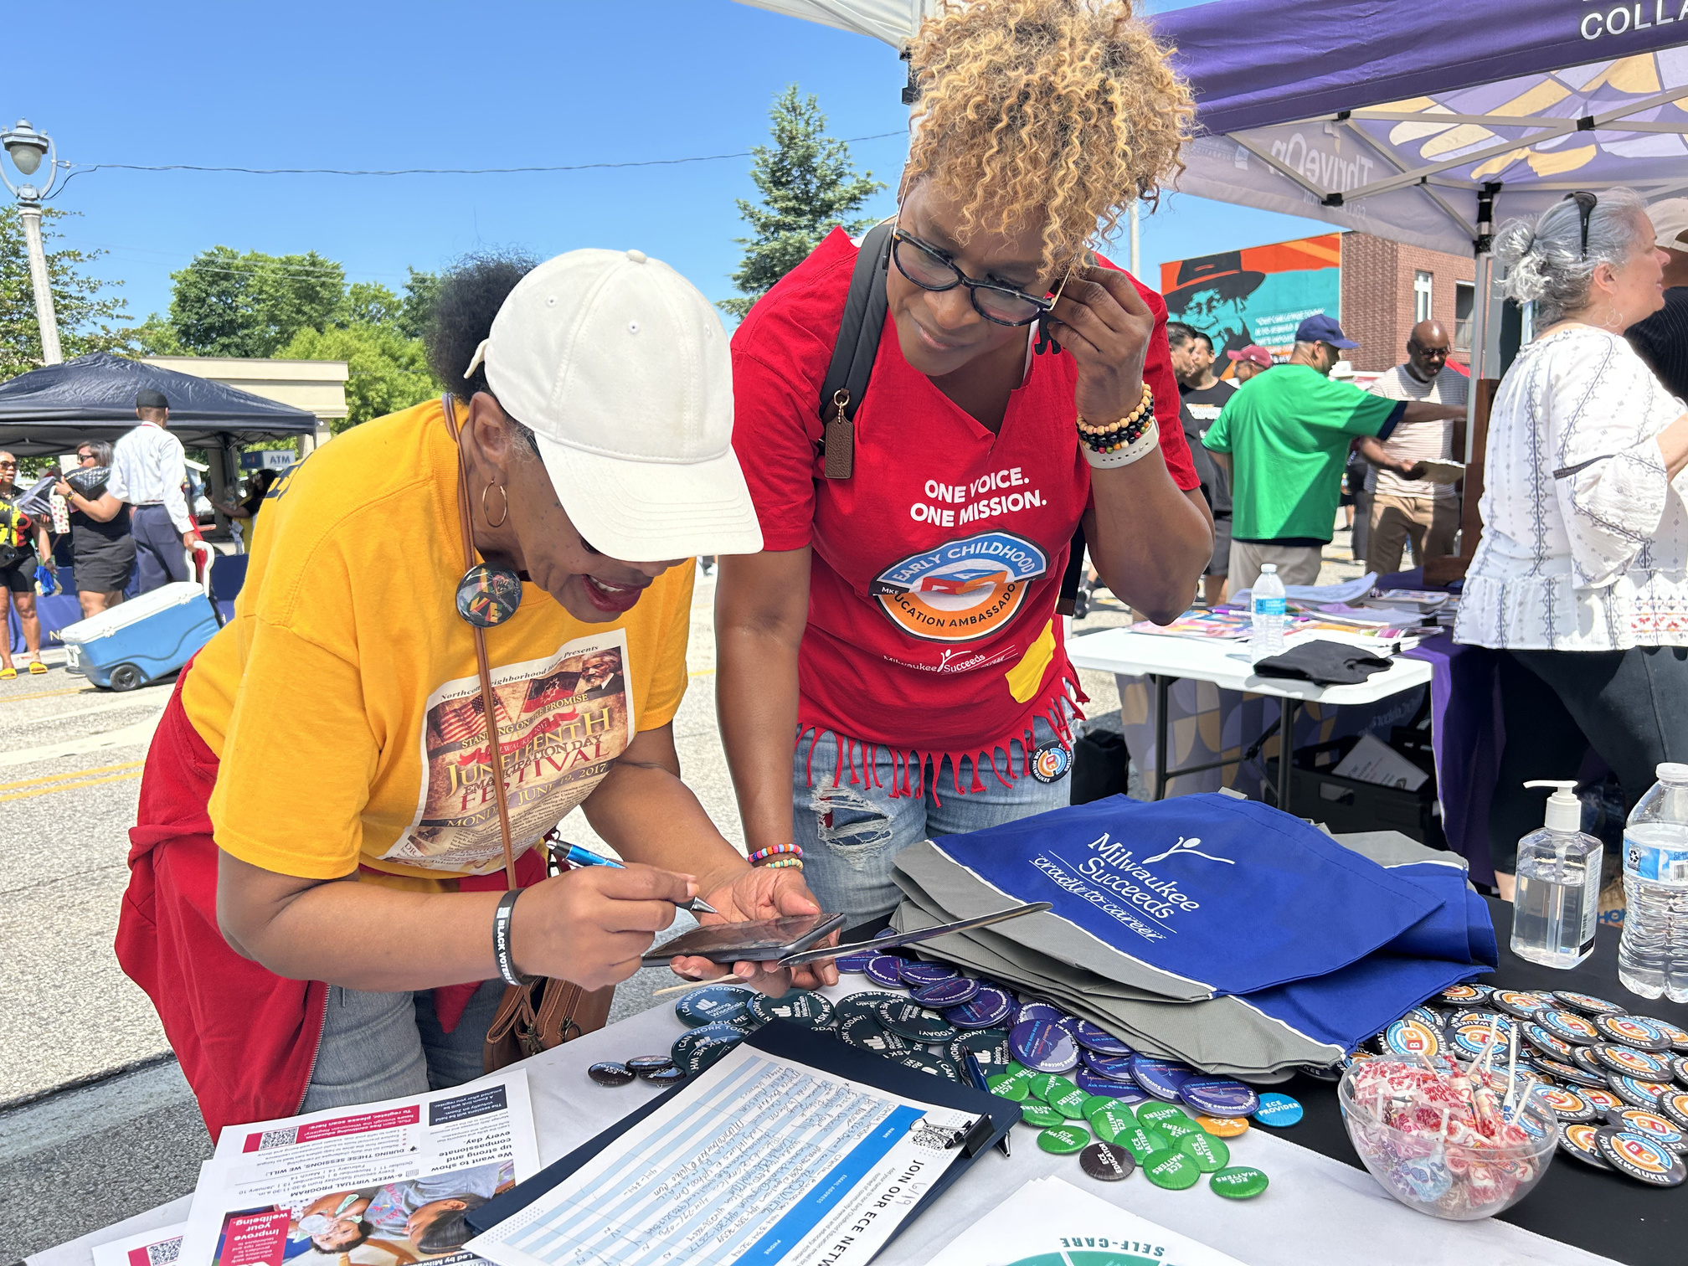
COMPENSATION
Lived experience is valued. We ensure community members are compensated for their time and contributions.
Compensation consistent across projects & built into budgets
Youth and parent ambassadors are paid hourly.
Research contributors receive gift cards.
Notes:
SR
We value the time and expertise of our lived experience partners.
That means we build compensation into all of our project budgets.
Our Youth and parent ambassadors are paid hourly, including when they listen to recorded meetings or attend public events.
Our research contributors receive gift cards when they participate in focus groups, interviews or surveys.

Slide 17

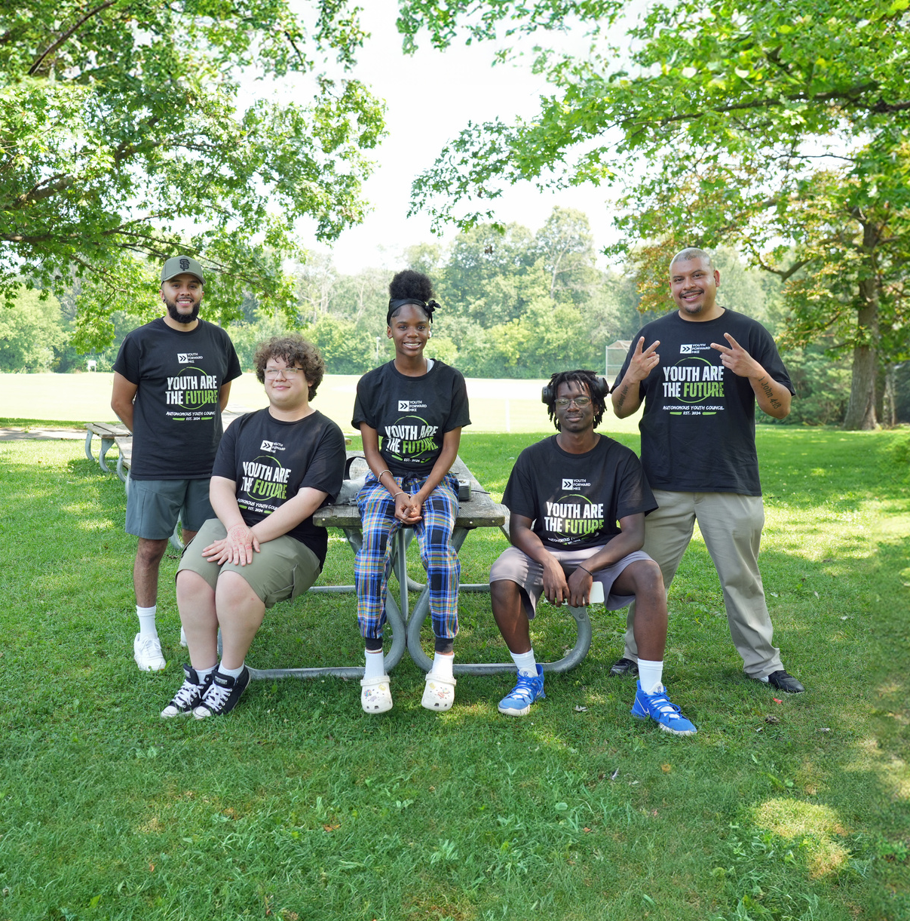
TRANSPARENCY
We believe people have the right to know how data about their communities is collected, interpreted, and shared.
Explain why we’re asking for data and how it will be used.
Share findings directly with those who contributed.
With consent, include open-ended responses.
Findings available publicly; include clear methods, tools, sources, and calculations.
Acknowledge limitations and challenges when things don’t go as planned.
Notes:
SR
We explain upfront what data we’re collecting, how it will be used, and who will see it.
We share findings directly with the people and partners who contributed.
For internal evaluations, we build in feedback loops so participants know what we heard and how we adjusted.
Our reports are publicly available and include methods, tools, sources, and calculations, along with limitations and what didn’t go as planned.
Thinking about the strategies I just shared—relationships, community voice, compensation, and transparency—any quick reactions and thoughts?

Slide 18


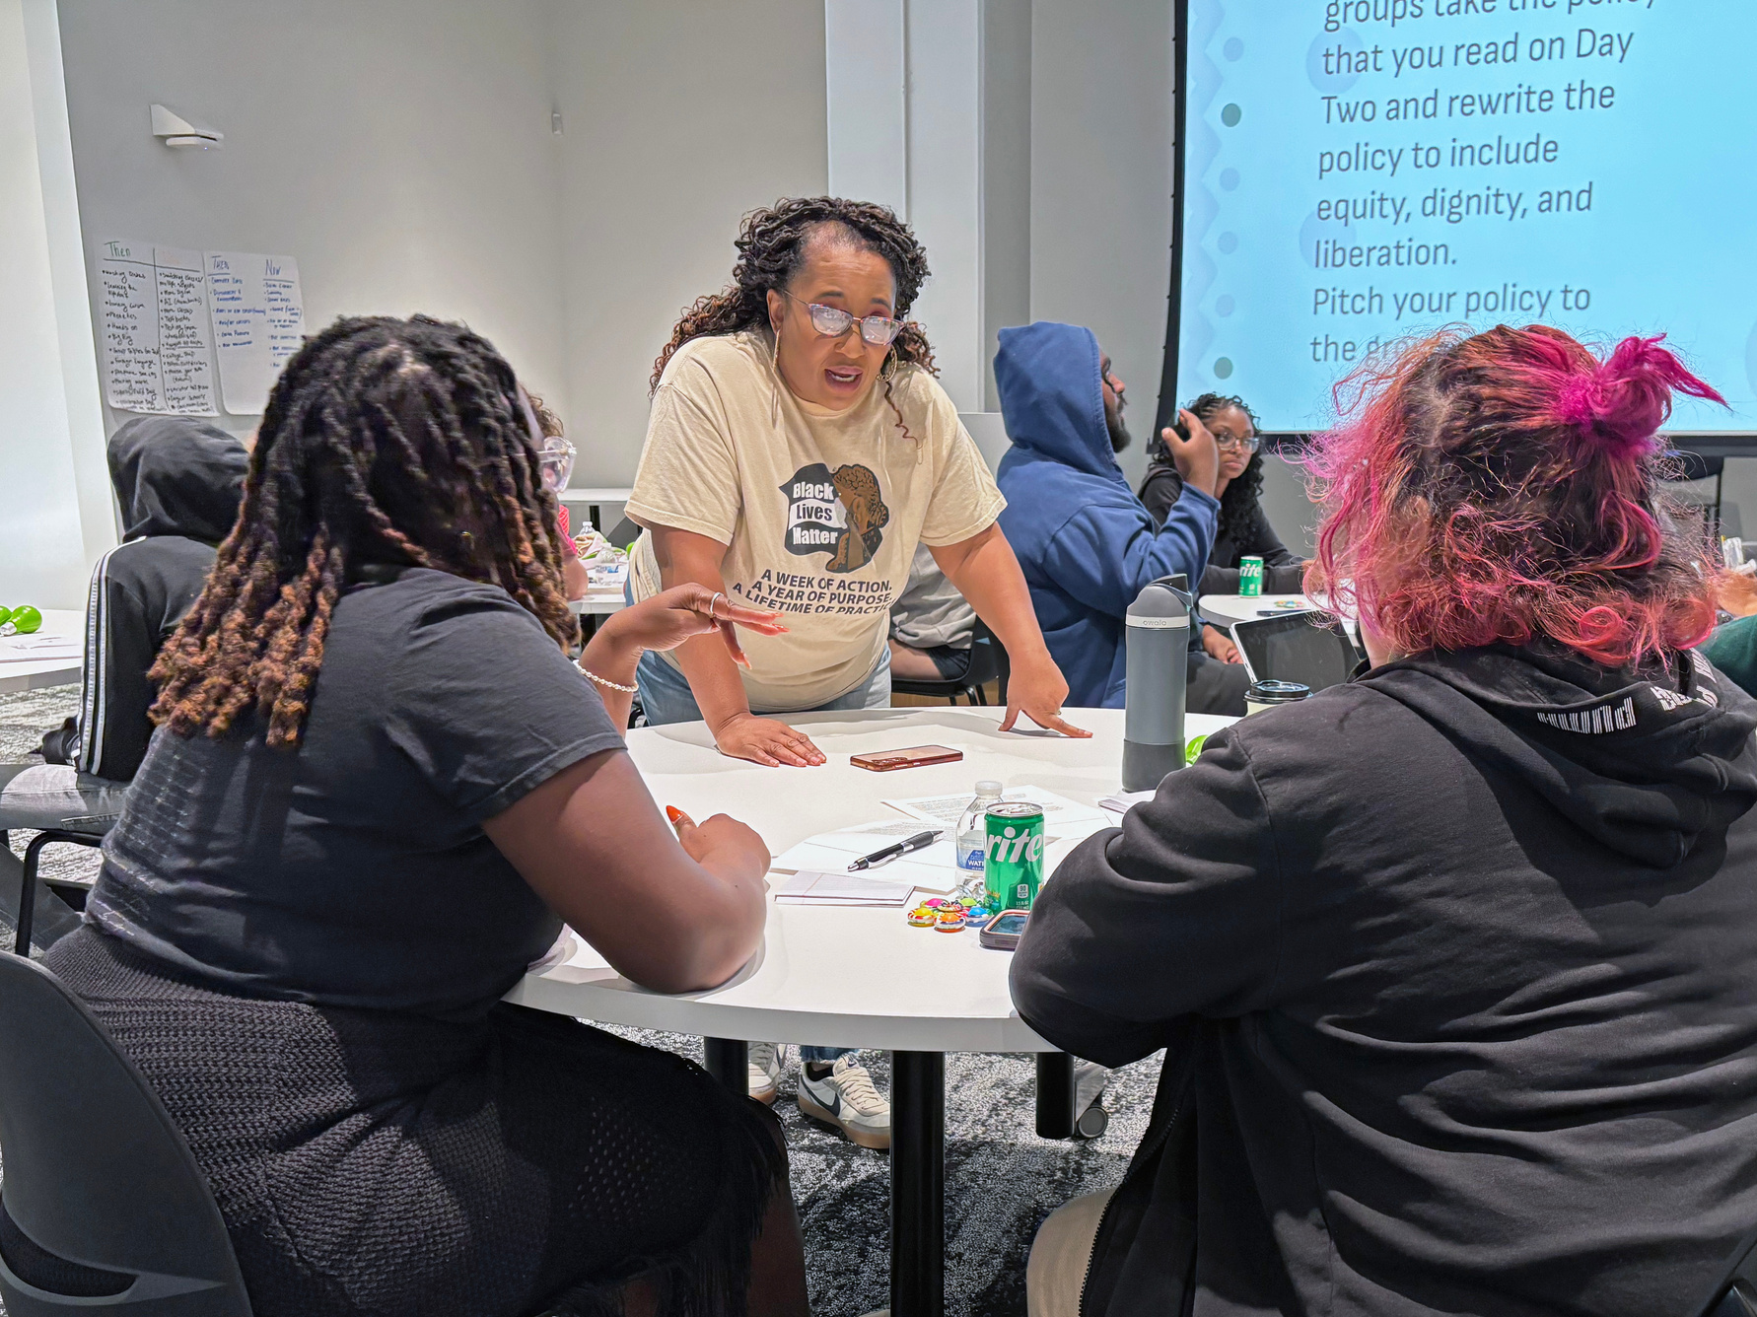





ACCESSIBILITY & LANGUAGE
We use plain language, visuals, and translations so results are understandable and usable across audiences.
Write tools, reports, and presentations in plain language for the intended.
Pair visuals and data so key messages are clear.
Translate materials and discussions so language never limits participation or understanding.
Use community review to check clarity and tone before releasing findings.
Offer results in multiple formats: reports, infographics, presentations, social media.
Notes:
KK
When we release our final products, we’re using plan language, visuals, and translations so that results are understandable and usable across multiple audiences.
Data visualization, including the use of color, white space, and phrasing to highlight the key takeaway, is important to ensure key messages are clear.
Our materials are often translated into Spanish as Milwaukee as a significant Spanish-speaking population, especially amongst child care providers.
Our data advisory committees review products before publication, and we’ll use multiple formats—full report, infographics, social media, and presentations—to share results.

Slide 19

RESPONSIVENESS
Adjust tools, methods, approaches, and timelines as conditions change.
Use advisory groups to review and refine questions and protocols.
Translate materials to be more inclusive and increase reach.
Adjust as things happen
Adapt outreach when barriers arise—like closing surveys or shifting to direct contact.
FEEDBACK LOOPS
We don’t work in silos. We circle back regularly to share updates and get input. We are over communicators ☺
Notes:
KK
We believe in feedback loops and being responsive to our partners. We adjust tools, methods, and timelines as needs change.
Use advisory groups to review and refine questions and protocols, including how and types of questions we ask.
Translate materials to be more inclusive and increase reach.
Adjust as things happen
Adapt outreach when barriers arise—like closing surveys or shifting to direct contact. For example, the Wisconsin Shares survey link was published online, so we got spammed with over 1,000 survey responses. We ended up closing that survey link, cleaning the data file, and then pivoting to unique survey links to select child care providers so we could more accurately monitor results as they came in.
We also use consultants or our parent ambassadors for outreach, making phone calls and sending emails. We used Text em all to increase our survey responses when we have cell numbers for our participants.

Slide 20
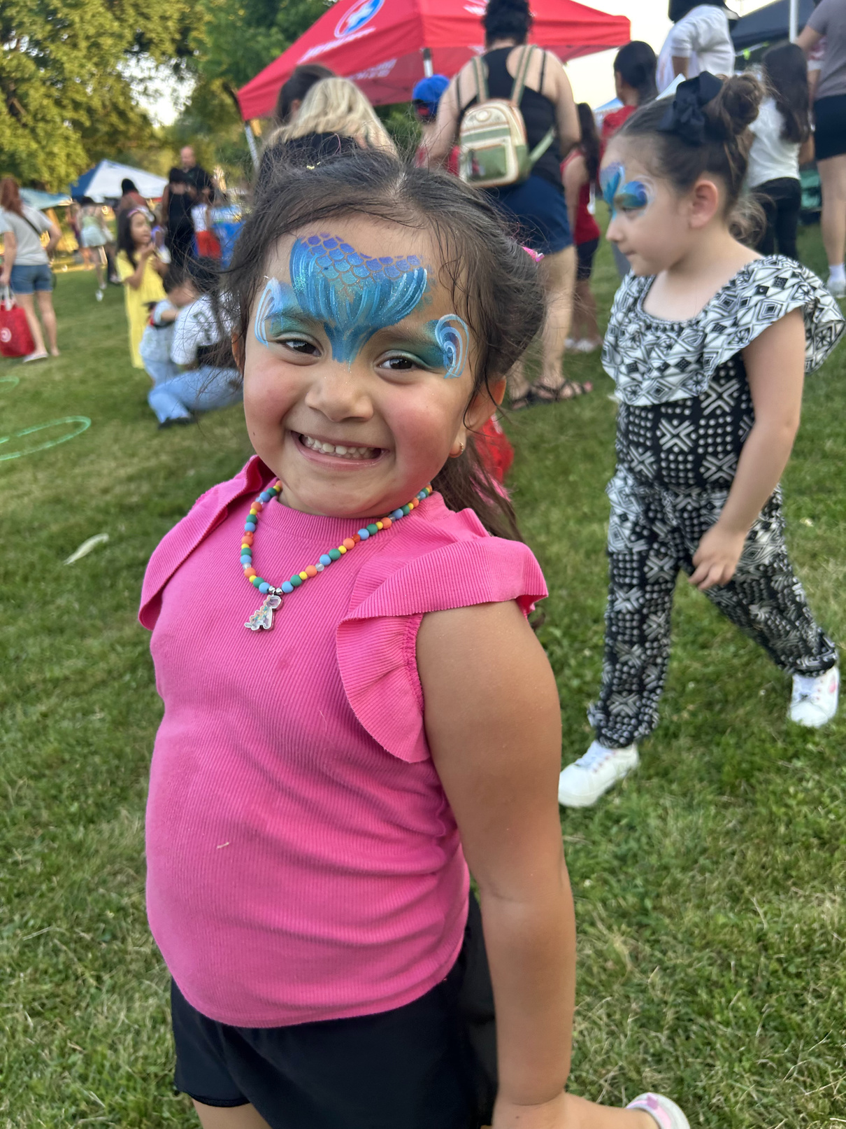




TIMING
We align timelines with purpose—moving quickly when decisions are being made and taking more time when it strengthens the work.
Tend to have flexible-ish deadlines; adjust based on responses and partner feedback.
Working backwards thinking about when something is the most useful or impactful.
Consider when timing is best for partners.
Schedule outreach and meetings at times that fit community routines and responsibilities.
Notes:
KK
We are extremely purposeful when it comes to our timelines, but also build in flexibility as needed.
We work backwards, thinking about when something is the most useful or impactful. We know that results from Still Making Every Dollar Count were needed in March 2025, so we managed our work to correspond with that as our release date. SMEDC wouldn't have been useful in July, after the state budget had been signed.
We also consider when is it a good time for ECE providers or students to get a survey…May/June, when everyone is transitioning at school or gearing up for summer programming, is not the best time to launch a survey.
Tend to have flexible-ish deadlines, will extend based on responses and partner feedback, unless we have something solid, like the state budget.
We have flexible timing for focus groups, interviews, feedback, meetings—often held in evenings or on weekends, when our partners may be free. We’ll have a mix of virtual and in-person options.
I mentioned our ambassadors making outreach phone calls for our surveys—they can do these phone calls when it works for them: evenings weekends, around their other responsibilities.

Slide 21
TURNING STRATEGIES INTO DESIGN DECISIONS
Strategy | What this means when designing an evaluation
Relationships | Who are you building with, not just informing? How will you sustain trust and collaboration? How will you create and maintain a psychologically safe space for partners? How will you successfully plan for staff or partner changes?
Community Voice | Who helps shape your questions, tools, and interpretations?
Compensation | How do you recognize time and expertise?
Transparency | How will you tell people why you’re collecting data and how you’ll use it?
Accessibility | Who will be able to read or use your findings? How are you sharing your finding and in what formats?
Responsiveness | What feedback or conditions might require you to adjust your plan? What feedback loops do you have built into your work? Don’t work in silos 🙂
Timing | How can you pace the work to stay both timely and thorough?
Notes:
KK
These are a few reflection questions that can be used to help increase your usage of these strategies, which is also available via the QR code at the end.
Thinking about the strategies I just shared—accessibility and language, responsiveness, and timing—any quick reactions and thoughts?

Slide 22
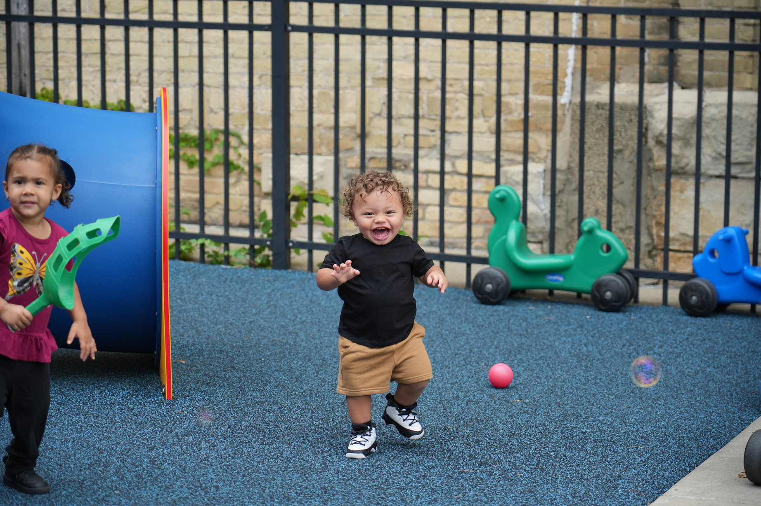




LOOKING AHEAD
This work is a continuum—we’re always building and improving.
Building data/research capacity in community
Stability project with ECE programs
PhotoVoice Project to visually show what it’s like to run an ECE program.
Evaluate Wisconsin Shares from the ECE provider perspective.
Notes:
Here are some key projects that we’re working. I know we’re out of time, but we’re always to chat. Or grab a beer across the street. Fun fact: happy hour starts at 2 PM at on tap.
SR
We’re always building and improving- here’s what doing looking ahead.
We recently completed our data training series with our ECE Ambassadors. That came directly from their feedback after the program evaluation — they wanted to build their confidence using and interpreting data. It’s part of a longer effort to build capacity and shift power over time, with the goal of us eventually stepping back into a consulting role for support and the Ambassadors leading their own data, research, and evaluation projects.
We launched our Stability Project, which includes focus groups with ECE program owners and directors to identify factors that support programs to stay open and ones that lead to closure as well as developing three metrics to monitor stability in the child care sector (churn, closure, stability).
As part of the Stability Project we also launched Seeing the Value, a PhotoVoice project where ECE owners document what it’s like to run a program day to day. It’s a way to show the realities of early childhood work through their own images and words. We’re really excited to showcase this work with our co-researchers at the Week of the Young Child in April.
We’re planning a Wisconsin Shares study from the provider perspective next year. That idea came straight from the community — we kept hearing during focus groups that the program doesn’t work well for the ECE program owners and directors, and we want to better understand why.

Slide 23


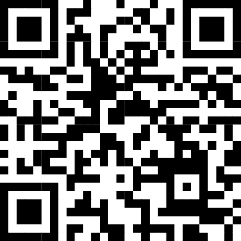
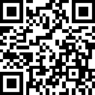
CONTACT & RESOURCES
Kristin
kkappelman@milwaukeesucceeds.org
Sam
sreynoso@milwaukeesucceeds.org
Our strategies & reflection table
Visit our research page!
Notes:
SR
Keep in touch! Our contact information is on the screen, we’d love to connect outside of the Data Dive today!
We’ve also included a QR code to the strategies we talked about today and the reflection question table.
Finally, we have the QR code to our Milwaukee Succeeds research page where you can see the full range of our work!

