Slide 1
Communicable Disease Surveillance
City of Milwaukee Health Department

Slide 2
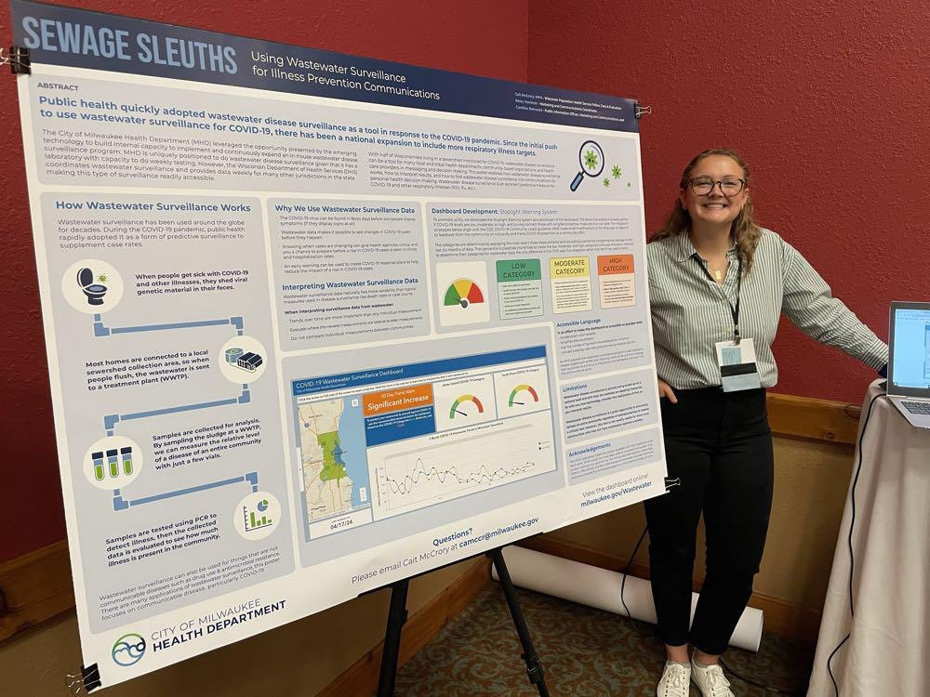
Cait McCrory MPH
(she/her/Hers)
Clinical Epidemiologist at Milwaukee Health Department (MHD)

Slide 3
Intro to mhd

Slide 4
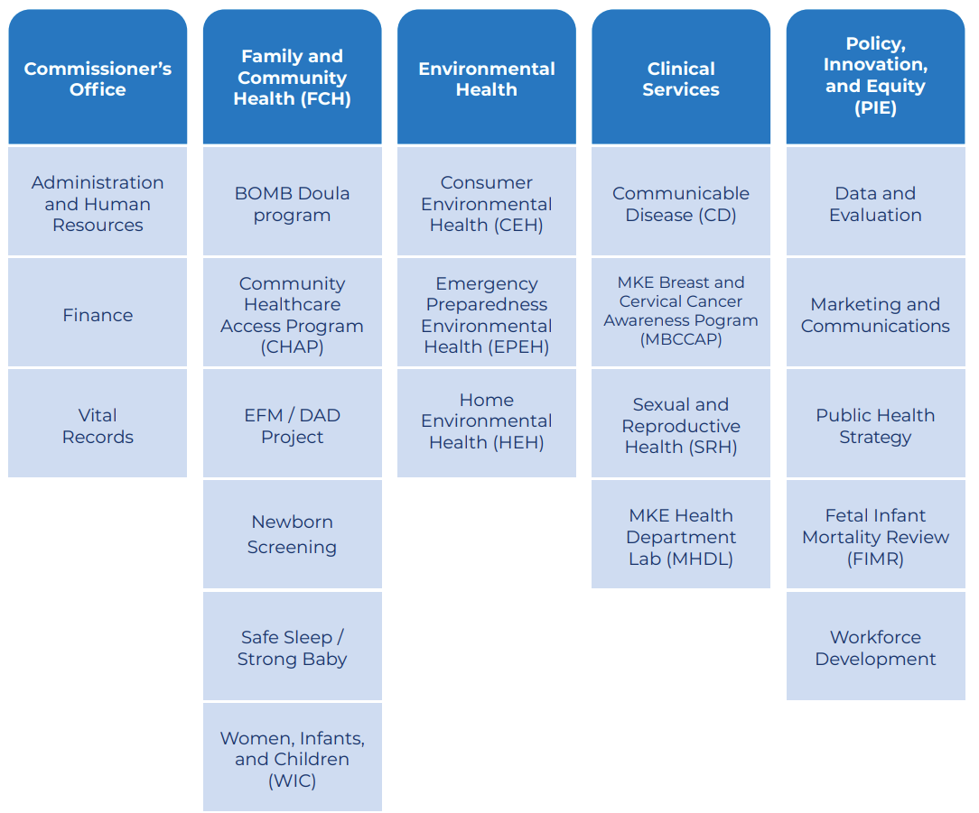
City of
Milwaukee
Health
Department
(MHD)

Slide 5
SurvNet

Slide 6
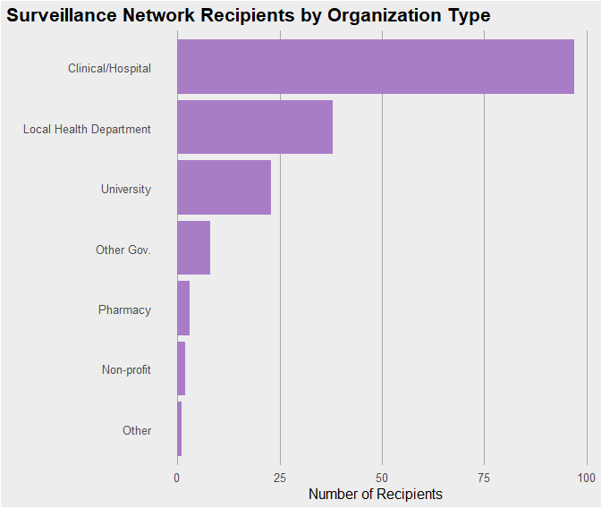
Surveillance Network
Aka SurvNet
Communication tool for infectious diseases
~ 200 Recipients

Slide 7
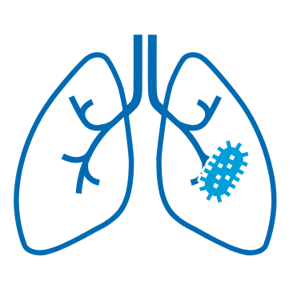



SurvNet
Communication Types
Weekly Respiratory Illness Reports
CD Emergency Response Tabletop Exercise
Monthly SurvNet Reports
Public Health Advice for Current Outbreaks

Slide 8
SurvNet
Communication Types
Weekly Respiratory Illness Reports
CD Emergency Response Tabletop Exercise
Monthly SurvNet Reports Sunset in 2026
Public Health Advice for Current Outbreaks

Slide 9

SurvNet
Origin Story
1993 Cryptosporidium Outbreak
SurvNet Report seemed to take form in 2000 lead by MHD
(Foldy, 2004)

Slide 10
Disease Registries
Wisconsin Electronic Disease Surveillance System (WEDSS)
Per Wisconsin Statute
Providers must report cases or suspected cases
Over 100 reportable conditions
Does NOT mandate inclusion of negative test results
Data from WEDSS feeds into the SurvNet report and CD Dashboard

Slide 11
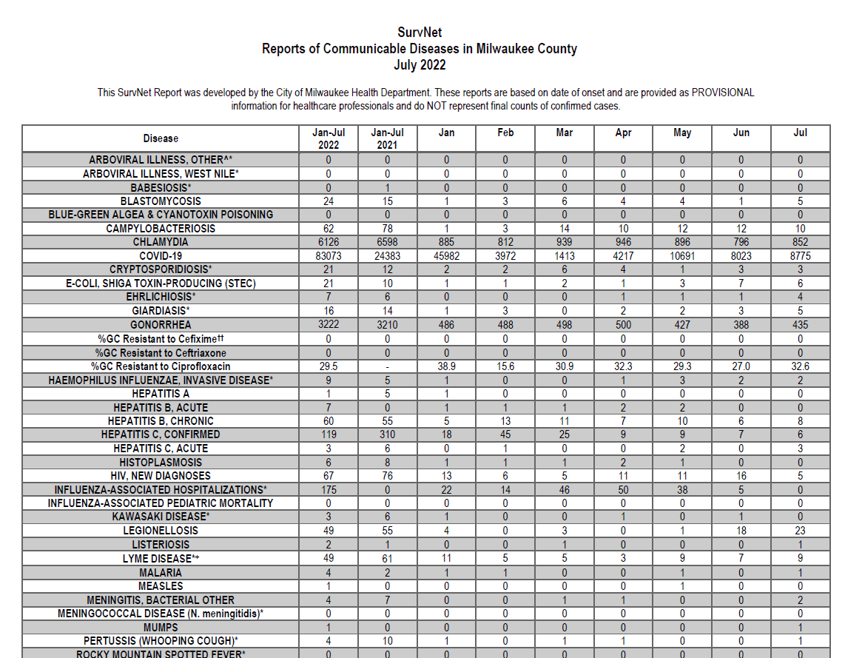
Update time:
10 hours
Software for data cleaning:
Excel
Software for data viz:
Excel

Slide 12
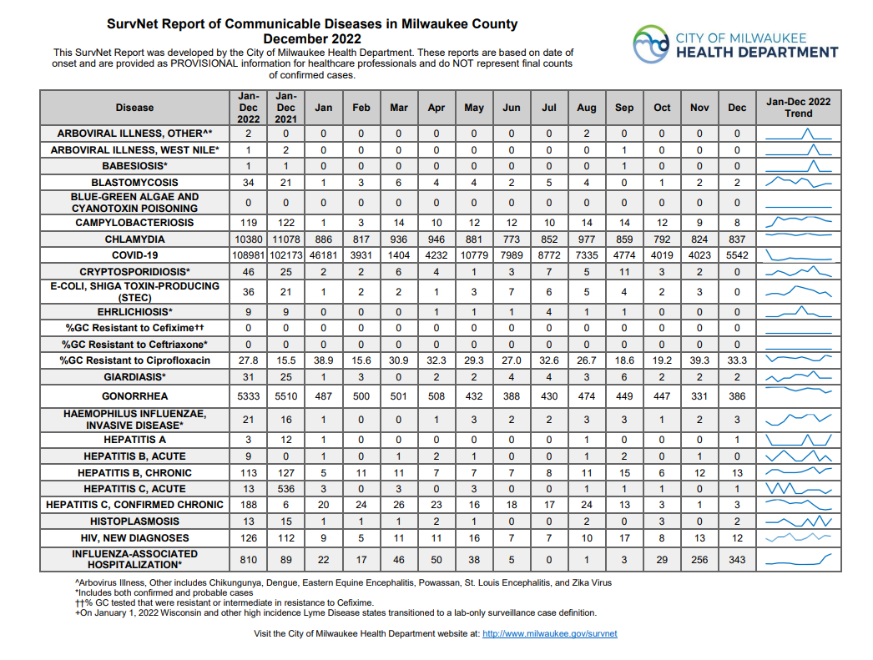
Update time:
1 hour
Software for data
cleaning:
RStudio
Software for data viz:
RStudio and Excel

Slide 13
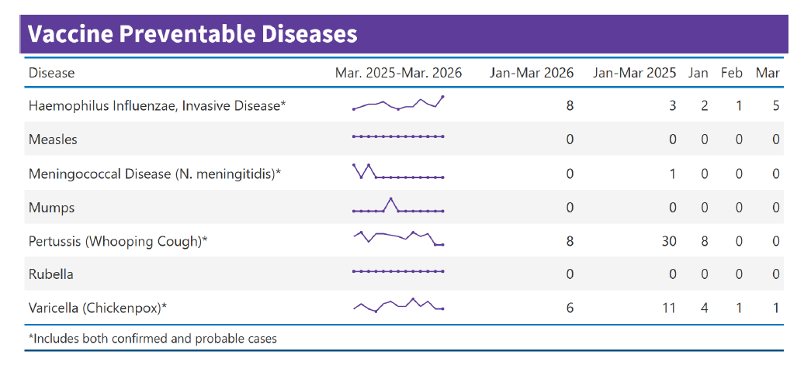
Update time:
30 minutes
Software for data
cleaning:
RStudio
Software for data viz:
RStudio

Slide 14
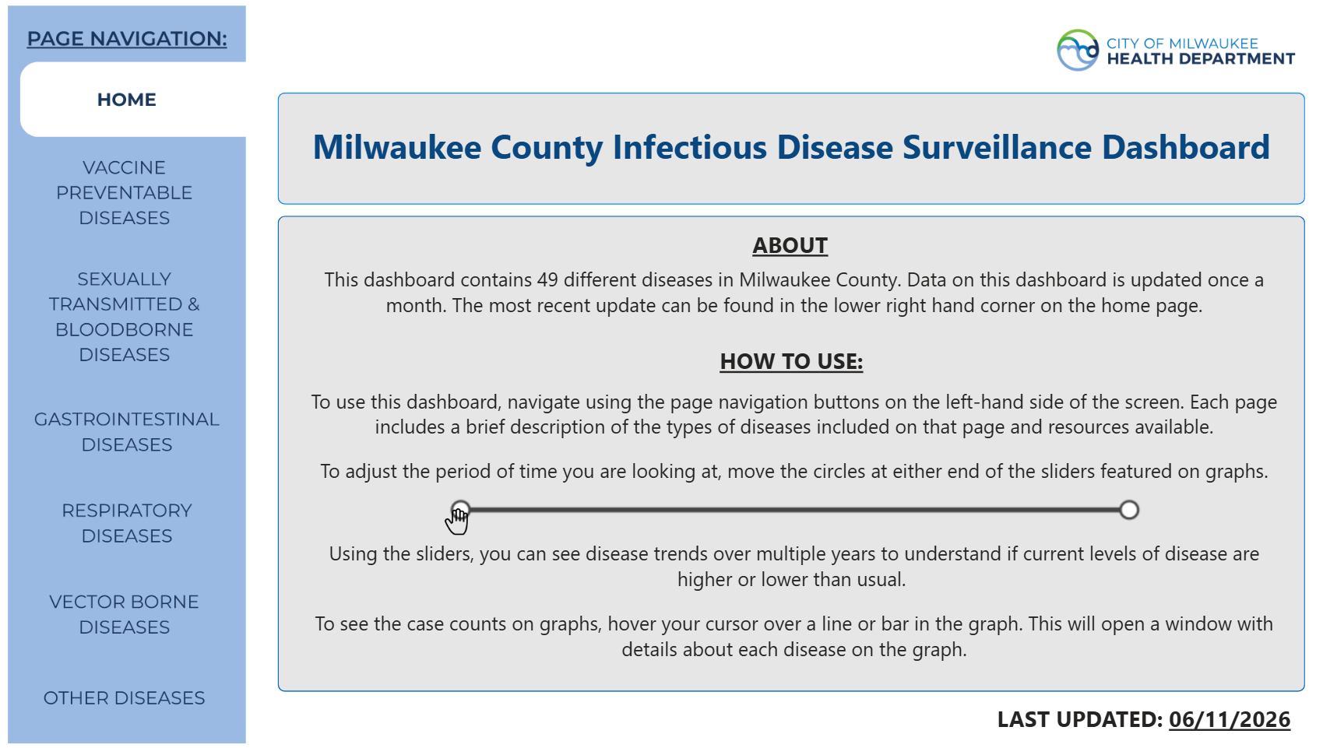
Update time:
7 minutes
Software for data
cleaning:
RStudio
Software for data viz:
PowerBI

Slide 15
CD Dashboard demo

Slide 17
Exploring data

Slide 18
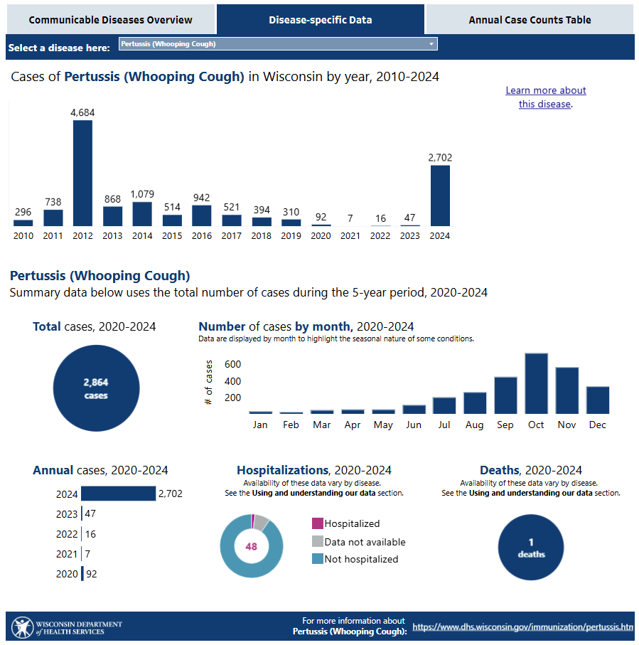
Wisconsin Department of Health Services (DHS) Statewide CD dashboard
(WI DHS, 2026)

Slide 19
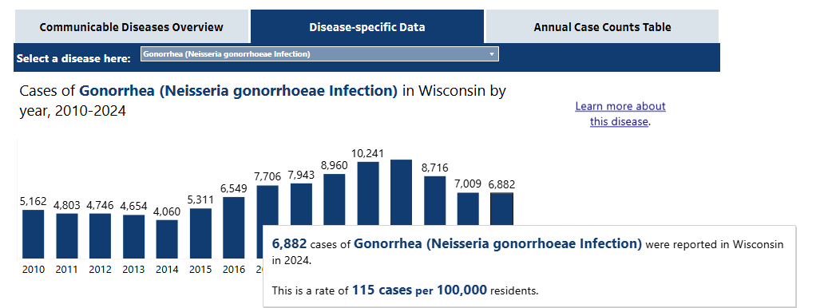
6,822 cases of Gonorrhea in 2024 in WI
(WI DHS, 2026)
Notes:
4363 Cases of Gonorrhea in MKE Co 2024

Slide 20
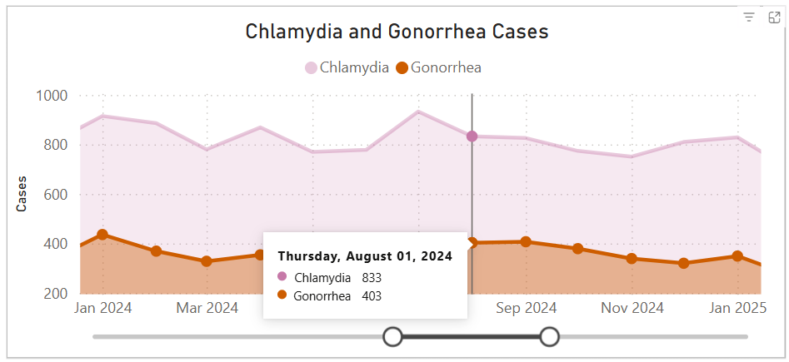
4364 cases of Gonorrhea in MKE County in 2024
(WI DHS, 2026)
Notes:
4363 Cases of Gonorrhea in MKE Co 2024

Slide 21
MKE Co makes up 63% of the states cases while being 15% of WI population
(WI DHS, 2026)
Notes:
4363 Cases of Gonorrhea in MKE Co 2024

Slide 22
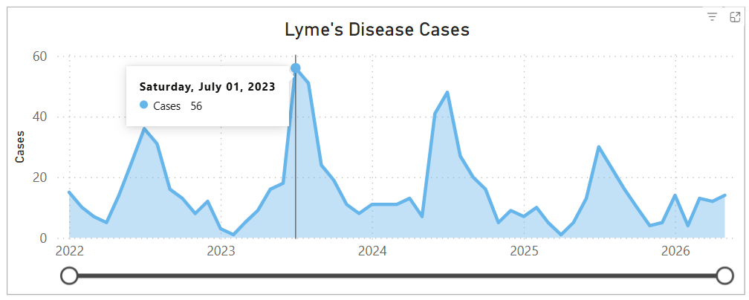
MKE Co had a large Lyme’s Disease peak in 2023
(WI DHS, 2026)

Slide 23
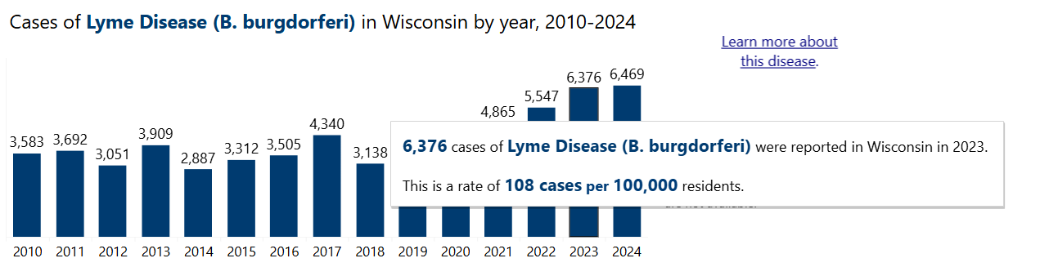
Lyme’s Disease has been higher than usual in WI
(WI DHS, 2026)

Slide 24
MKE Co makes up only 3% of Lyme’s Disease cases in 2023
(WI DHS, 2026)

Slide 25
CD Summary Report

Slide 26

Adding context
Beyond the SurvNet Audience
Explaining local disease patterns
Comparing MKE county trends to state and national trends
Show what public health professionals are focused on

Slide 27
Adding context
Beyond the SurvNet Audience
Explaining local disease patterns
Comparing MKE county trends to state and national trends
Show what public health professionals are focused on

Slide 28
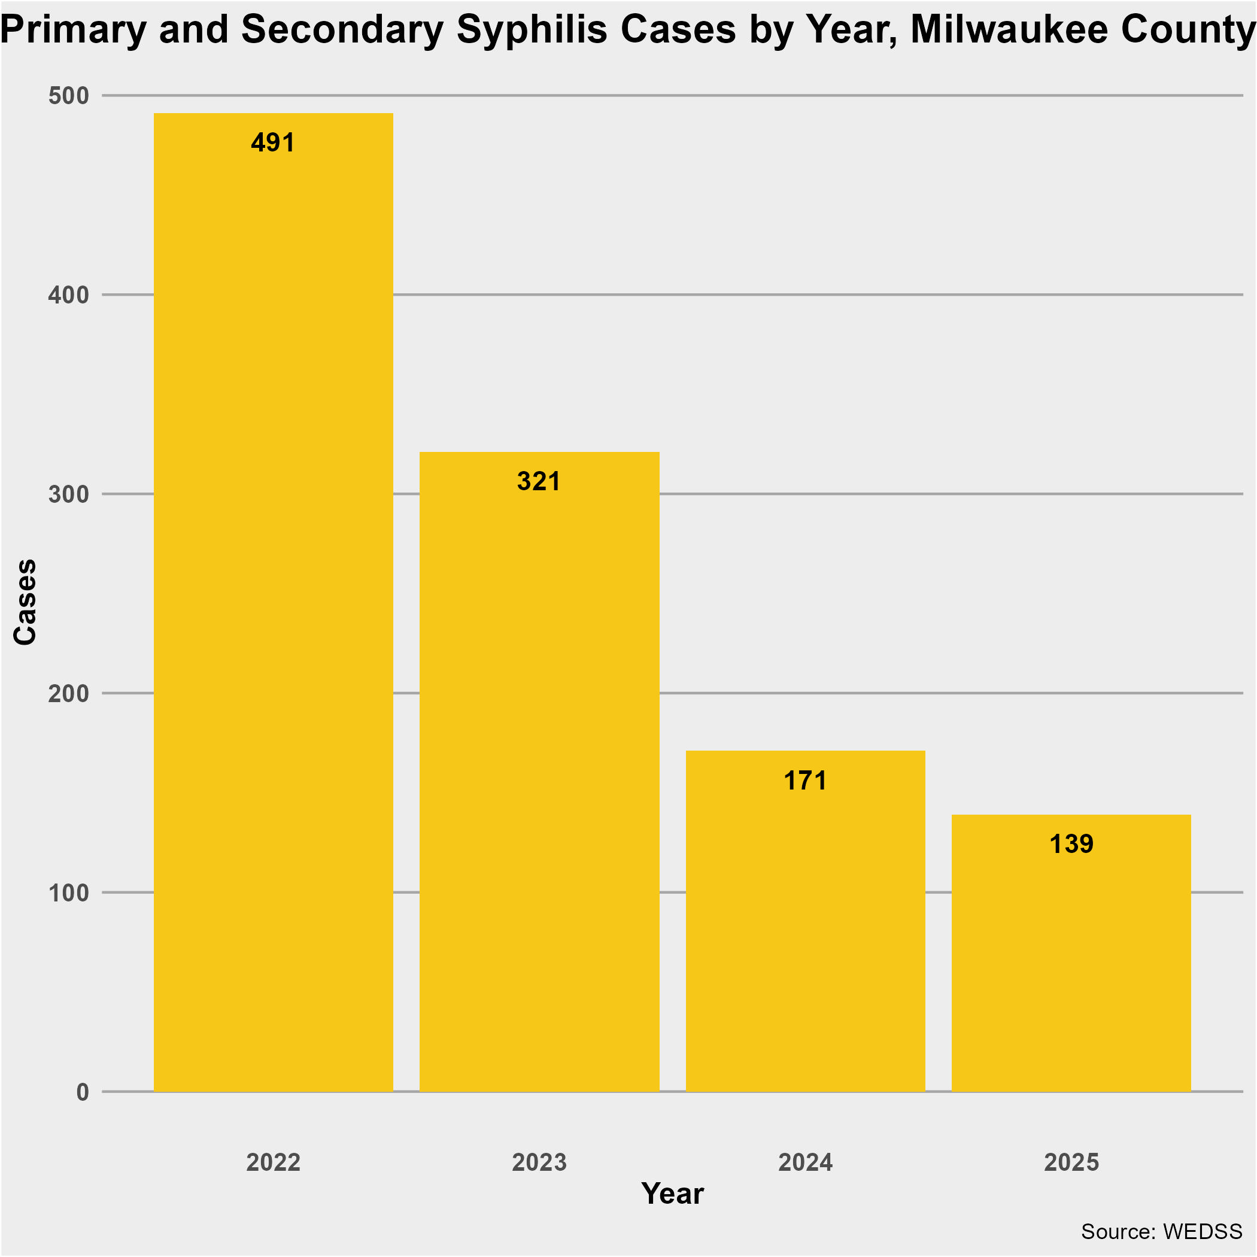
Syphilis
In Milwaukee, primary and secondary syphilis cases more than doubled between 2020-2021
In 2025, there were less cases than in 2020

Slide 29
Adding context
Beyond the SurvNet Audience
Explaining local disease patterns
Comparing MKE county trends to state and national trends
Show what public health professionals are focused on

Slide 30
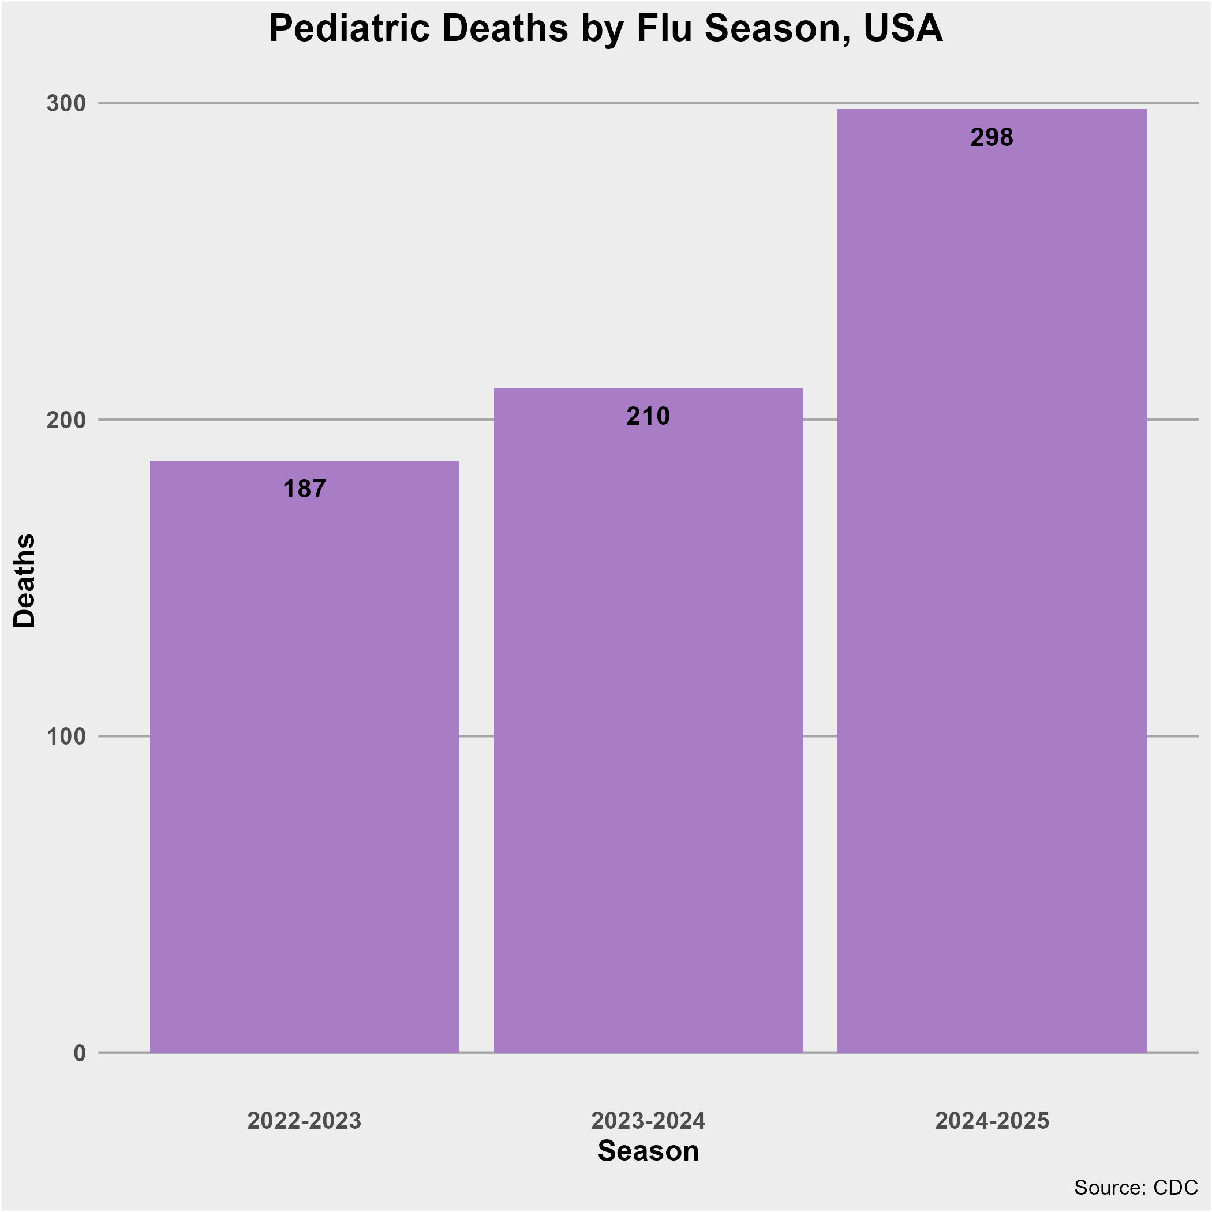
Flu Season
Nationally, 2024-2025 Flu Season one of the worst in recent history.
No pediatric deaths from flu in MKE Co.

Slide 31
Adding context
Beyond the SurvNet Audience
Explaining local disease patterns
Comparing MKE county trends to state and national trends
Show what public health professionals are focused on

Slide 32

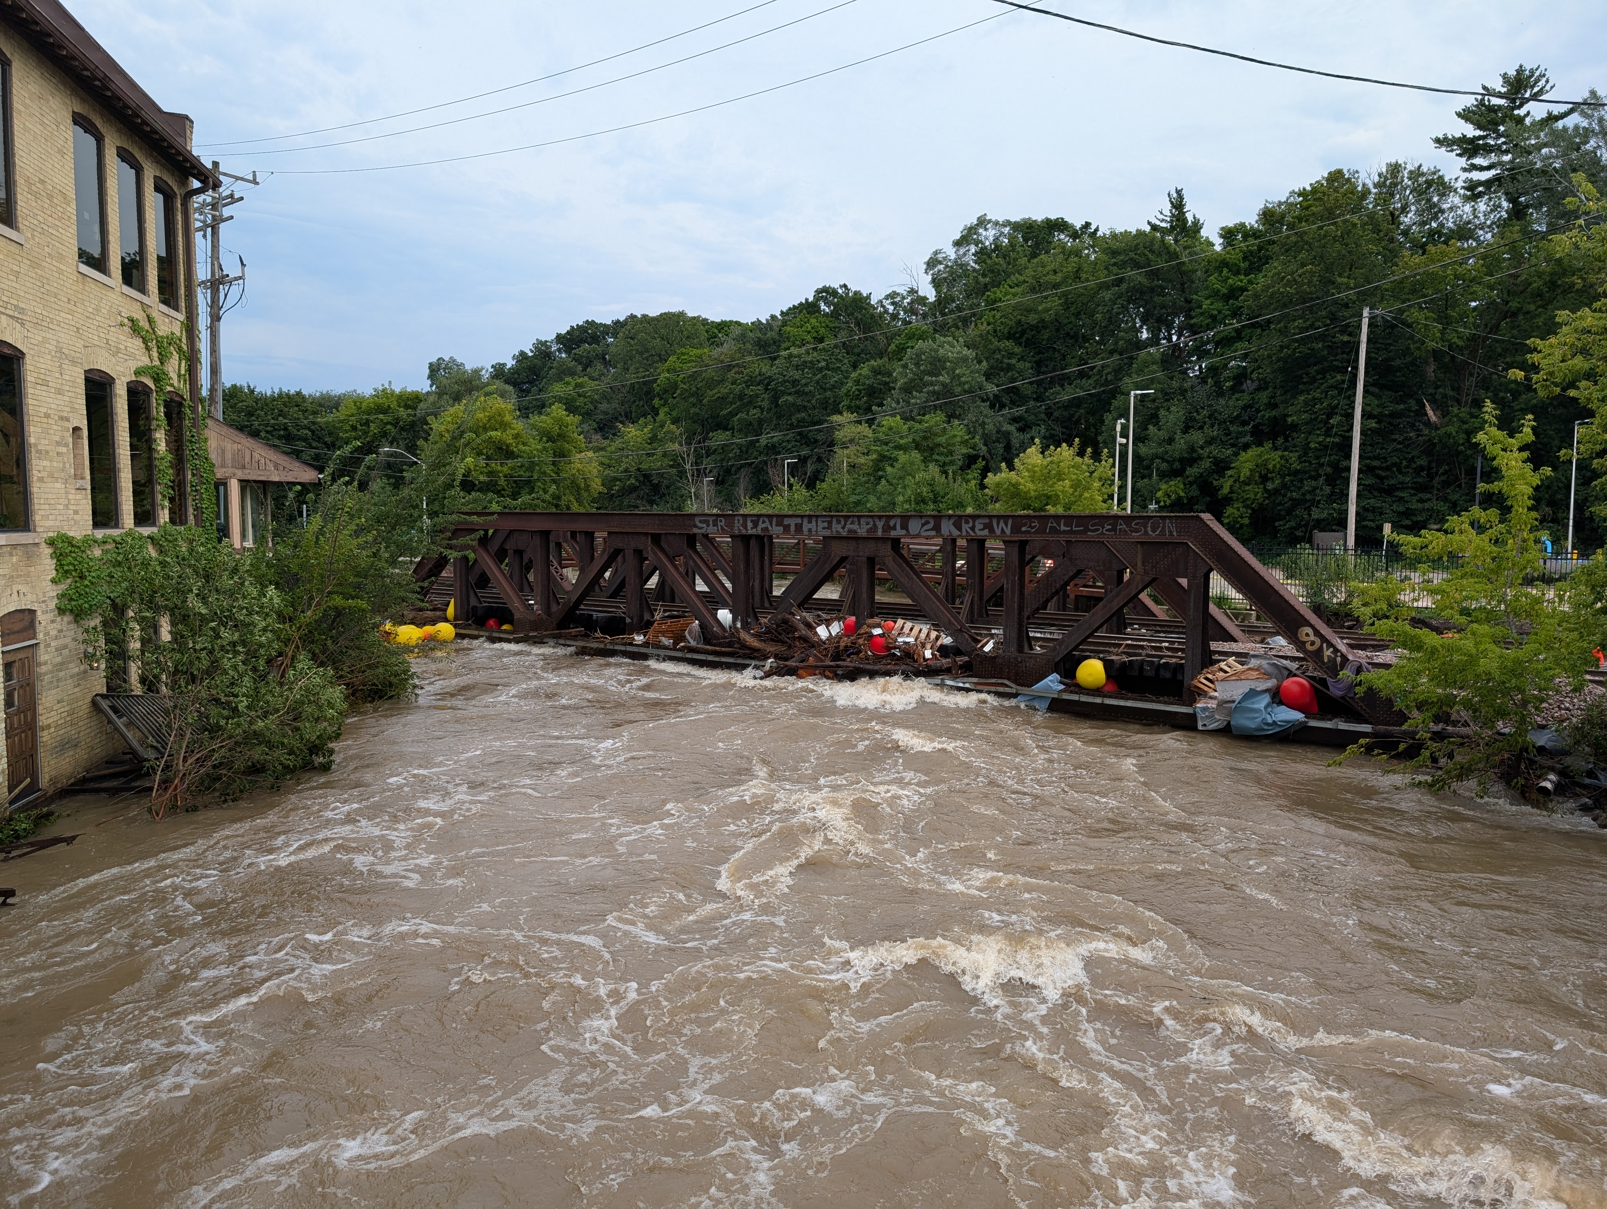
1,000 year flood
August 9th-10th, 2025

Slide 33
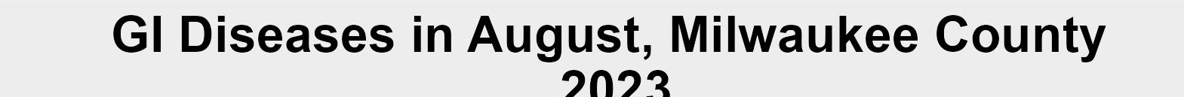
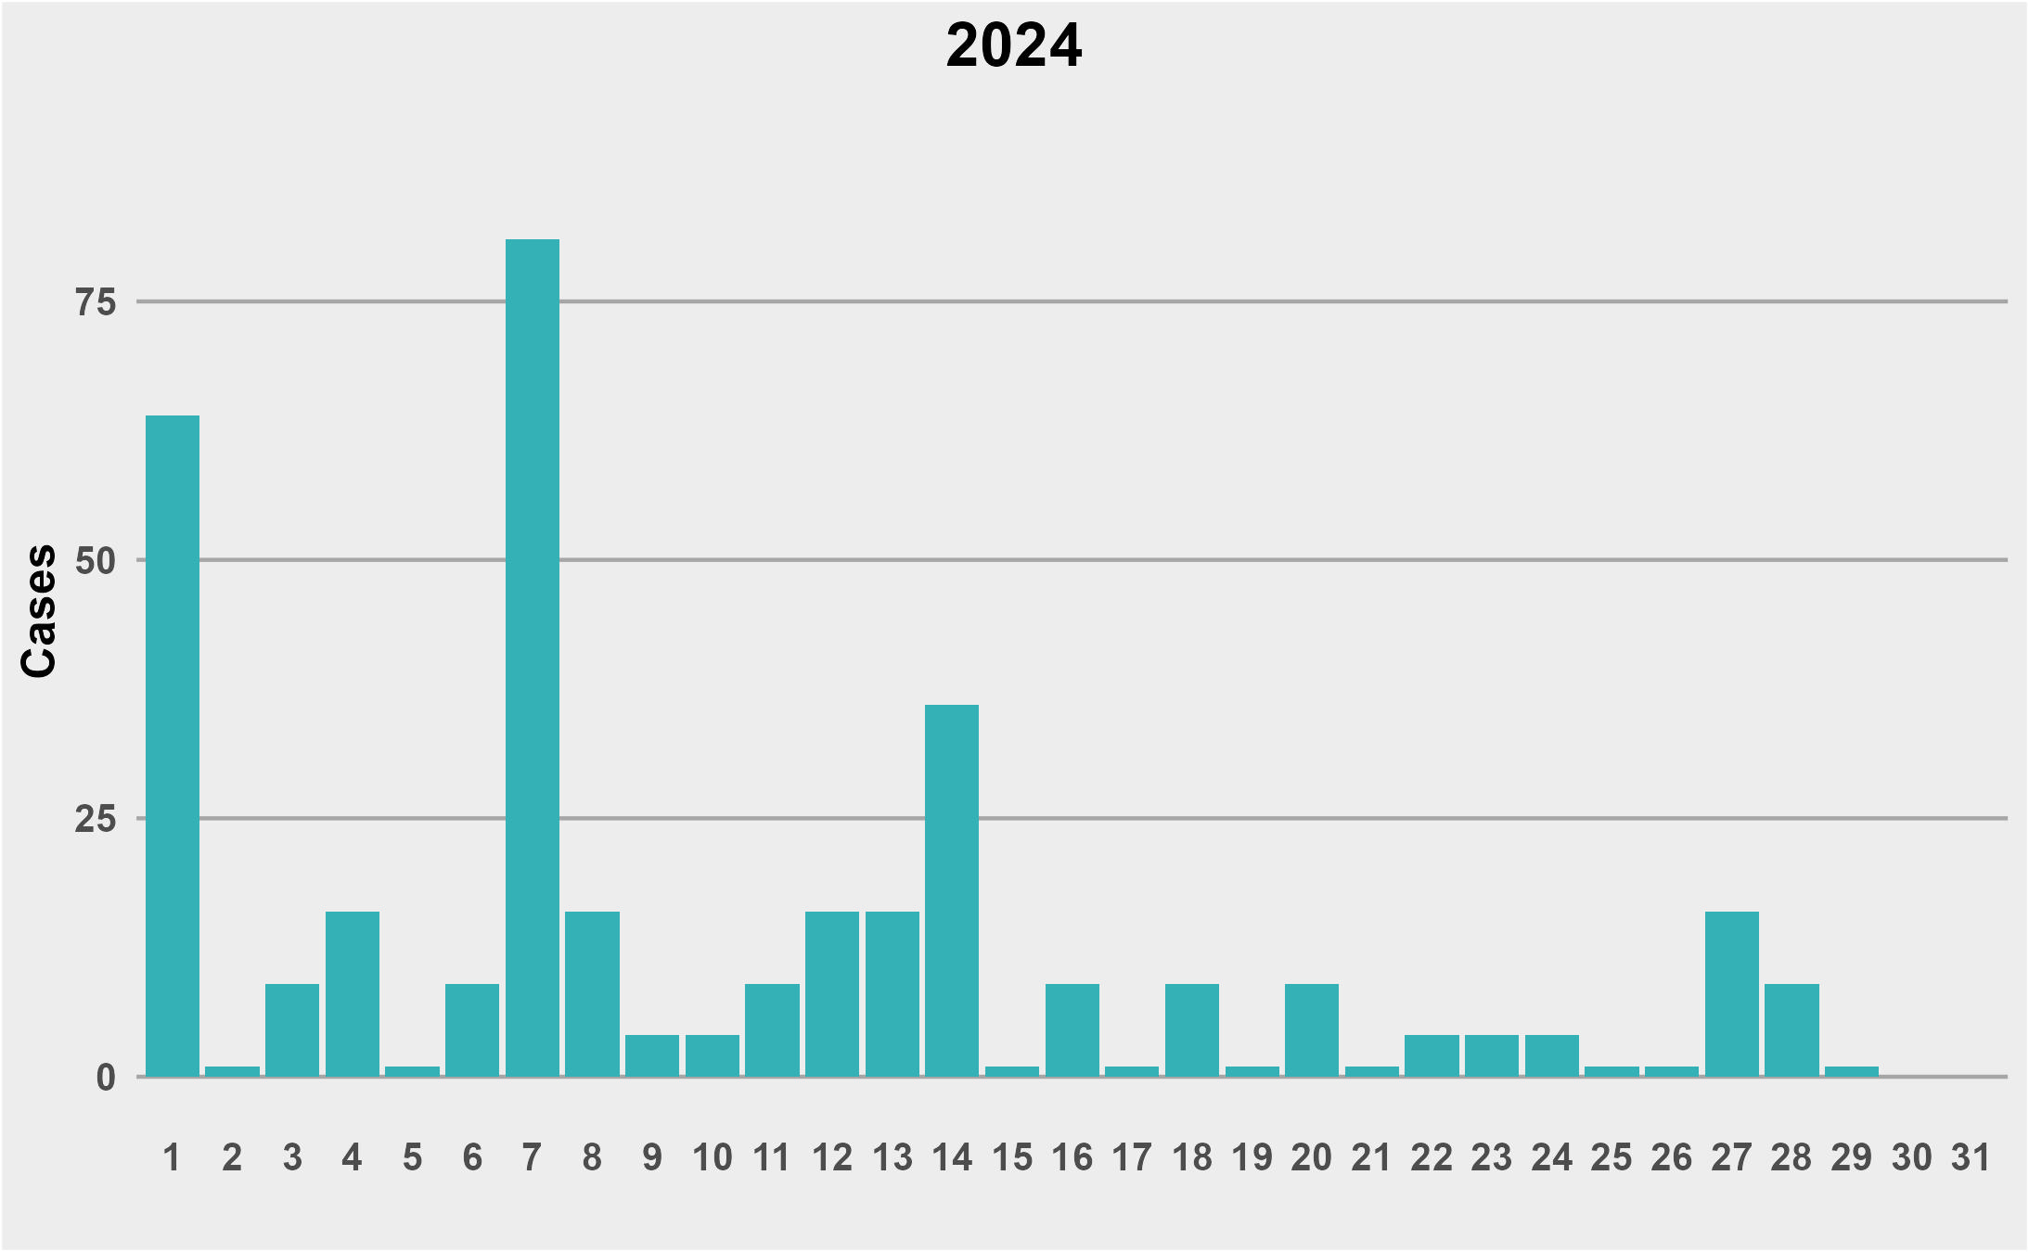
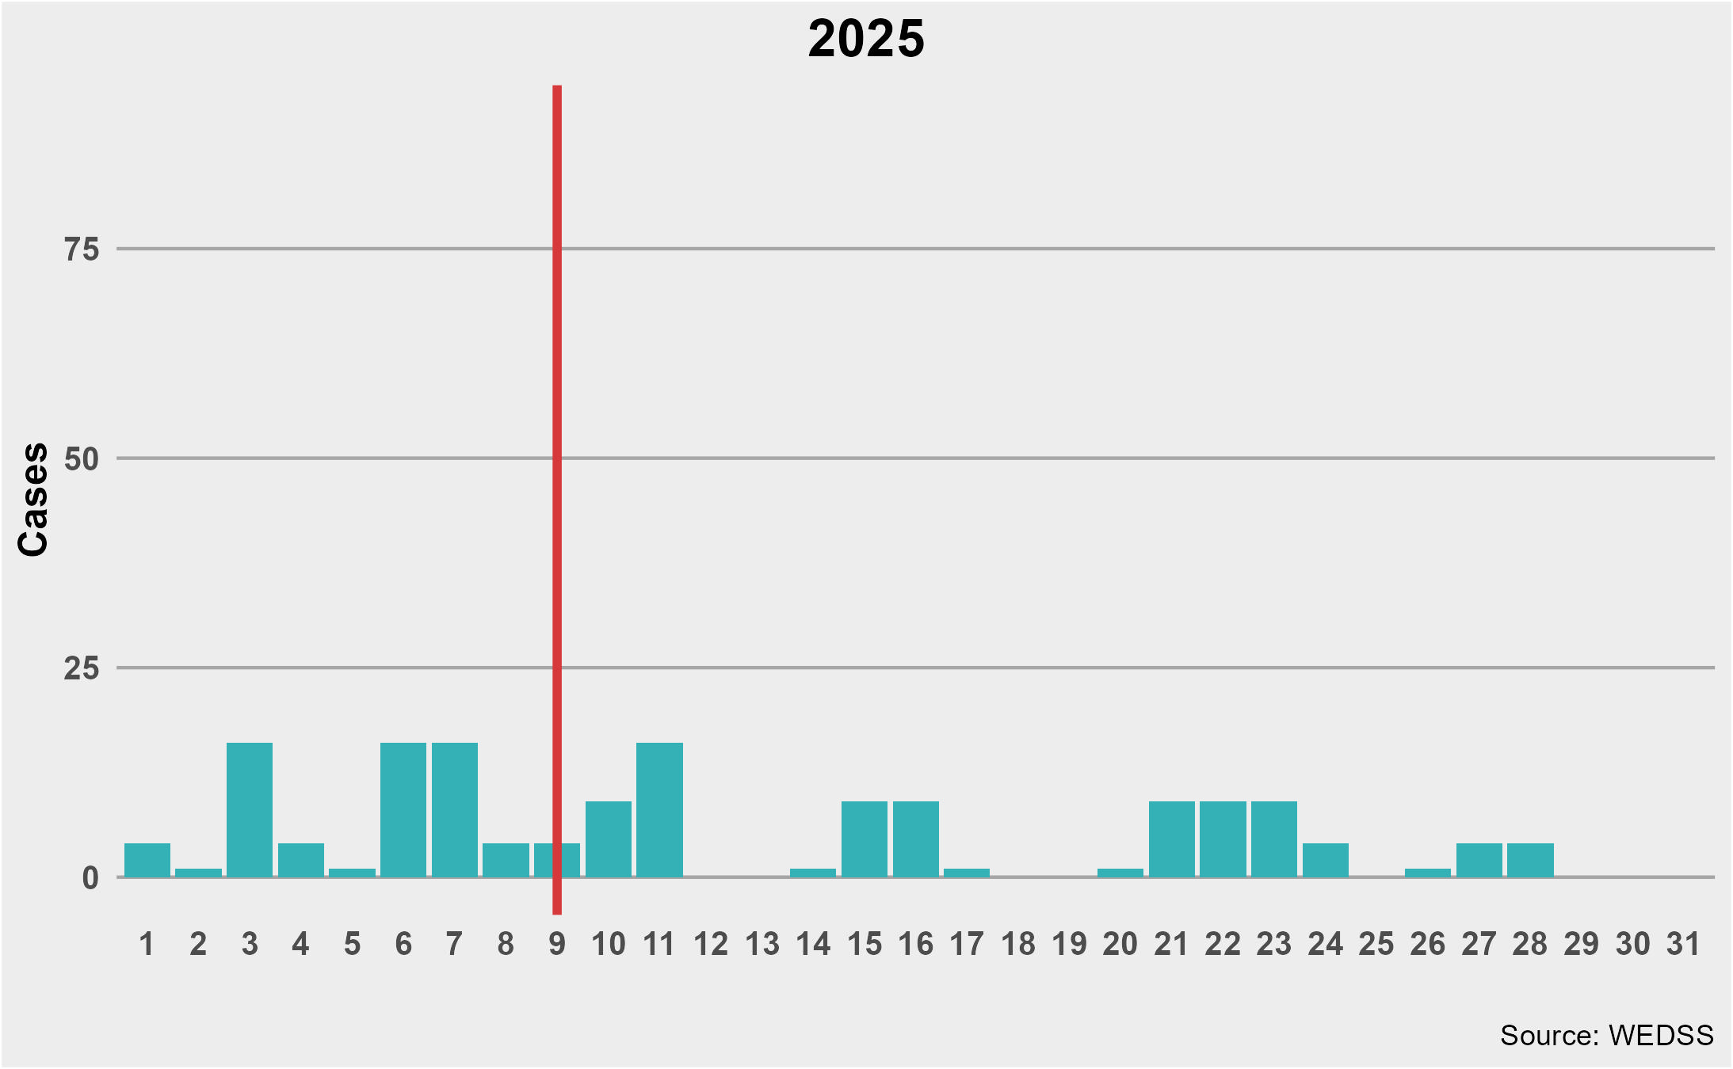
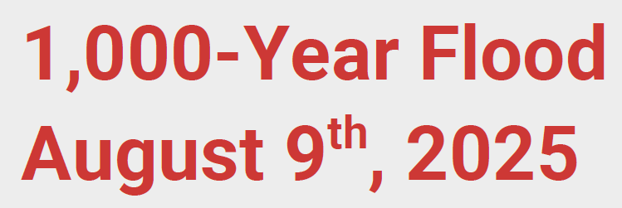
GI Diseases
GI Diseases associated with flooding: Campylobacter, E. coli, yersiniosis, cryptosporidium, Cyclospora, giardia, and salmonella

Slide 34

MHD Reports
Data and Evaluation Team Work
Regulatory Reports
Program-Specific Reports
Department-wide Reports
Need something else? Submit a data request

Slide 35

MHD reports

Slide 36
Thank you!
Contact: camccr@milwaukee.gov

Slide 37
Sources
Foldy, S. (2004) Linking Better Surveillance to Outcomes. MMWR September 24, 2004 / 53(Suppl);12-17. Retrieved from: https://www.cdc.gov/mmwr/preview/mmwrhtml/su5301a4.htm
Wisconsin Department of Health Services (2026) Communicable Disease Surveillance Data. Retrieved from: https://www.dhs.wisconsin.gov/disease/communicable-disease-surveillance-data.htm

