Slide 1
Something in the Water
How data shaped flood recovery and is leading us towards resiliency

Slide 2
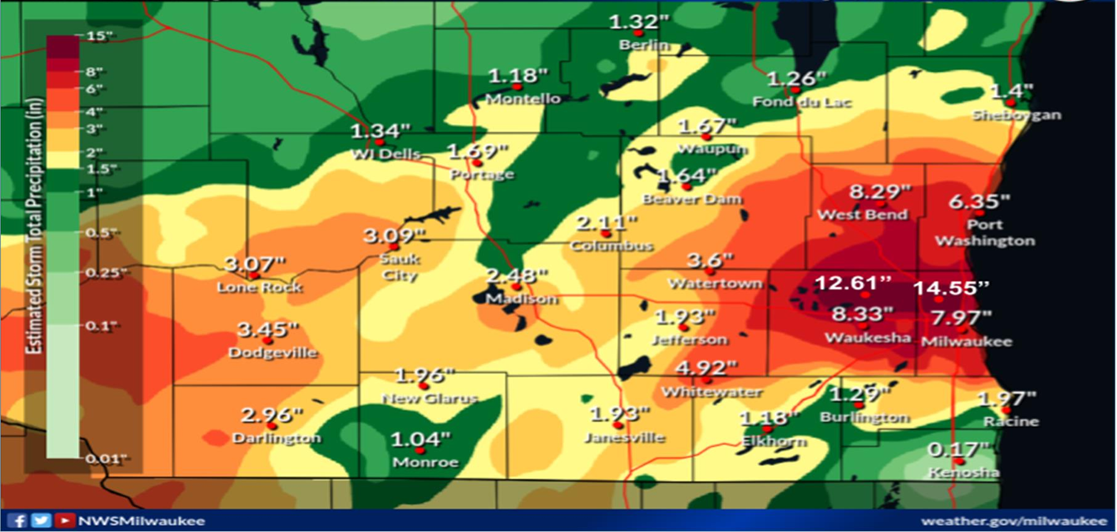
August 9-10, 2025 flood event

Slide 3
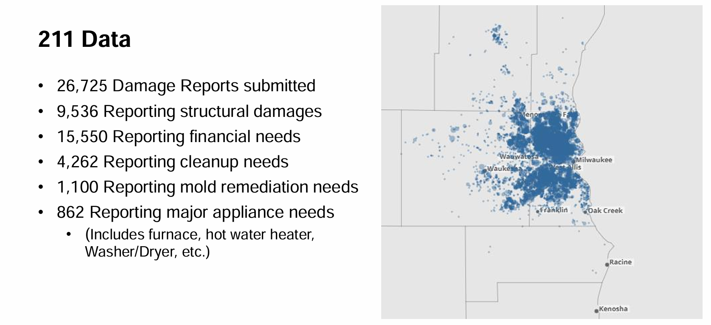
How data was collected

Slide 4
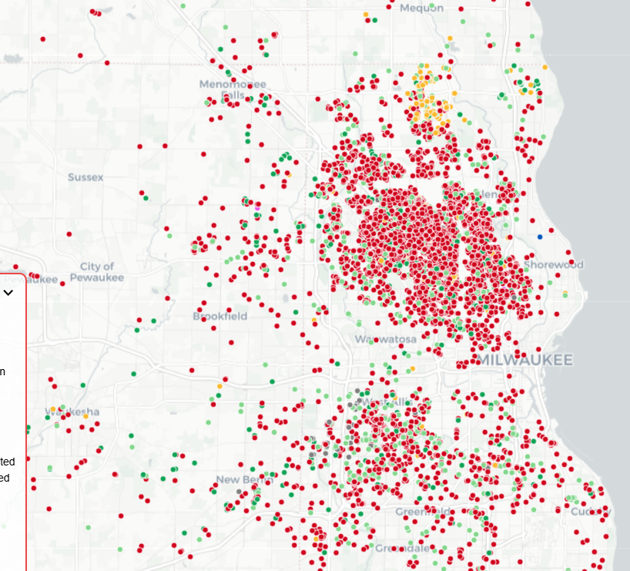
How data was organized and used
Crisis Cleanup
Aggregated data from 211 calls into a map based format
This allowed a coordinated response among all involved agencies.

Slide 5
Housing Resources Work
75 calls about foreclosure with causes traced back to floods
20 furnaces installed
24 water heaters installed
7 rebates to homeowners who did their own work
6 displaced residents temporarily rehoused

Slide 6
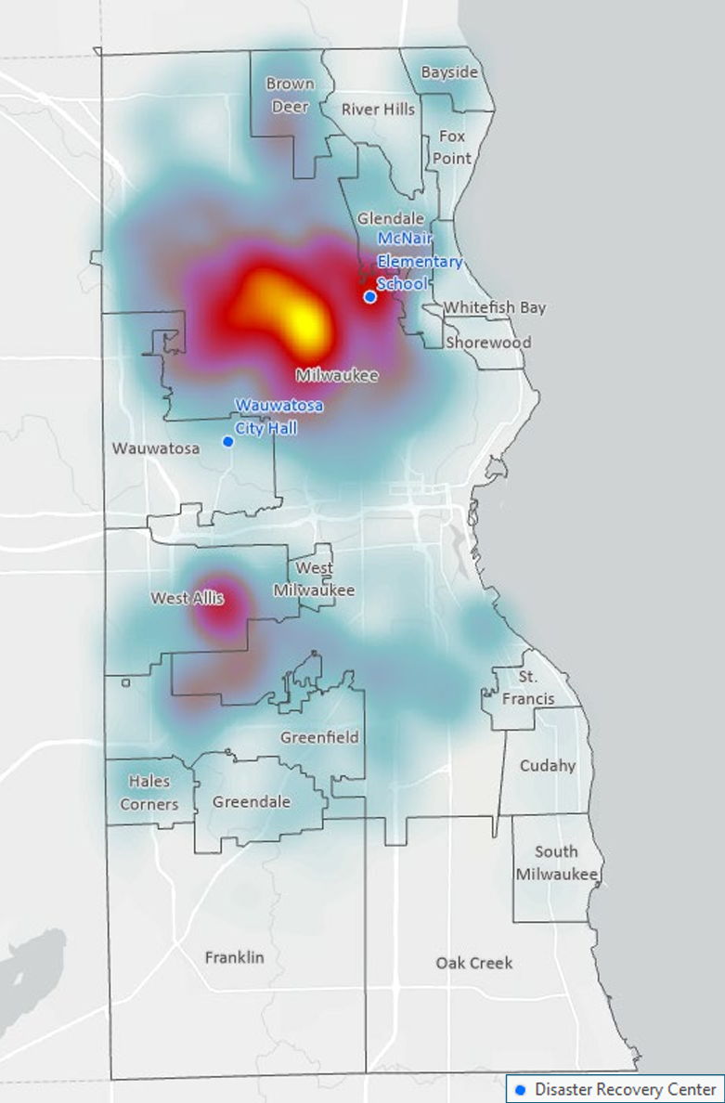
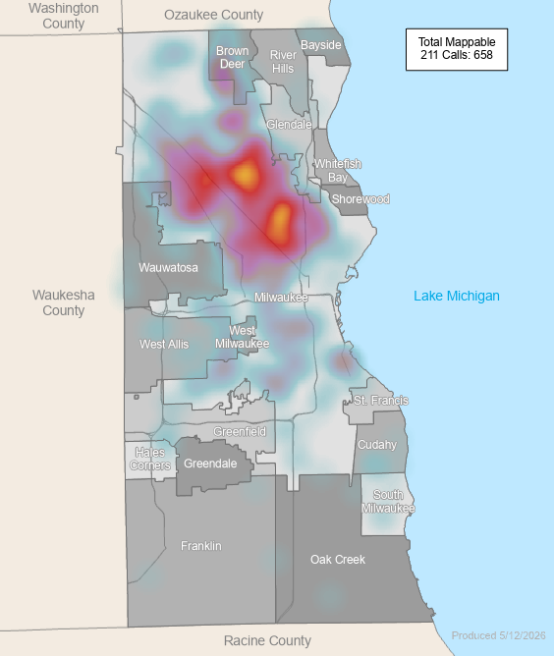
April 2026 flood event
August 2025
April 2026

Slide 7
How data helps us move forward
These events are going to be a part of regular life
Reacting to events is not good enough
Data is crucial is developing resilient neighborhood
It helps to tell stories for potential funders

Slide 8
What we are doing
Un-met needs working group-Headed by UMCOR, includes Milwaukee County Office of Emergency Management, Revitalize Milwaukee, and Us
August 1, 2026 we launched our resiliency initiative.
18 month program focused on education, evolution and response
Includes resiliency classes
Preparation and recovery kits
Help evaluate homes for flood preparedness

Slide 9
Emmett Gross
Home Retention Manager
Housing Resources Inc
414-461-6330
Emmett_gross@hri-wi.org

