Slide 1

Making the Case
Using Local Data to Strengthen Grant Proposals
Amanda Aliperta & Meghan Roesner Newton
Data Day 2026 | October 7, 2026
Notes:
Presenter: Amanda
- Welcome participants.
- Explain that the session will cover readiness, funder fit, local data, and building a clear case for support.
- Emphasize that strong proposals begin well before the writing starts.
- Q&A at the end

Slide 2
About Us
Momentum Nonprofit Strategies is a Milwaukee-based consulting firm helping nonprofits maximize impact by reaching their fundraising goals. Our philosophy revolves around building strong relationships between nonprofits and funders.
Amanda Aliperta
Meghan Roesner Newton
Founder & Principal
Grant Writer & Consultant
20 years of nonprofit fundraising experience
Expertise in development strategy, institutional giving, donor relations, and board engagement
Provides overall development strategy and funder relationship support
12+ years of nonprofit fundraising experience
Specializes in grant strategy and writing
Has secured more than $2.2 million for Momentum clients
Leads grant development and reporting for DYCU
Together, we support Data You Can Use's fund development efforts.
A
Notes:
Presenter: Amanda starts, Meghan describes herself
- Briefly introduce Momentum and your respective roles.
- Explain that your work with DYCU includes both strategy and hands-on grant development.
- Note that DYCU provides a real-world example of the concepts you will discuss today.

Slide 3
Our Partnership with Data You Can Use
What Momentum Helped Put in Place
The Challenge
1
2
3
Significant reliance on consulting and project-based revenue
Need for more unrestricted funding
Limited sponsorship and individual giving revenue
Limited internal fundraising capacity
Grant Infrastructure
Diversified Fundraising
Organizational Capacity
Funder research and grants calendar
Grant messaging and boilerplate
Grant writing, reporting, and outreach
Data Day sponsorship strategy
Individual donor campaigns
Development planning
Funder relationship strategy
Visibility and communications
A
Notes:
Presenter: Amanda
- This has been a multi-year partnership.
- DYCU needed stronger fundraising infrastructure and more diversified revenue.
- Grant strategy was one component of a broader development approach.

Slide 4
The Results
What happened over a three-year partnership
373%
$58,926
2,622%
increase in grant revenue
in Data Day sponsorships
increase in individual giving
$108,000 to $510,501
$0 to$ 58,926
$900 to $24,502
The bigger outcome: greater organizational capacity
More unrestricted and multi-year funding
Reduced reliance on consulting contracts
Additional staffing
Greater ability to pursue high-impact projects
Stronger funder relationships
Notes:
Presenter: Meghan
Over the course of this three year partnership they did what they had to do and had a lot of success
Read three main stats on slide
These results were achieved over several years, not from one grant or funder
Growth occurred across multiple revenue streams - grants, event sponsorships, and individuals
With this increased capacity, Data You Can Use was able to hire a dedicated Development and Communications Coordinator to manage this enhanced activity along with some other new positions
A lot of this came down to relationships - they strengthened relationships with existing funders which led to increased, multi-year funding and they established new funder relationships across all three revenue streams
The larger outcome was greater flexibility and organizational capacity (call out the smaller bullets)

Slide 5
The Proposals Weren't the Starting Point
Strong grant proposals are the product of strong fundraising infrastructure.
1
2
3
4
5
+
+
+
+
Organizational Readiness
Funder Fit
Relationships
Clear Messaging
Credible Data
=
A Stronger Case for Funding
Notes:
Presenter: Meghan
While grant revenue more than tripled, the proposals weren’t the starting point because writing is only one part of successful grant fundraising
Strong applications depend on what is already in place - organizational readiness, funder fit, relationships, clear messaging, and credible data to support your story
Today we will unpack each of these components and share how Data You Can Use tools can give you the credible data you need to create a strong case for support

Slide 6
Organizational Readiness: It's a Spectrum!
Grant readiness starts inside the organization.
1
Clear mission, priorities, and programs
2
Strong governance and organizational leadership
3
Legal, regulatory, and organizational documentation in place
4
Sound financial management and documentation
5
A compelling and well-documented case for support
6
Clearly defined outcomes and evidence of impact
7
Capacity and systems to manage grants
8
A broader fundraising and funder-engagement strategy
You can't be grant ready until your organization is ready,
and everyone is at a different level of readiness.
A
Notes:
Presenter: Amanda
Suggested talking points:
- Clear mission, priorities, and programs: The organization can clearly articulate its mission, vision, strategic priorities, programs, population served, and what it is trying to accomplish.
- Strong governance and organizational leadership: The organization has an engaged board, adequate staffing, clear leadership responsibilities, and sufficient capacity to carry out the work described in funding requests.
- Legal, regulatory, and organizational documentation in place: Essential documents such as 501(c)(3) status, EIN, articles of incorporation, bylaws, required registrations, policies, and W-9 are current and readily accessible.
- Sound financial management and documentation: The organization has appropriate financial controls, accounting systems, budgets, financial statements, required tax filings, and the ability to track restricted funds and project expenses.
- A compelling and well-documented case for support: The organization has strong, reusable language explaining its history, programs, community need, population served, accomplishments, partnerships, evaluation approach, and financial context.
- Clearly defined outcomes and evidence of impact: The organization can identify program goals, outputs, outcomes, metrics, demographics, and community needs and has systems to collect both quantitative data and qualitative stories.
- Capacity and systems to manage grants: Someone is responsible for grant writing, funder communication, tracking opportunities and reports, maintaining records, and meeting deadlines.
- A broader fundraising and funder-engagement strategy: The organization has diversified revenue sources, realistic expectations about grant funding, strong funder and partner relationships, board involvement, and an approach to ongoing stewardship.
It's okay if you're not at 100% for all these factors. It can be helpful to assess where you can improve. The stronger you are in these areas, the more competitive you'll be in writing a grant.

Slide 7
Reflection: How Grant Ready Are You?
Think about your organization today.
1
Clear mission, priorities, and programs
Which of these feels strongest?
2
Strong governance and organizational leadership
3
Legal, regulatory, and organizational documentation in place
4
Sound financial management and documentation
Which would create the biggest scramble if a grant were due next week?
5
A compelling and well-documented case for support
6
Clearly defined outcomes and evidence of impact
7
Capacity and systems to manage grants
Take 30 seconds to reflect.
8
A broader fundraising and funder-engagement strategy
Notes:
Presenter: Meghan
So now it’s time to think about - how grant ready are you?
Across these elements - mission, governance, financial capacity, etc. - think about where you feel the most prepared, and what areas would cause problems if a grant was due next week
So just take about 30 seconds to think, trying to identify one strength and one gap
Invite two or three people to share.
As demonstrated by your examples, you can see that readiness is often uneven. That’s ok! The exercise of identifying the gap in and of itself can be extremely useful - it gives you actionable steps to take to further your organizational readiness.
When you are ready, you still need to determine whether or not you are going to pursue the grant opportunities you find

Slide 8
Should We Pursue This Grant?
An available grant is not automatically the right grant.
Mission fit
Organizational capacity
Financial readiness
Evidence and credibility
Does it advance our mission and priorities without mission drift?
Do we have the staff time, systems, and reporting capacity?
Can we manage match, reimbursement timing, and cash flow?
Can we show impact, community trust, and stable leadership?
Funder fit and competitiveness
Return on investment
Risk
Long-term value
Are we eligible, and do we have a realistic chance?
Is the amount worth the time and effort to pursue and manage?
Could it create mission, financial, or reputational risk?
Will it strengthen our positioning, and can we deliver?
Even the right grant doesn't guarantee funding.
A
Notes:
Presenter: Amanda
Full questions for each factor:
- Mission fit: Does the opportunity clearly advance the organization's mission and strategic priorities, without creating mission drift?
- Organizational capacity: Does the organization have sufficient staff time, leadership bandwidth, systems, and reporting capacity to successfully manage the grant?
- Financial readiness: Are the financial requirements manageable, including match, reimbursement timing, cash flow, reserves, and long-term sustainability?
- Evidence and credibility: Can the organization demonstrate measurable impact, relevant outcomes, community trust, and stable leadership?
- Funder fit and competitiveness: Does the organization meet eligibility requirements, understand the funder's priorities, and have a realistic chance of being competitive?
- Return on investment: Is the potential funding amount worth the staff time, effort, and organizational focus required to pursue and manage the grant?
- Risk: Could the grant create meaningful mission, capacity, financial, reputational, or sustainability risks?
- Long-term value: Will pursuing the opportunity strengthen the organization's long-term positioning, and is the organization fully prepared to deliver strong results if funded?
- Return on investment: consider the application requirements and what it will take to successfully complete the application. Pursuing every open opportunity wastes capacity.
- Look at both what a funder says it supports and what it has funded previously.
- Consider grant size, requirements, geography, population, and type of support.
- Sometimes the right decision is not to apply.

Slide 9
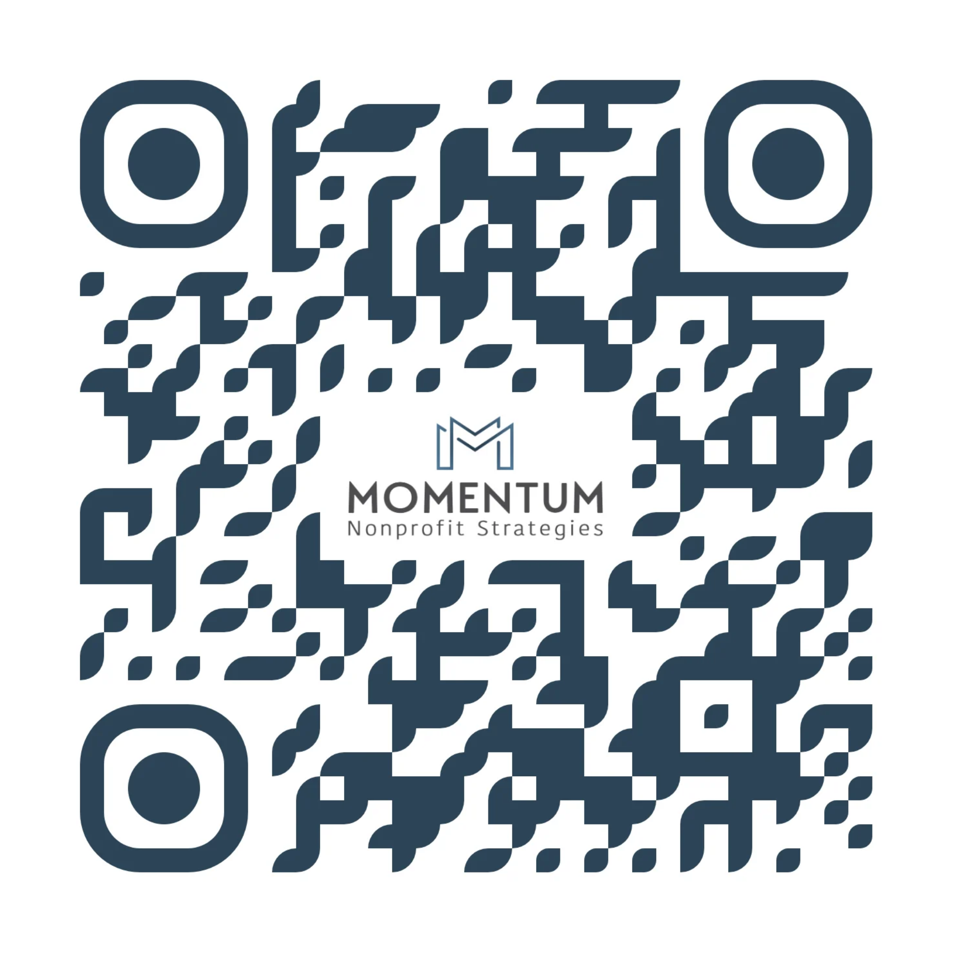
Grant Go or No Go Worksheet
A practical worksheet for deciding whether a grant opportunity is
worth pursuing before you apply.
Notes:
- Hand out the Grant Go / No-Go Worksheet.

Slide 10
Reflection: Would You Apply?
Are there any red flags that would give you pause before applying?
Assume you fit the priorities listed in the Grant Purpose.
HYPOTHETICAL GRANT OPPORTUNITY: COMMUNITY IMPACT FUND
Grant Purpose
Eligibility
The Community Impact Fund supports nonprofit organizations seeking to expand or strengthen programs that improve economic stability, health, education, or quality of life for underserved residents in Milwaukee County. Funding may be used for program staff, participant supports, supplies, outreach, evaluation, and other direct program expenses.
Applicant must be a 501(c)(3) nonprofit organization.
Organization must have been operating for at least two years.
Proposed activities must directly serve residents in the funder's geographic service area.
Applicant must demonstrate measurable community need and clearly defined program outcomes.
Organizations may submit only one application per funding cycle.
Grantees must attend an in-person award luncheon.
Grantees must submit a brief video expressing gratitude for the award.
Grant Amount
$10,000 to $20,000
Notes:
Presenter: Meghan
Time for another exercise!
Now we are going to ask you to apply those questions to a hypothetical grant opportunity
As I read through this example grant opportunity, think about any red flags that would give you pause before applying.
For the purpose of this exercise, assume you fit the interest areas/priorities listed in the Grant Purpose.
The opportunity continues on the next slide (payment structure and reporting).

Slide 11
Reflection: Would You Apply? (continued)
HYPOTHETICAL GRANT OPPORTUNITY: COMMUNITY IMPACT FUND
Payment Structure
Reporting Requirements
This is a reimbursement grant. Grantees must incur and pay eligible expenses before requesting reimbursement. Reimbursement requests may be submitted quarterly and must include invoices, receipts, payroll documentation, and proof of payment.
Brief progress report six months after the grant begins
Final narrative and financial report within 30 days of the grant period ending
At least one participant story or testimonial
What red flags would give you pause before applying?
Notes:
Presenter: Meghan
Keep reading through slide
Feel free to take a few seconds to reflect, but we would love to hear from a few people about any red flags that would give you/your organization specifically pause before applying
Depending on feedback, ask if anyone feels like they would be ready enough to submit this grant

Slide 12
Use Local Data to Make the Need Specific
You're organizationally ready and the funder is a strong fit. Now you need to make your case.
DYCU data can help Milwaukee nonprofits describe:
1
Who lives in the community
2
What conditions residents are experiencing
Population
Race and ethnicity
Age
Household composition
Income and poverty
Housing and affordability
Health
Education and opportunity
Economic and neighborhood conditions
Plus resident voice and perspective,
a DYCU hallmark
Use data to answer: Who is affected, and what are they experiencing?
A
Notes:
Presenter: Amanda
- This is a unique resource. Milwaukee is fortunate to have this kind of accessible, local data that has been intentionally and carefully crafted.
- Data by the community, for the community.
- Having the data side by side with the resident voice is truly unique. Many research organizations focus solely on the data, which doesn't always provide a complete picture.
- It helps demonstrate who is affected and what conditions look like in the community.
- External evidence can validate what staff and residents are already seeing.

Slide 13
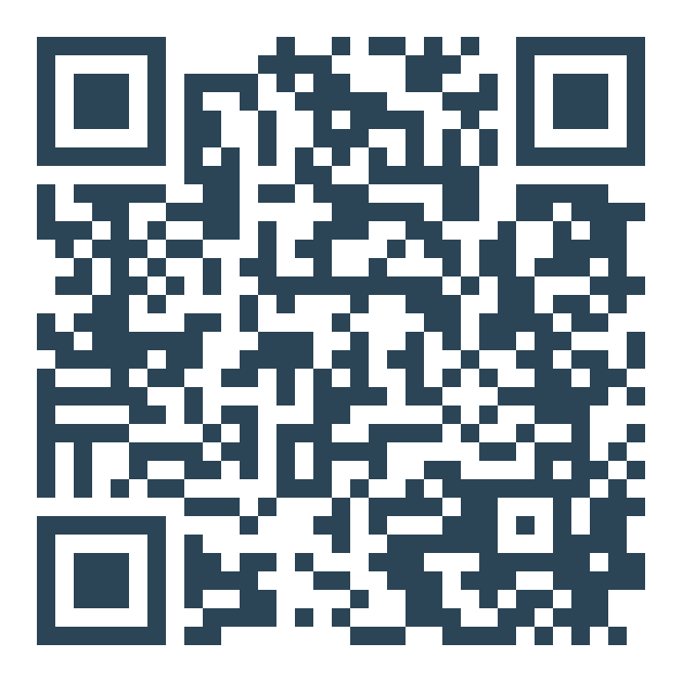
Where to Find the Data
DYCU's Data Resource Library
1
Neighborhood Portraits
2
MKE Indicators
3
Neighborhood Change Over Time
4
Interactive Maps & Dashboards
Scan to explore the library
Topic-Specific Reports
datayoucanuse.org/data-resources-landing-page
5
You don't need every statistic. You need the right evidence.
Notes:
Presenter: Meghan
Data You Can Use has a plethora of local data and free tools that can give you the data you need to tell your story - use the QR code to see where they live on the Data You Can Use Website
These are tools we at Momentum use all the time to help provide demographic data when asked about population served, talk about specific neighborhood conditions for neighborhood-specific programs, etc.
These tools offer different levels of entry depending on what you need and your comfort level with accessing and using data, but the whole point is for the data to be accessible, understandable, and actionable
Walking through each:
Neighborhood Portraits provide snapshots of 27 neighborhoods across Milwaukee using neighborhood-level data on housing, health, education, employment, and demographics to clearly show conditions at the hyper-local level
Neighborhood Change Over Time reports show how key conditions within Milwaukee neighborhoods have changed over the past 10 years, helping users see trends, progress, and areas of continued need.
MKE Indicators are interactive maps showing Milwaukee neighborhood indicators such as housing, health, education, and employment allowing users to compare neighborhoods, explore patterns and disparities, and better understand conditions across the city.
Interactive Maps & Dashboards Turn complex data into easy-to-explore visuals that help users find patterns, compare places, and better understand community conditions (ex. include MKE HMDA Data Explorer and Milwaukee Air Quality Dashboard)
Topic-Specific Reports take a deeper look at important community issues by bringing together data, analysis, and local context around a specific topic (ex. include the Milwaukee Wealth Index and Milwaukee Air Quality Report)
Data You Can Use also just launched the Data Hub, a central data library for the city, which combines data across multiple partners all in one place; it’s a new resource still being built out, but more advanced users can find it on the DYCU website
It’s important to remember that you do not need every statistic available; start with the question you are trying to answer, and then identify the dataset that can support your narrative

Slide 14
No Data Without Stories, and No Stories Without Data
This is Data You Can Use's motto, and it applies to grant writing, too.
Local data helps establish
But data alone doesn't tell the full story.
The scale of the issue
Who is affected
Where conditions are concentrated
How a neighborhood compares with the broader community
A local story or testimonial can help a funder understand what those conditions look like in someone's day-to-day life.
A
Notes:
Presenter: Amanda
- DYCU's motto is also a useful grant-writing principle.
- A testimonial is stronger when evidence shows the experience reflects a broader community condition.
- Use authentic resident voice ethically and with permission whenever possible.
- Data shows the pattern. Stories show the lived experience behind it.

Slide 15
Combining the Numbers and the Stories
COMMON FIRST DRAFT
“Many families in Milwaukee are struggling financially, and poverty continues to be a significant challenge in our community. We hear regularly from our clients that the cost of living is difficult to manage.”
What is your initial response to this?
Notes:
Presenter: Meghan
Now we have to combine the numbers and the stories
I am going to show you how I do that using a Neighborhood Portrait
Here is a common first draft of a need statement for an organization or a program addressing poverty in Milwaukee (read it)
What is your initial response to this? What is this need statement telling you?
Then advance to the next slide to reveal the stronger version.

Slide 16
Combining the Numbers and the Stories
COMMON FIRST DRAFT
MORE COMPELLING WITH LOCAL DATA
“Many families in Milwaukee are struggling financially, and poverty continues to be a significant challenge in our community. We hear regularly from our clients that the cost of living is difficult to manage.”
“Families in Walker's Point experience higher rates of poverty than Milwaukee residents overall. Data You Can Use's 2026 Walker's Point Neighborhood Portrait shows that 34% of neighborhood residents live below the poverty line, compared with 22.8% across the City of Milwaukee. The effects of this economic pressure are also evident in housing costs: 54.2% of Walker's Point households paying rent spend 30% or more of their income on rent and are considered cost burdened. As one resident shared, ‘Even when we are working hard, it can feel like one unexpected bill puts us right back at the beginning.’”
Source: Data You Can Use, Walker's Point Neighborhood Portrait, 2026
Notes:
Presenter: Meghan
The first example isn’t wrong, it’s just general and lacking specificity.
If I know my program is in Walker’s Point, I can pull numbers directly from the Neighborhood Portrait, which was also informed by stakeholders in the neighborhood
When updating the portrait for 2026 DYCU shared the report with community members and neighborhood organizations who shared the ideas, stories, and strategies that they derived from the data which was also collected
It’s pretty clear how local data and resident experience combined make a more specific, compelling, and credible statement of need

Slide 17
Strong Data Lays the Foundation
Credible, Competitive Case for Investment
4
Impact and Evaluation
Evidence that your activities are working
3
How You Address That Need
Program description
2
Statement of Need Supported by Data
1
Each layer builds on the one below it.
A
Notes:
Presenter: Amanda
- Funders should be able to follow a clear progression from need to investment.
- When you start with a clear and compelling need, your proposed activities should come as a clear response to the need.
- Make it easy for the funder to understand the logic of the request.

Slide 18
Before You Submit
Consider your answers to these questions:
Where are we on the organizational readiness spectrum?
Is this funder a strong fit?
✓
✓
Can we clearly demonstrate the need?
Is the data local and specific when possible?
✓
✓
Does our response logically address the need?
Are the intended results clear and measurable?
✓
✓
Readiness + Fit + Evidence + Clarity = A Stronger Grant Proposal
Notes:
Presenter: Meghan
The goal is a proposal that is credible, specific, and easy to understand.
So before you submit, ask yourself these question (read them)
Walk through the equation:
Strong writing cannot compensate for poor fit or weak readiness
Good data is useful only when it supports a clear, logical request

Slide 19
Closing Reflection
What is one thing you will do differently the next time you prepare a grant proposal?
1
Strengthen organizational readiness?
2
Be more selective about funder fit?
3
Find more local data?
4
Better interpret the data you use?
5
Connect the need more clearly to the proposed response?
Use the right data. Tell the clearest story. Pursue the right opportunities.
A
Notes:
Presenter: Amanda
- Invite one or two people to share if time allows.
- Encourage them to leave with one practical change they can apply immediately.

Slide 20
Q&A
Open Discussion
Notes:
Open discussion.

Slide 21
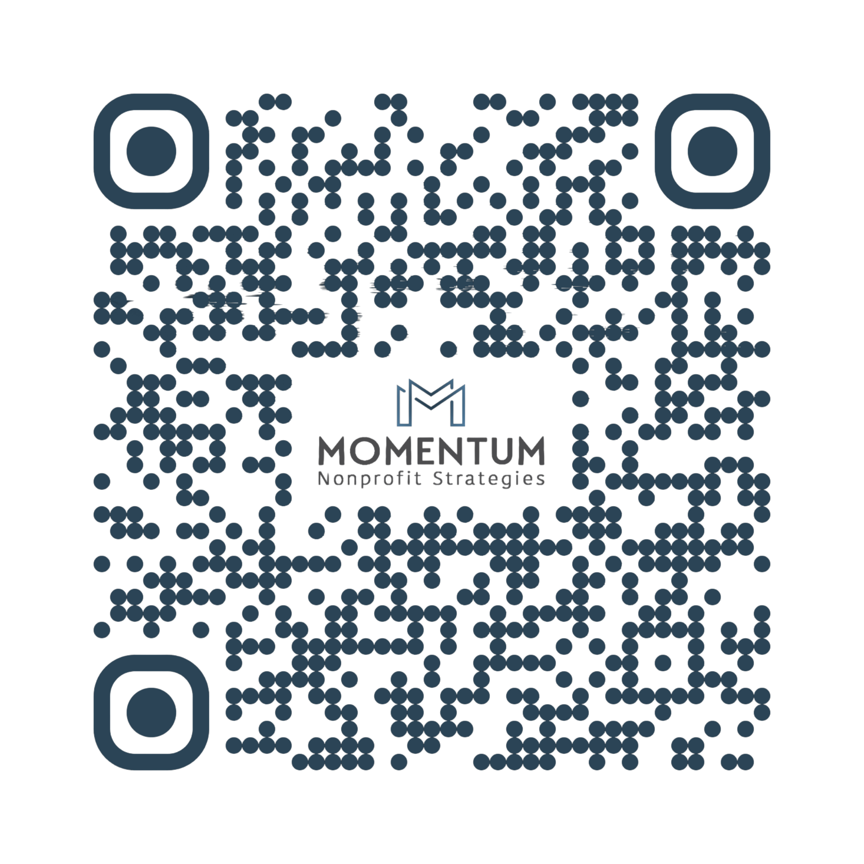
Stay Connected
Momentum Nonprofit Strategies
Amanda Aliperta & Meghan Roesner Newton
WEB
momentumnonprofitmke.com
EMAIL
amanda@momentumnonprofitmke.com
meghan@momentumnonprofitmke.com
PHONE
414.241.0352
Sign up for the Momentum Newsletter

