Slide 1

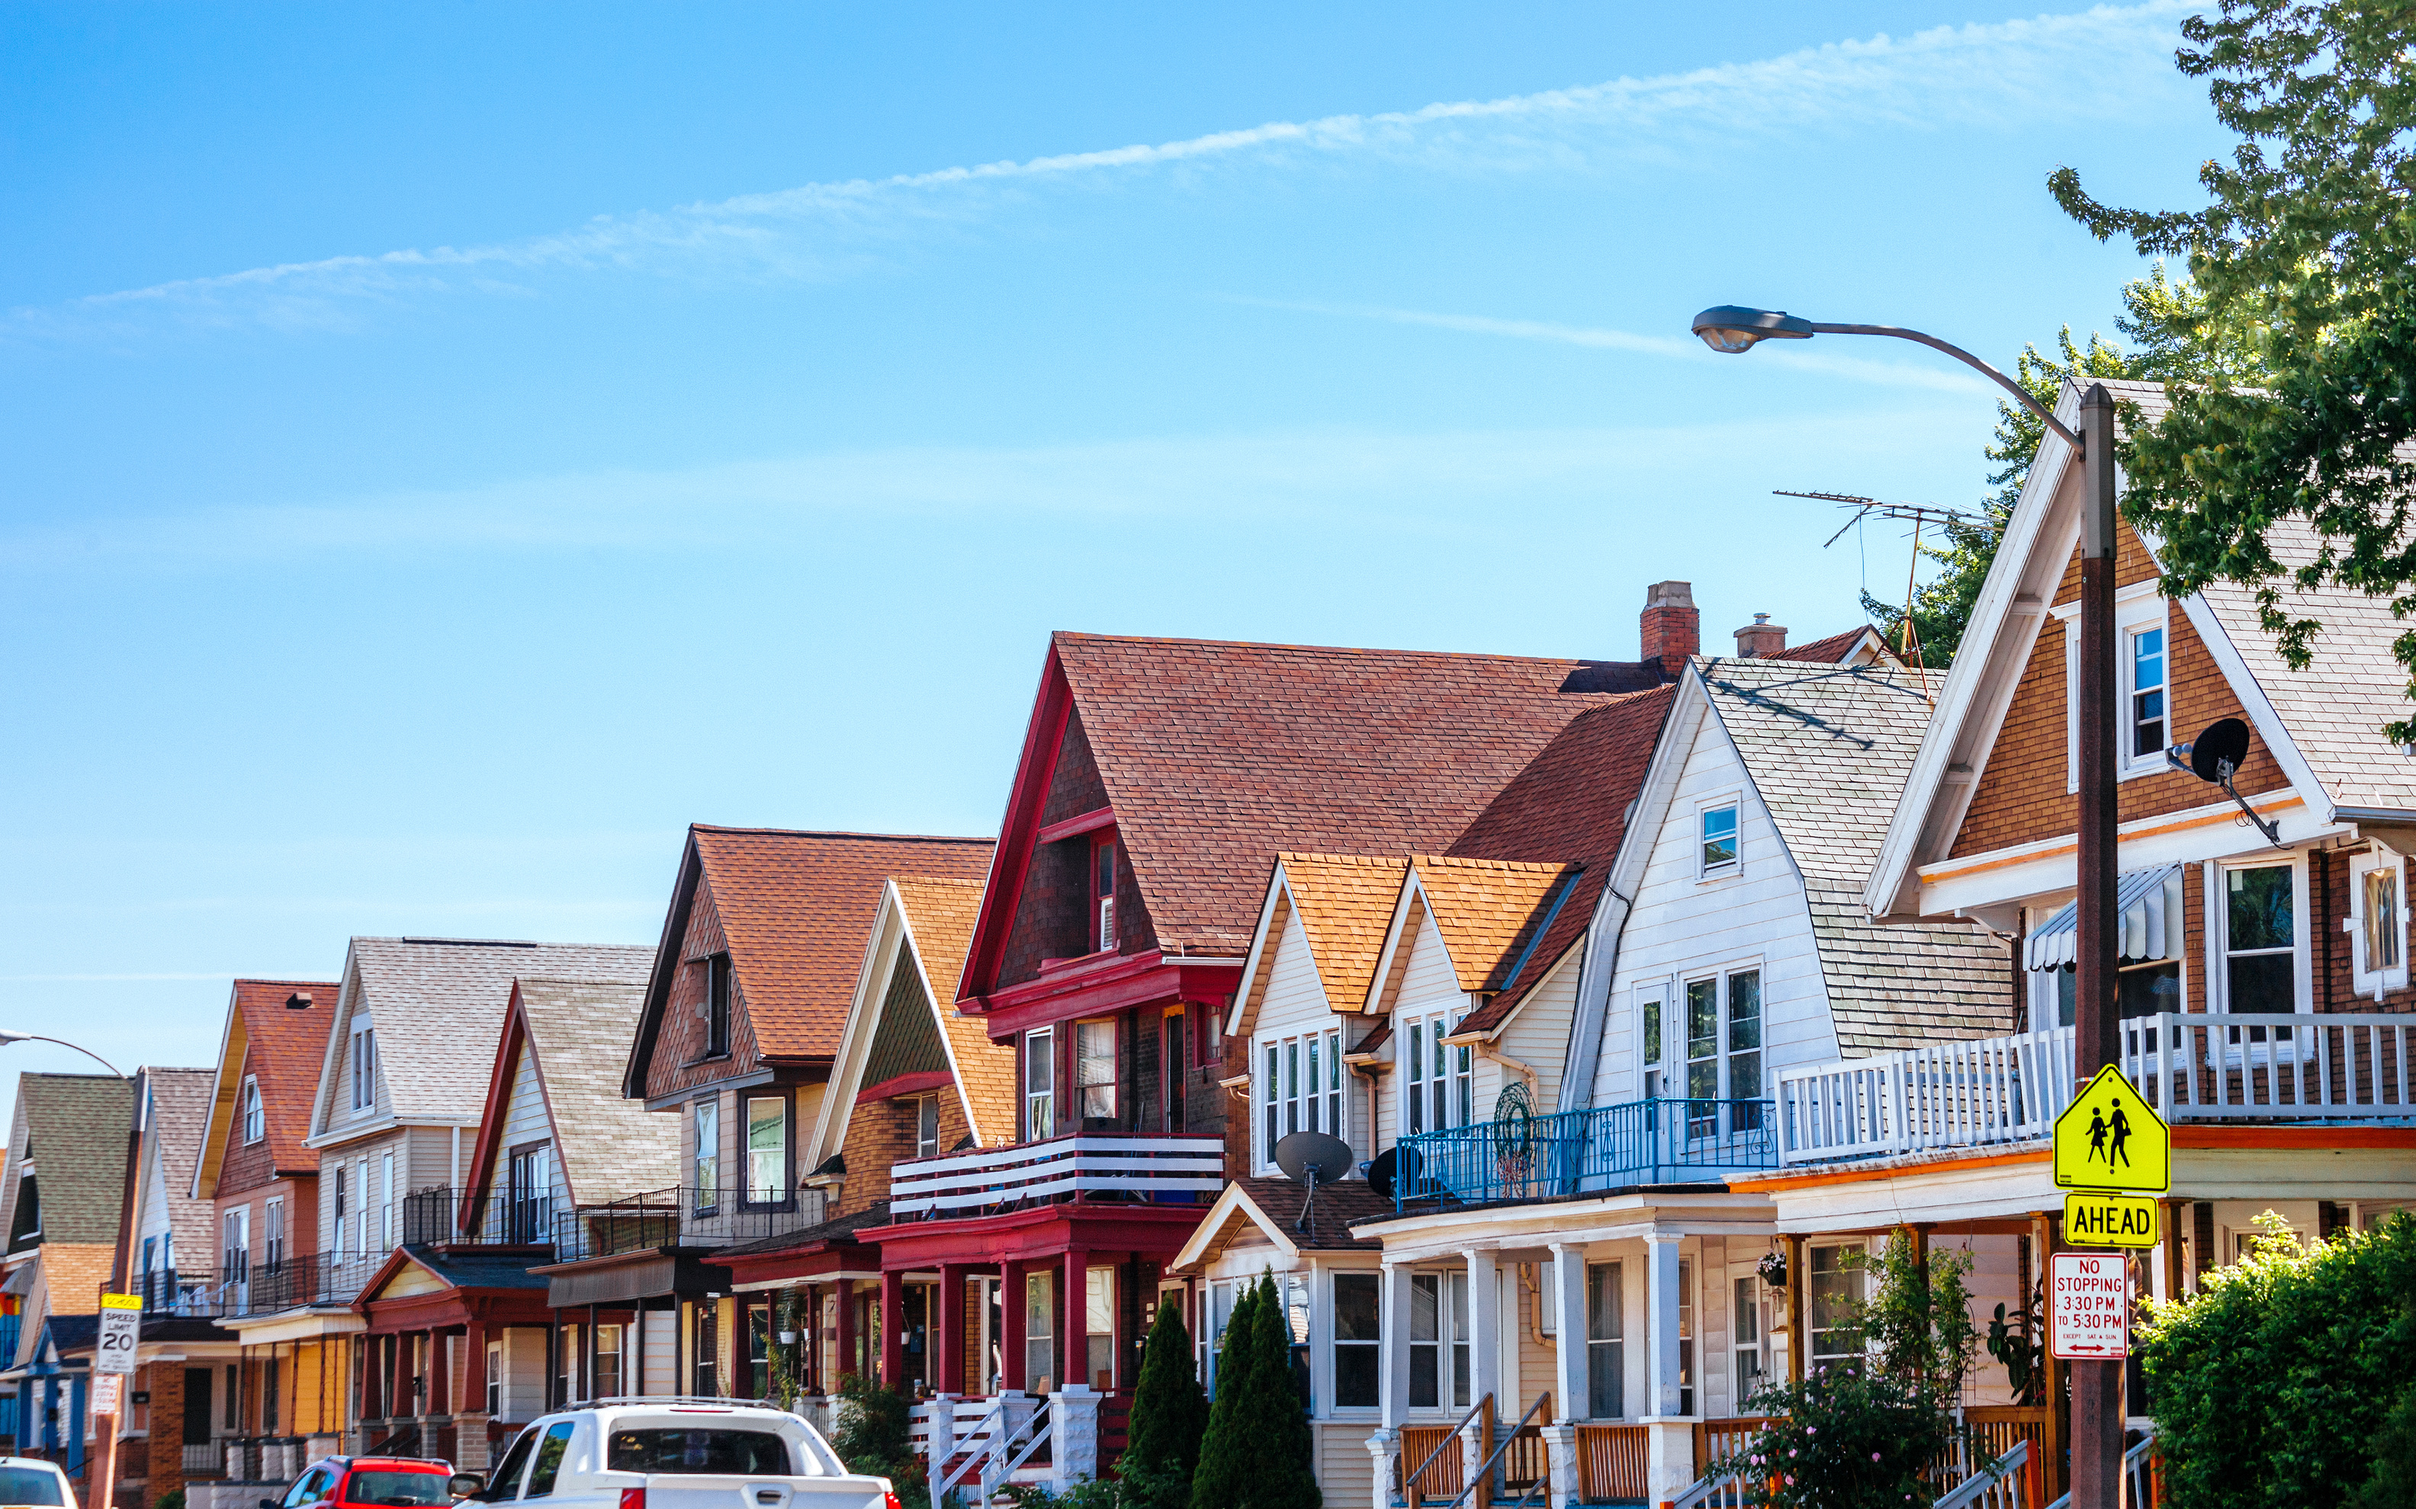
TOGETHER FOR HOMES
COALITION
FROM PERMIT TO HOME
MAKING MILWAUKEE’S HOUSING DATA VISIBLE
TOGETHERFORHOMES.ORG

Slide 2

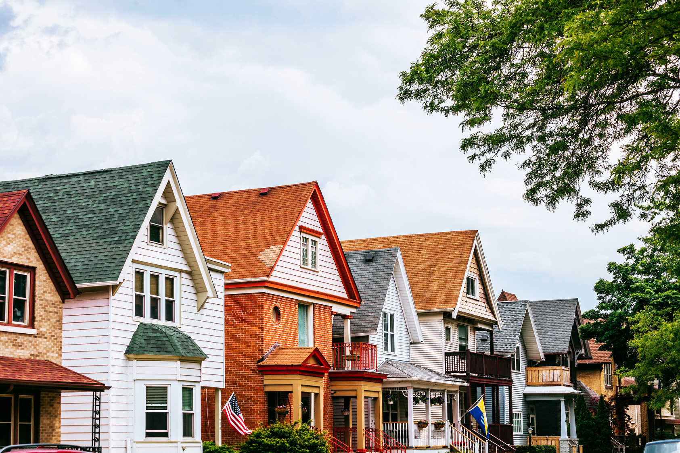

HOW LONG DOES IT TAKE TO GET HOUSING BUILT IN MILWAUKEE?
1
THE QUESTIONS THAT STARTED THIS PROJECT
WHERE DOES HOUSING GET STUCK?
a
2
OUR HOUSING QUESTION BECAME A DATA QUESTION.

Slide 3
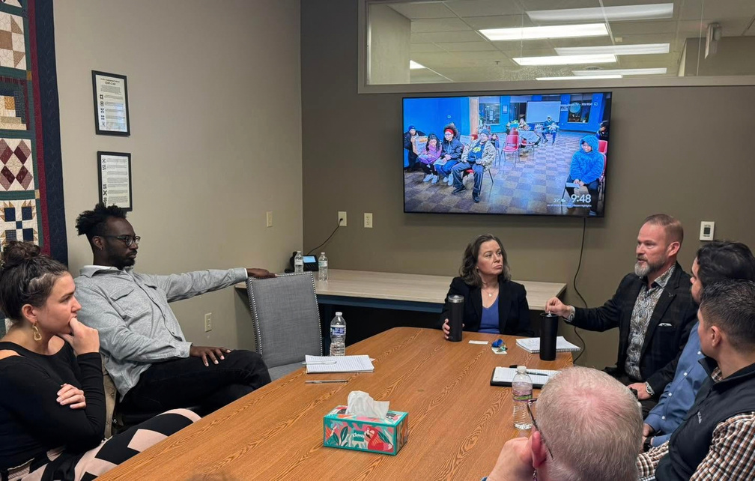
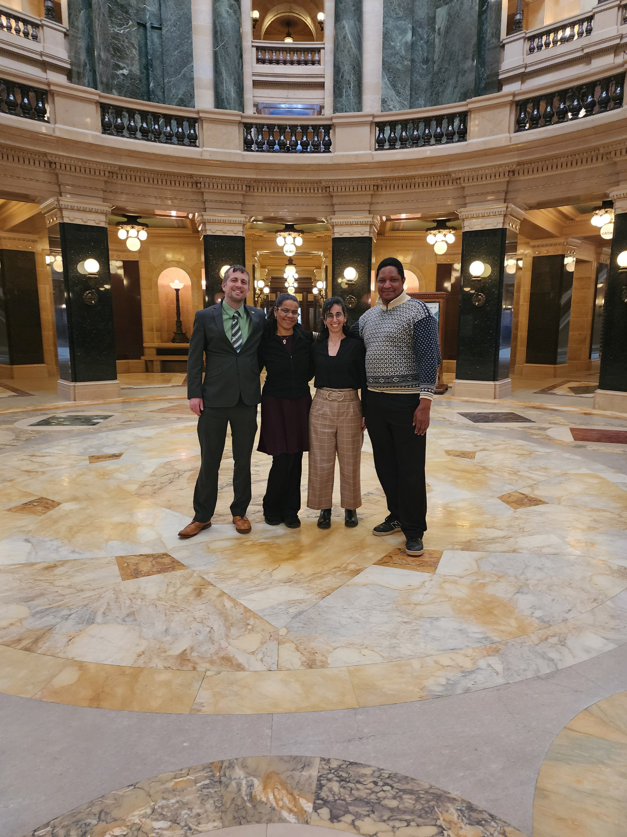
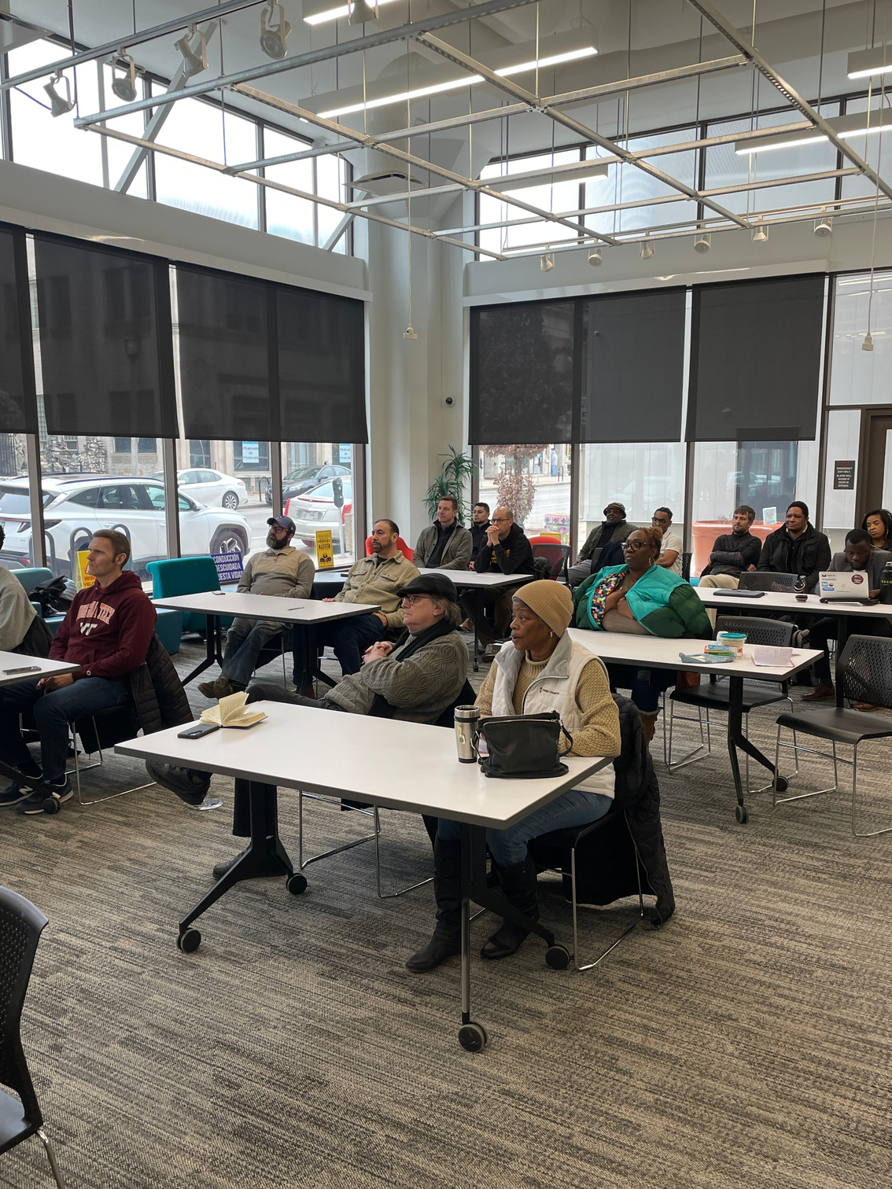
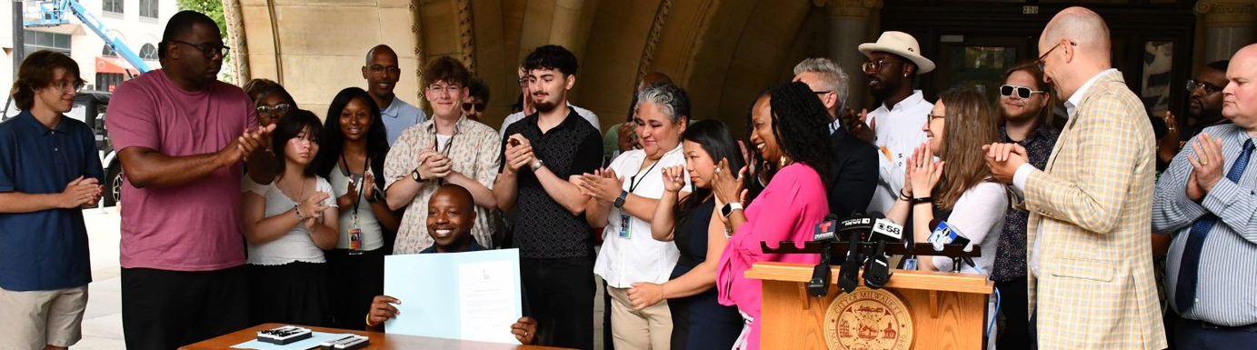

BUT FIRST: WHO ARE WE?
To educate and empower Milwaukeeans in order to change the narrative around housing issues and support policies that increase the availability of affordable housing.
OUR MISSION

Slide 4












TOGETHER FOR HOMES
COALITION
THE TEAM
MONTAVIUS
JONES
SOLANA
PATTERSON-RAMOS
EZRA
HAUGABROOKS
COALITION MANAGER
ADVOCACY MANAGER
DASHBOARD DEVELOPER
CURRENT COALITION MEMBERS

Slide 5
HOUSING REALITY OF MILWAUKEE
  RISING COSTS
  HOUSING SUPPLY SHORTAGE
  HIGH # OF RENTERS

Slide 6


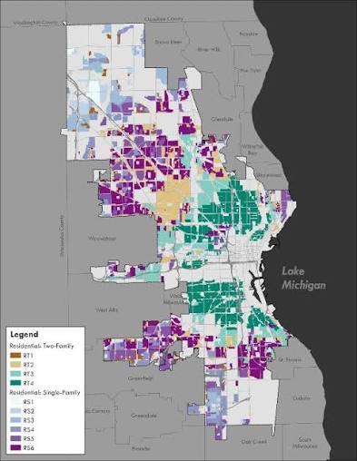
MILWAUKEE IS CHANGING HOW WE BUILD
MAYOR’S
YEAR OF HOUSING
Elevating housing as a citywide priority
HOUSING ELEMENT
Planning for more housing and greater variety
ZONING REFORM
Reconsidering what types of housing can be built and where
BUT CHANGING WHAT WE CAN BUILD IS ONLY THE BEGINNING.
TOGETHER FOR HOMES
COALITION

Slide 7
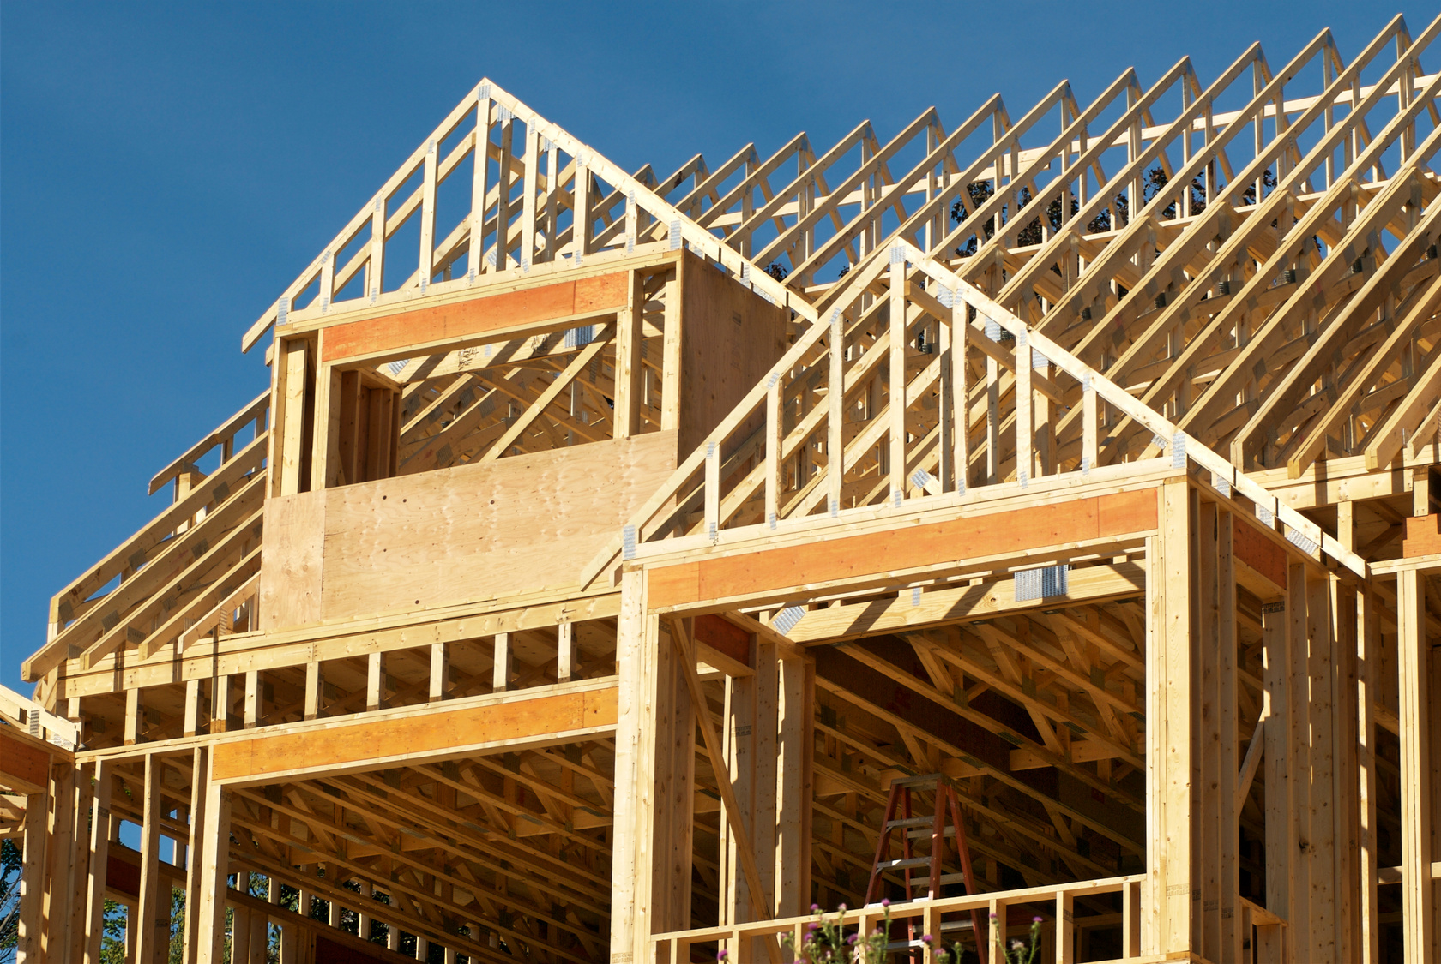
GETTING PERMISSION TO BUILD IS A PROCESS
1.
ZONING
2.
APPLICATION
3.
PLAN REVIEW
4. REVISIONS
6.
CONSTRUCTION
5.
PERMIT
WHERE DOES THE TIME GO?
How long does permitting take?
Where might delays occur?
THE CHALLENGE
Publicly available data isn't always publicly usable.
TOGETHER FOR HOMES
COALITION

Slide 8
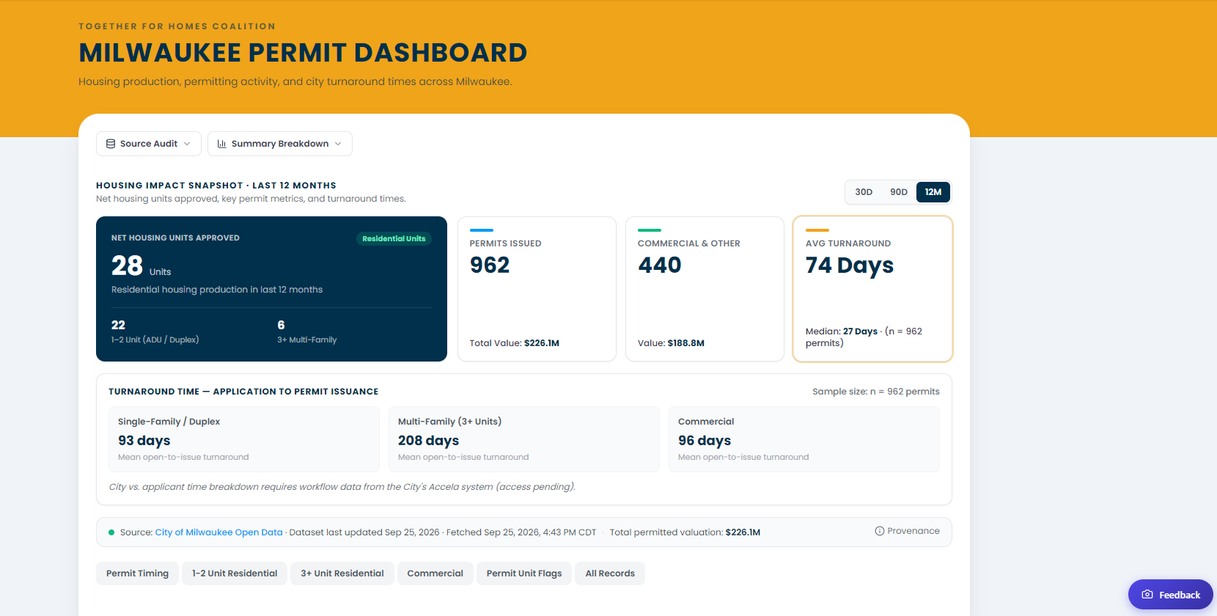
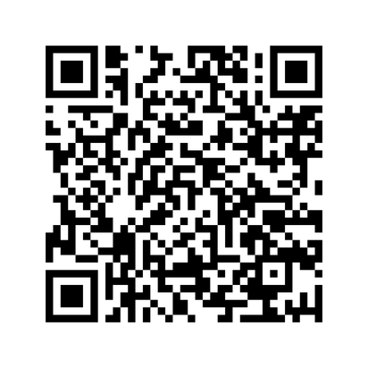
SCAN
HERE
TOGETHER FOR HOMES
COALITION

Slide 9

WHAT CAN WE LEARN?
PROJECT ACTIVITY
What housing projects are moving forward?
PERMIT
TIMELINES
How long does the process take?
DEVELOPMENT TRENDS
How does activity change over time?
POTENTIAL BOTTLENECKS
WHERE should we investigate further??
SCAN
HERE

Slide 10

WHO CAN USE IT?
RESIDENTS
Explore housing development in their neighborhoods
JOURNALISTS & RESEARCHERS
Investigate housing activity and development trends
COMMUNITY ORGANIZATIONS & ADVOCATES
Support housing education and advocacy
DEVELOPERS & HOUSING PROFESSIONALS
Explore permit activity and timelines
POLICYMAKERS & CITY STAFF
Examine permit data and identify areas for further study
SCAN
HERE
TOGETHER FOR HOMES
COALITION

Slide 11
HOW IT WORKS
PUBLIC
DATA
DATA PIPELINE
SOURCE AUDIT
WEB APP
DATA.MILWAUKEE.GOV
CHECKS EVERY
12 HRS
NEXT.JS + VERCEL
LIVE SOURCES
Permit records published by the City of Milwaukee. We don't create or edit them.
Pulls, cleans, and matches each permit to its aldermanic district.
A standard web framework (not AI), hosted on Vercel, built to embed on the TFH website.
Shows which data sources are live and where each number comes from.

Slide 12



PARTNER WITH THE CITY TO APPROVE DATA COLLECTION AND PROCESSING
1
NEXT STEPS
CONTINUE TO COLLECT AND REVIEW COMMUNITY FEEDBACK TO STRENGTHEN THE TOOL
2
REFINE THE DASHBOARD
FOR GREATER ACCURACY USABILITY & TRANSPARENCY
3

Slide 13
ADDITIONAL
COMMENTS
TOGETHER FOR HOMES
COALITION

Slide 14
ADDITIONAL
COMMENTS
TOGETHER FOR HOMES
COALITION

Slide 15

414-207-8887
info@togetherforhomes.org
SCAN
HERE
TOGETHERFORHOMES.ORG

