Slide 1
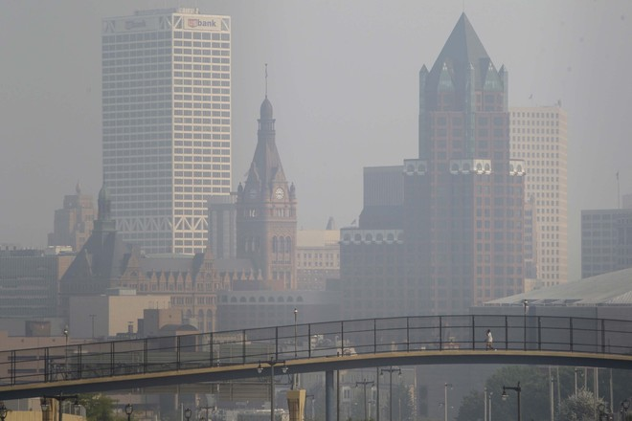

WEDNESDAY
OCTBER 7, 2026
IS SOMETHING BURNING IN HERE?
hOW OUTDOOR AIR IMPACTS OUR INDOOR AIR QUALITY
Danika Hill-Paulus, MSc
Co-Executive Director
DATA DAY 2026
WWW.MKEFRESHAIR.COM
Notes:
Hi, My name is Danika Hill-Paulus & I'm co-executive director of MKE FreshAir collective. We are an environmental justice nonprofit in Milwaukee focused on air quality. and Today I'm going to talk about the wildfire smoke events and share some data to show just how significant these events are.
Learn how outdoor air pollution affects indoor air, including a case study of the IAQ inside my home during the most recent wildfire smoke events, and community solutions to future hazardous air quality events.
(3-4 s)
Summary: Wildfire smoke has impacted Milwaukee summers for three of the past four years. It’s not just outdoor air quality that becomes unhealthy - it’s often just as bad inside your home as well. Learn how outdoor air pollution affects indoor air, including a case study of the IAQ inside my home during the most recent wildfire smoke events, and community solutions to future hazardous air quality events.

Slide 2
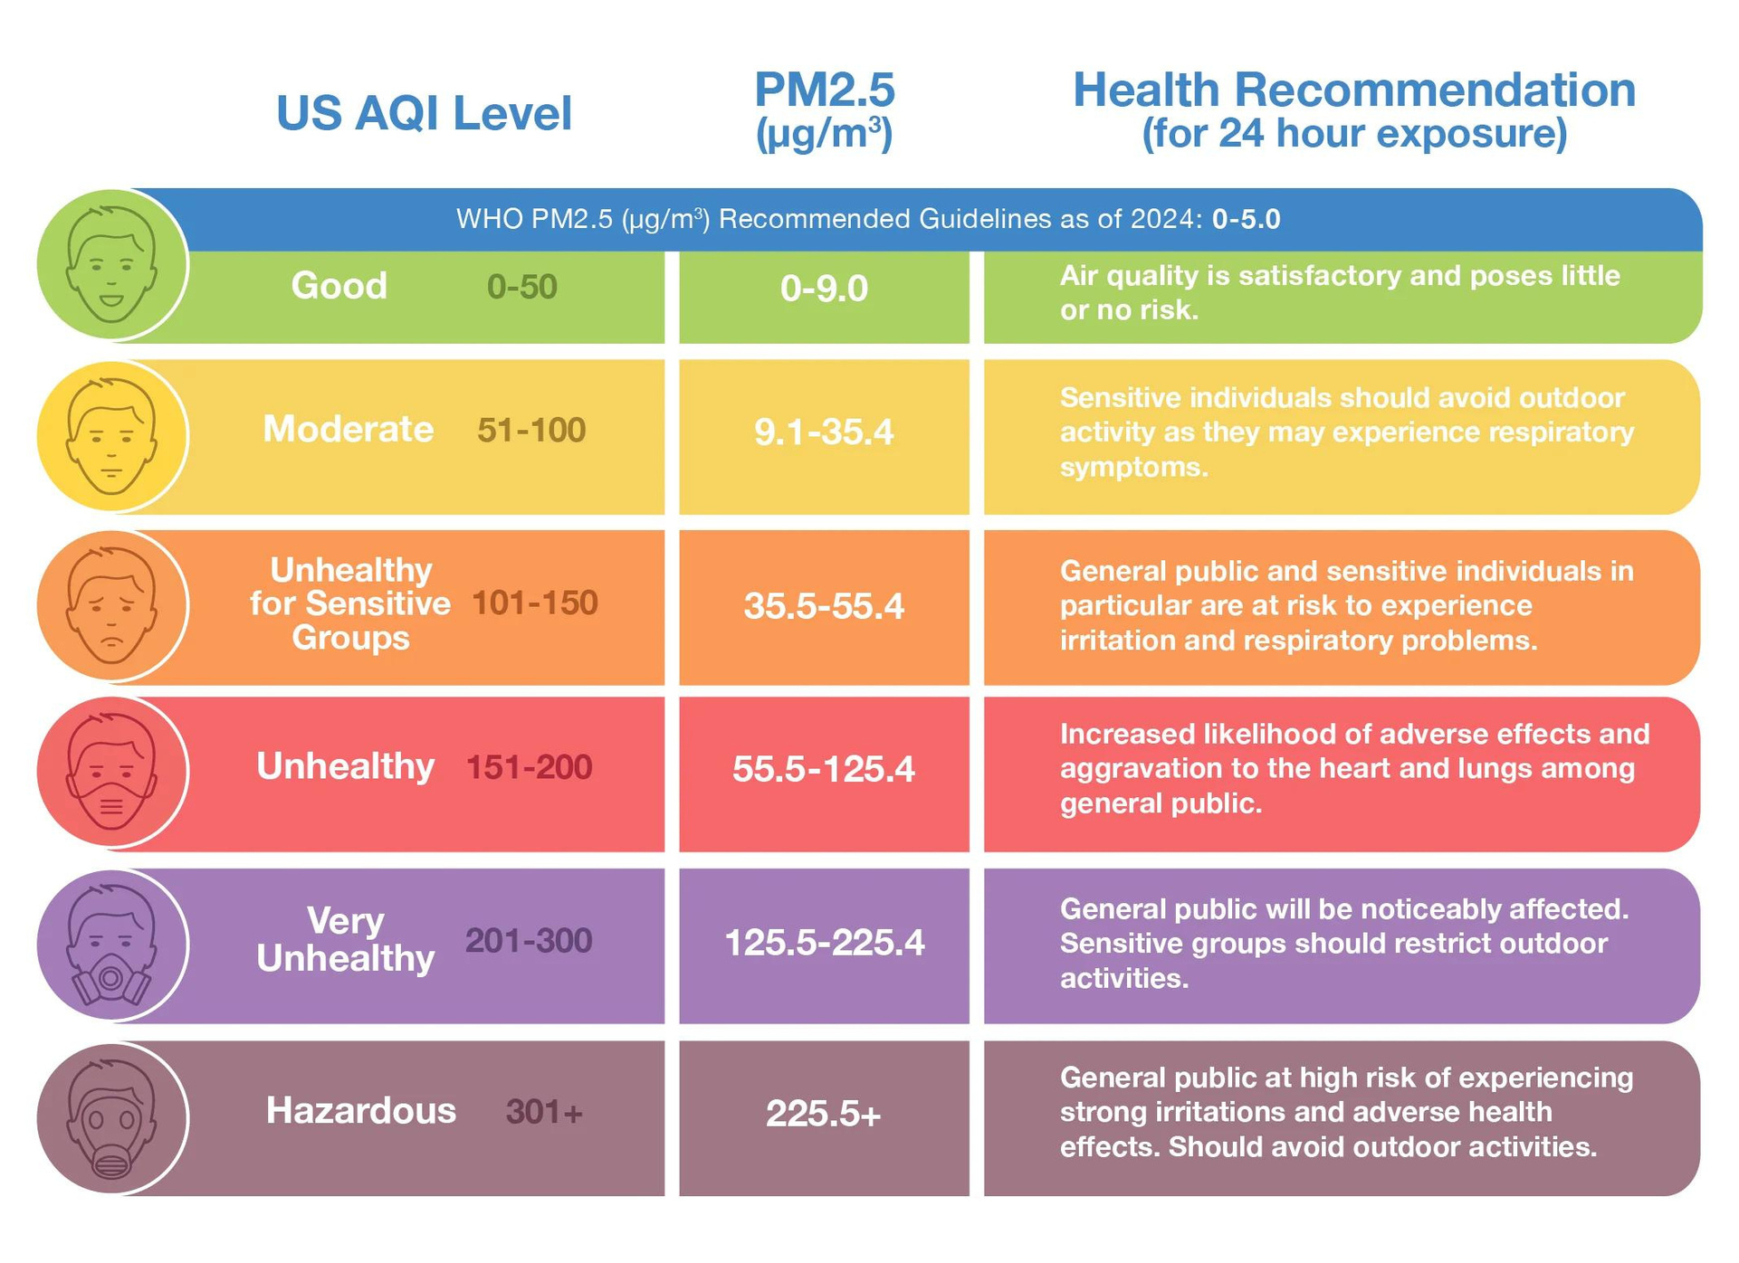
WHO & EPA Recommended Guidelines as of 2024
There is no safe level of air pollution!
As the Air Quality Index (AQI) reaches 100 and beyond, knowing whether the air we breathe is safe can help us take action to minimize the harmful health effects of air pollution.
Notes:
This is the AQI. It's color coded categorization of air pollution made by the EPA to make it easy to tell if your air is "good" or "bad" outside.
Orange - Unhealthy for sensitive groups
Red and above - unhealthy for everyone
-------
Caps at 300 - this summer AQI reached 500+

Slide 3
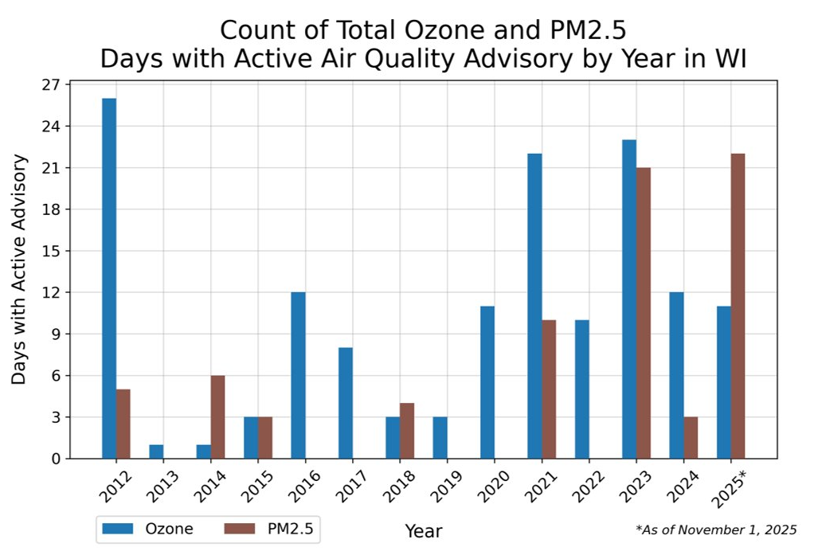


AIR QUALITY ALERT DAYS
Data from the Wisconsin Climatology Office
Notes:
This is a chart from the DNR showing air quality advisory days for the past 13 years. You can see we've always had issues with ozone (blue line). SE WI is nonattainment zone for ozone.(that's another topic)
BUT PM2.5 days are much more rare UNTIL we get the wildfire smoke days in 2023 and 2025.

Slide 4
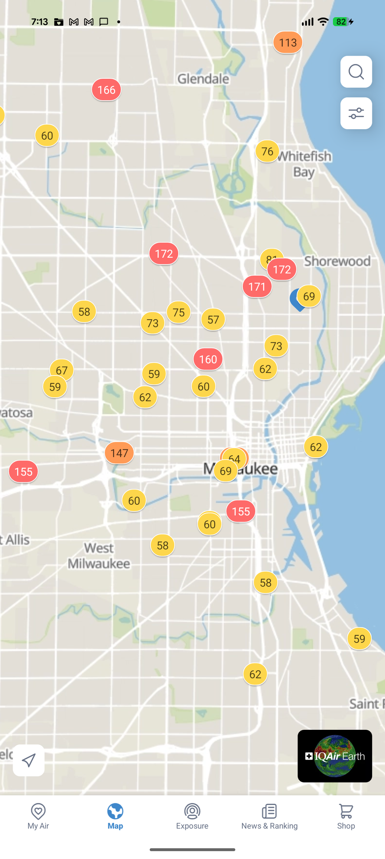
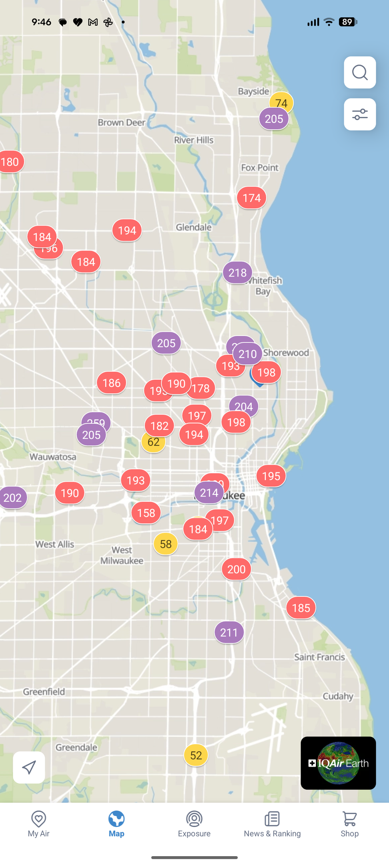
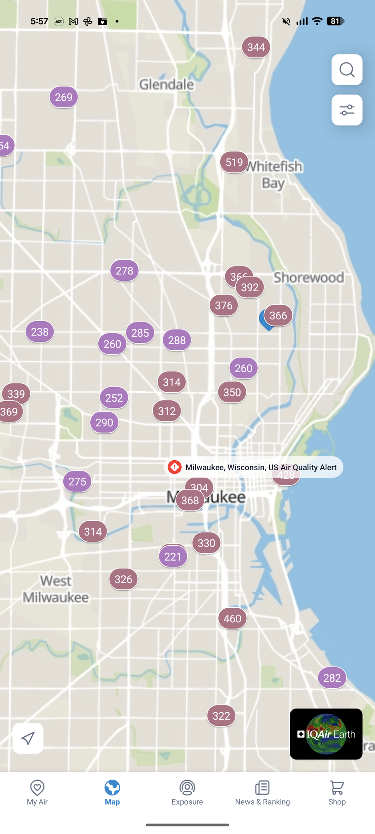
WILDFIRE SMOKE VARIATION
07/15/26
7:13 PM
07/15/26
9:46 PM
07/16/26
5:57 AM
Notes:
We had a very significant wildfire smoke event this summer. These are screenshots from my phone on the IQ Air app showing the distribution of AQI across Milwaukee
You can see there can be a lot of variation across the City for where the wildfire smoke tends to "settle" or linger
A theme for this presentation - it's so important to know your neighborhood air quality because of that variation

Slide 5
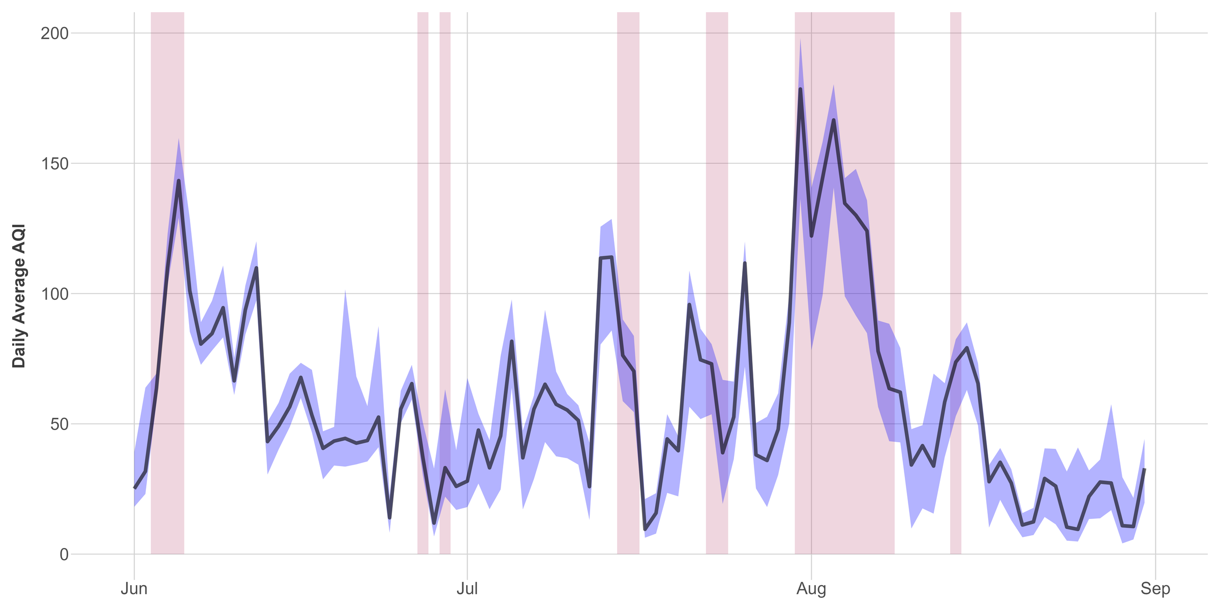
2025 AIR QUALITY ALERT DAYS & FRESHAIR SENSOR AVERAGES
Average AQI across all sensors
Variability each day
Air Quality Alert Day
Notes:
This chart has a lot going on - the black line is the average of all our sensors and the purple is the variation across all sensors.
The red bars are the air quality alert days from the DNR
Also this was made by Amanda Beavin with DYCU - shout out to her! It's in our 2025 Air Quality Report

Slide 6
2025 AIR QUALITY ALERT DAYS & FRESHAIR SENSOR AVERAGES
Average AQI across all sensors
Variability each day
Air Quality Alert Day
Notes:
These red circles show the air quality alert days that do not match our sensor's averages. There were days that the air quality spiked the day before or the day after the air quality event.
There's only 1 PM2.5 DNR sensor in Milwaukee and it's south of I94.
--------
Your weather app relies on modeling to tell you the air quality, but its missing what's actually happening on the ground. Our air quality sensor network helps fill in those gaps.

Slide 7
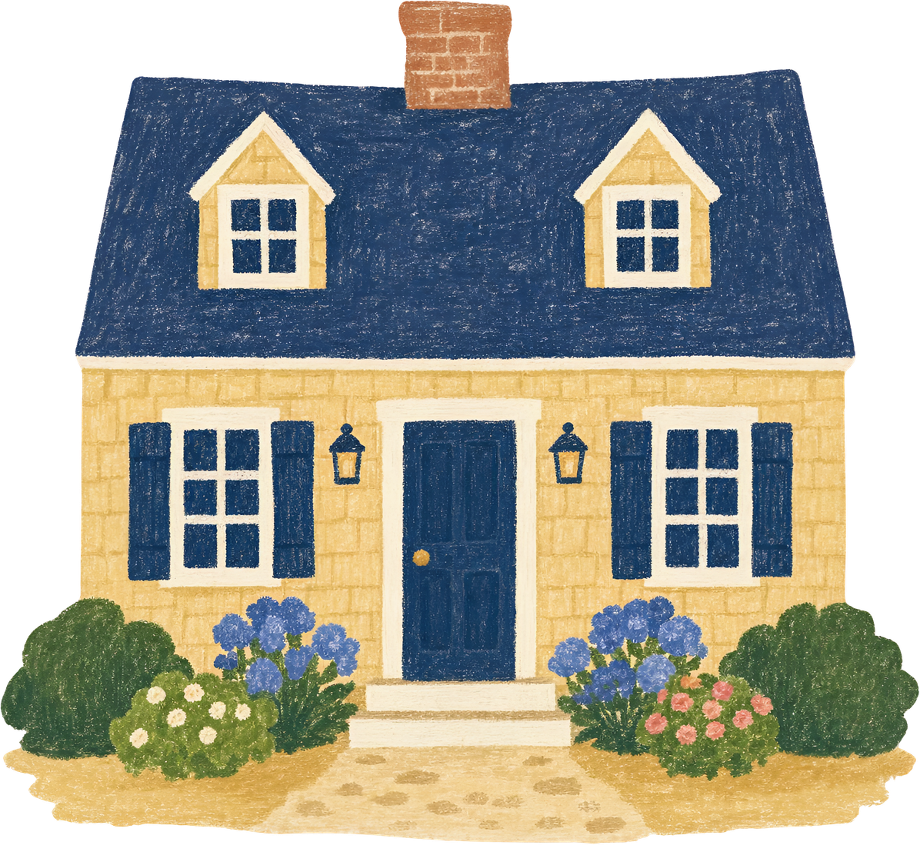
CASE STUDY: MY HOUSE
Details:
  Built in 1900
  Single family, single floor, ~1,000 sq ft
  2 HEPA Air Purifiers
  2 Indoor Air Quality Sensors
Notes:
I wanted to talk a little bit about what I've noticed with the IAQ inside my home. Because of my job, I

Slide 8
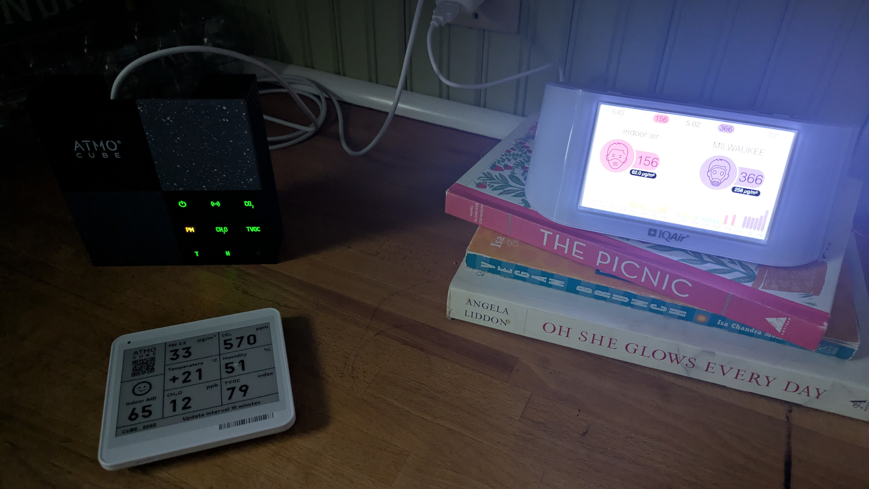
CASE STUDY: MY HOUSE
Interventions:
  Closed windows & doors
  Central A/C
  HVAC fan ON
  2 HEPA Air Purifiers
Thursday July 16th 2026
How much smoke infiltrates our indoor air during hazardous days?
How long does it take for infiltration to start?
Notes:
I wanted to talk a little bit about what I've noticed with the IAQ inside my home.

Slide 9
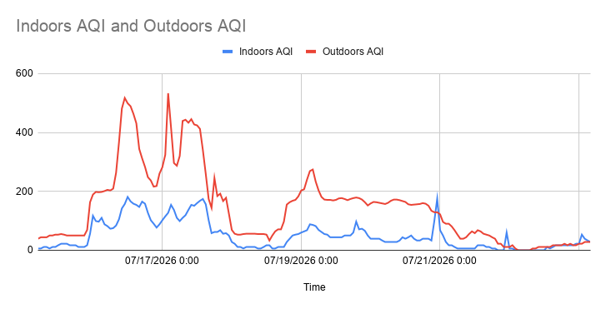
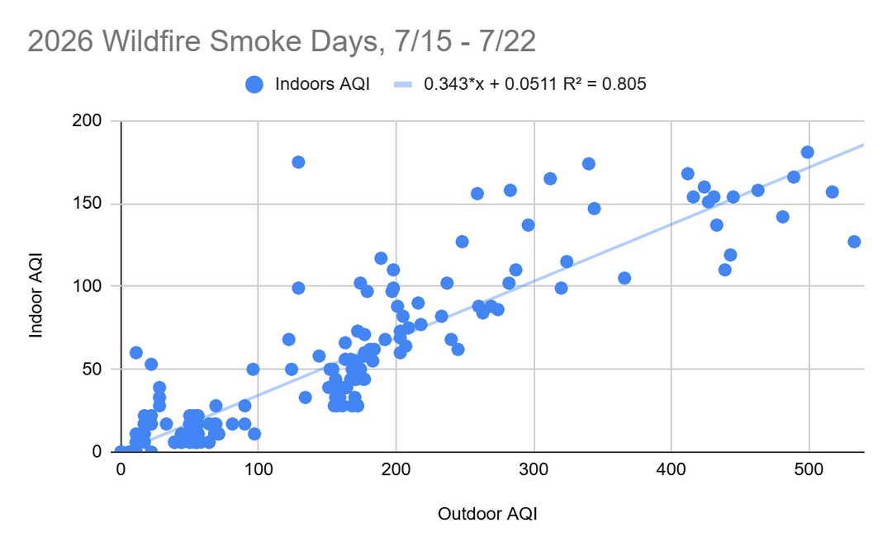
CASE STUDY, 2026 DATA

Slide 10
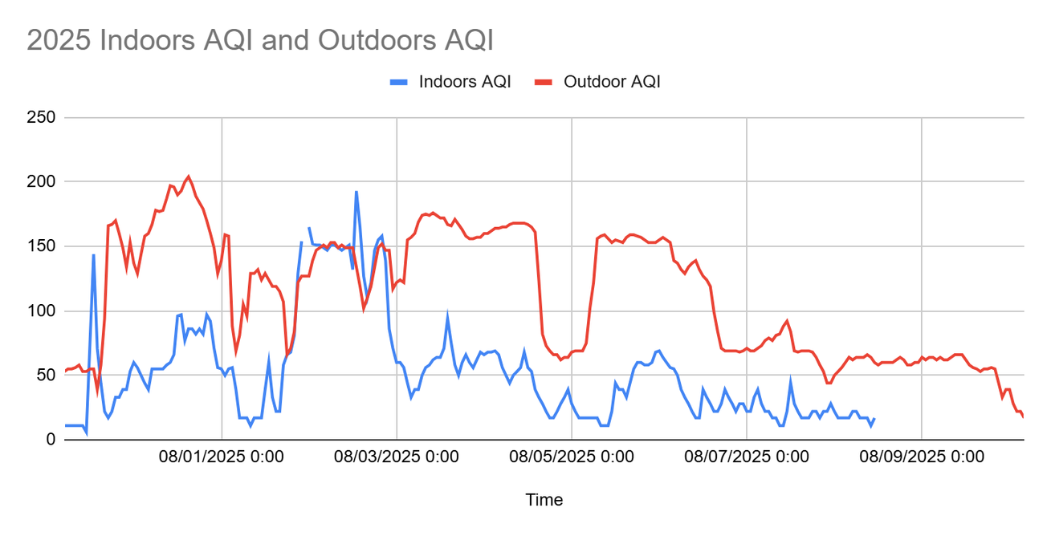
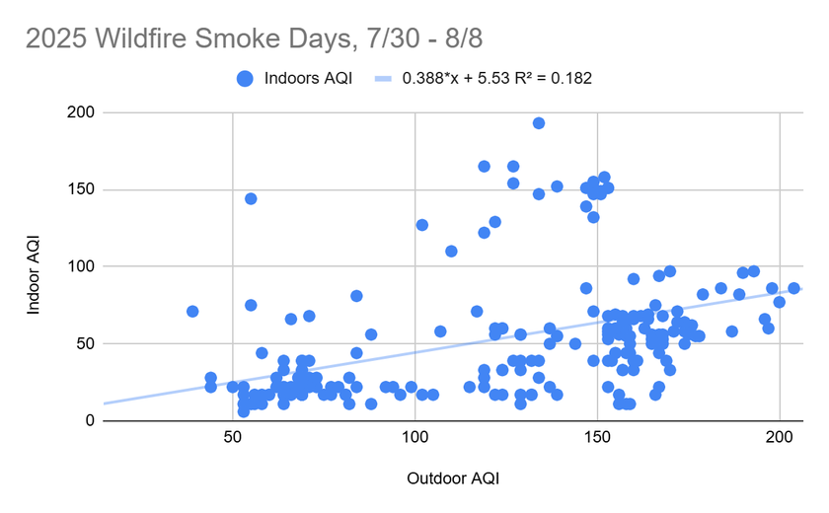
CASE STUDY, 2025 DATA

Slide 11
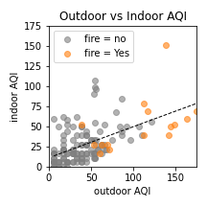
CASE STUDY, 2025 & 2026
2026: 0.34 point increase
Take Home Message:
For every AQI point increase outside, my home had an approximately
⅓ AQI point increase inside.
2025: 0.38 point increase
Notes:
Takeaways: outdoor air quality is worse during non-smoke AQAs and smoke AQAs, with a pretty direct relationship (as outdoor gets worse, so does indoor). Your indoor air purifiers are probably helping, since the relationship between indoor and outdoor is not linear (slope =1) and because the indoor air quality is actually better on days with non-smoke AQAs (my guess is you shut the windows and crank the purifiers when you get an alert, which probably is helping).

Slide 12
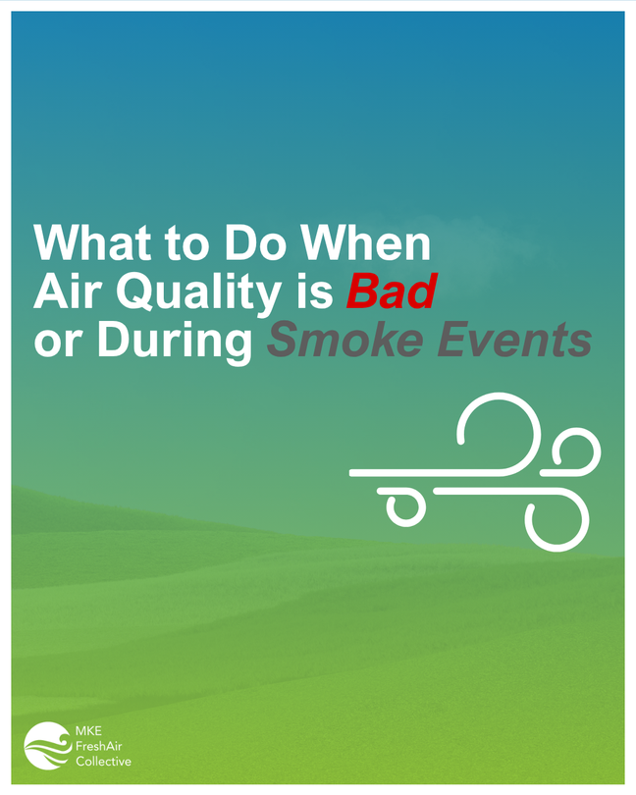
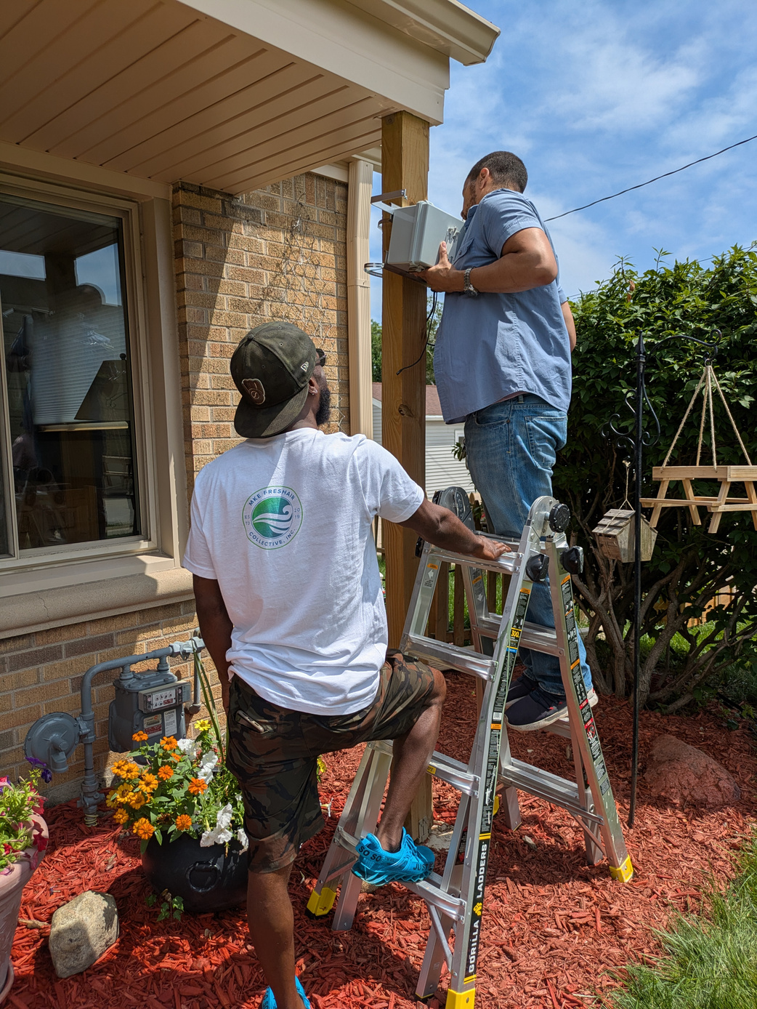
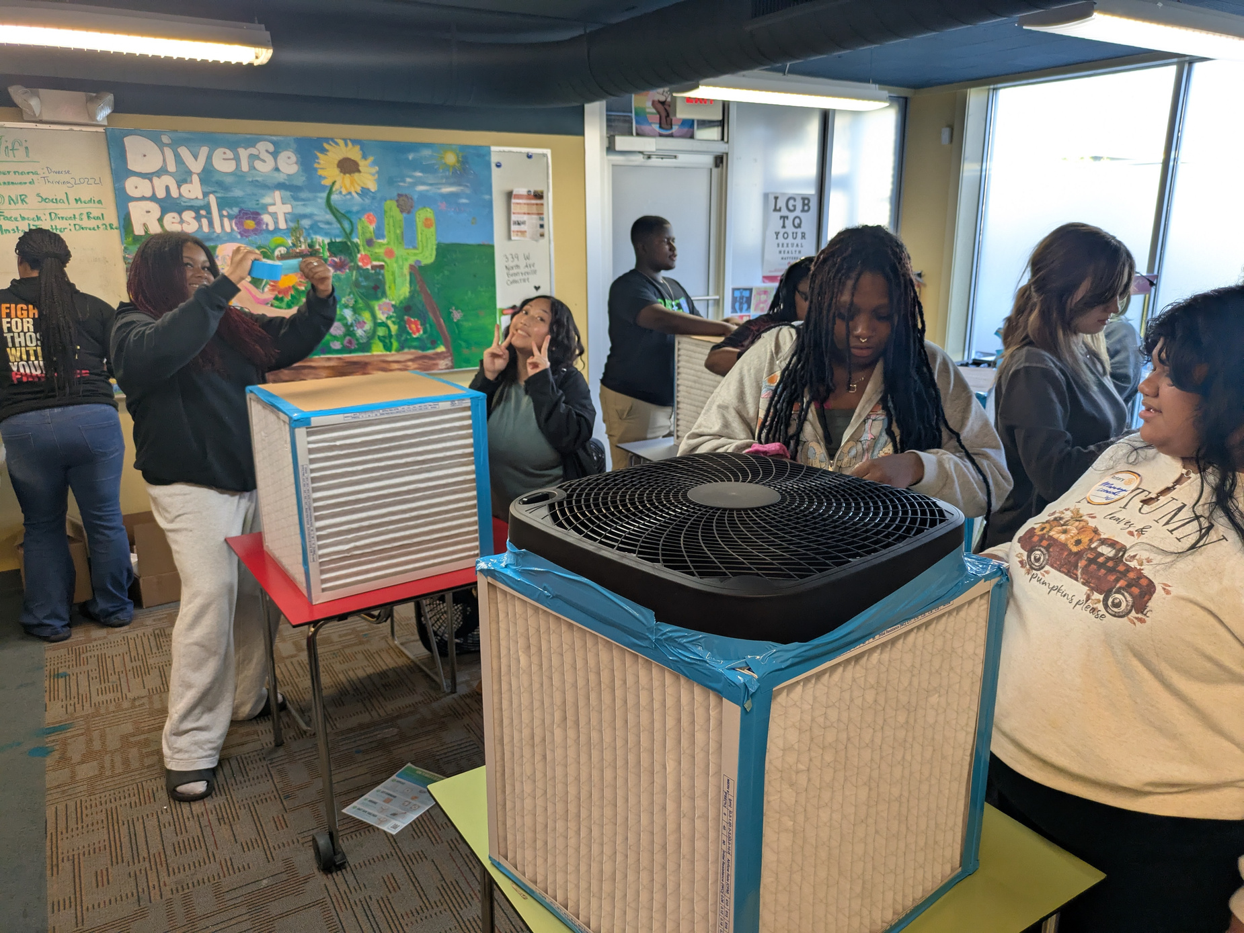
COMMUNITY SOLUTIONS
Real-time Neighborhood-level
Air Quality Data
Workshops: Education &
DIY Air Cleaners
Messaging & Public Outreach

Slide 13
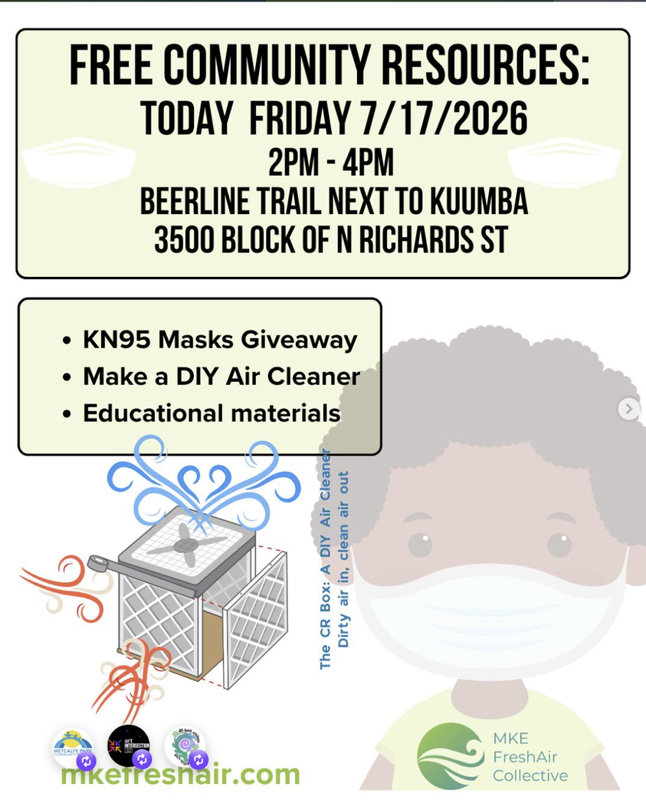
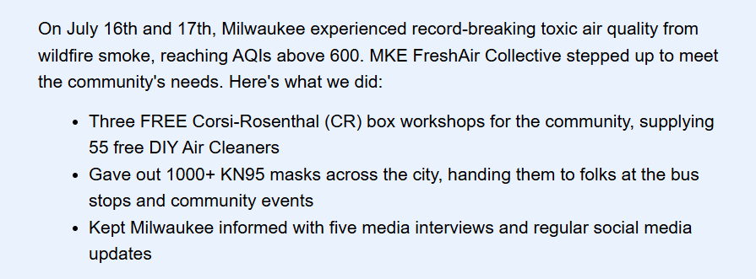
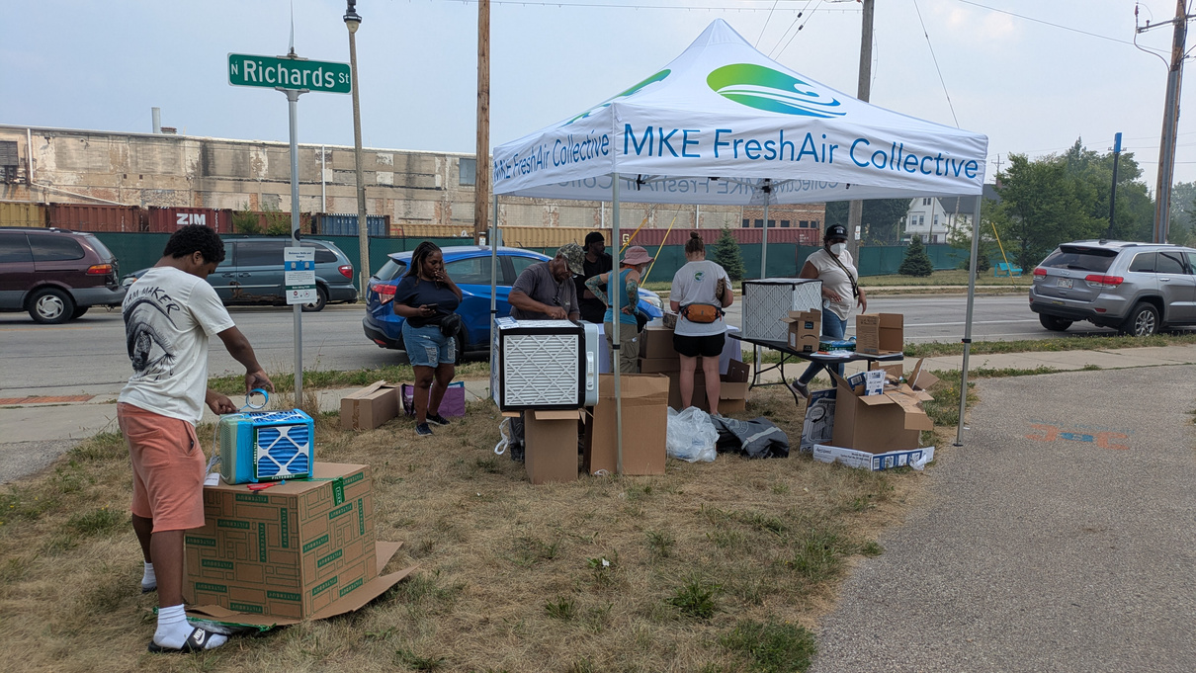
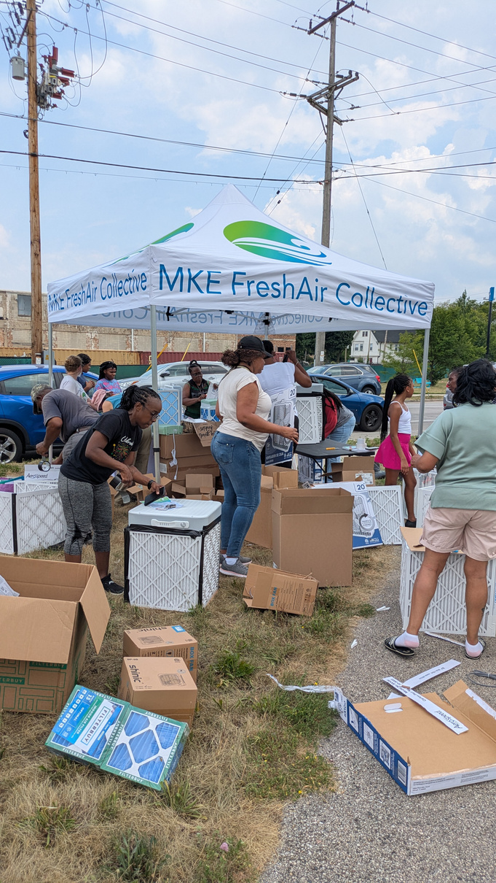
COMMUNITY SOLUTIONS

Slide 14
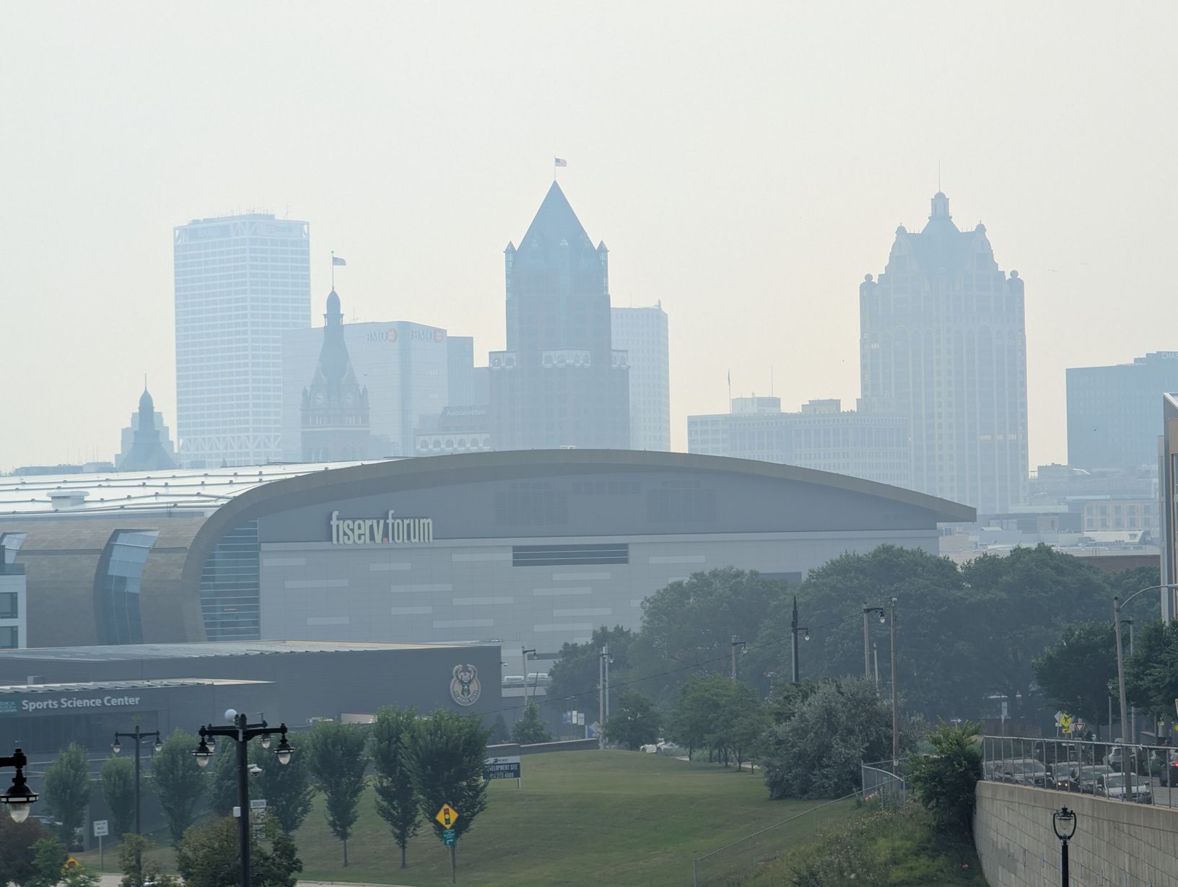
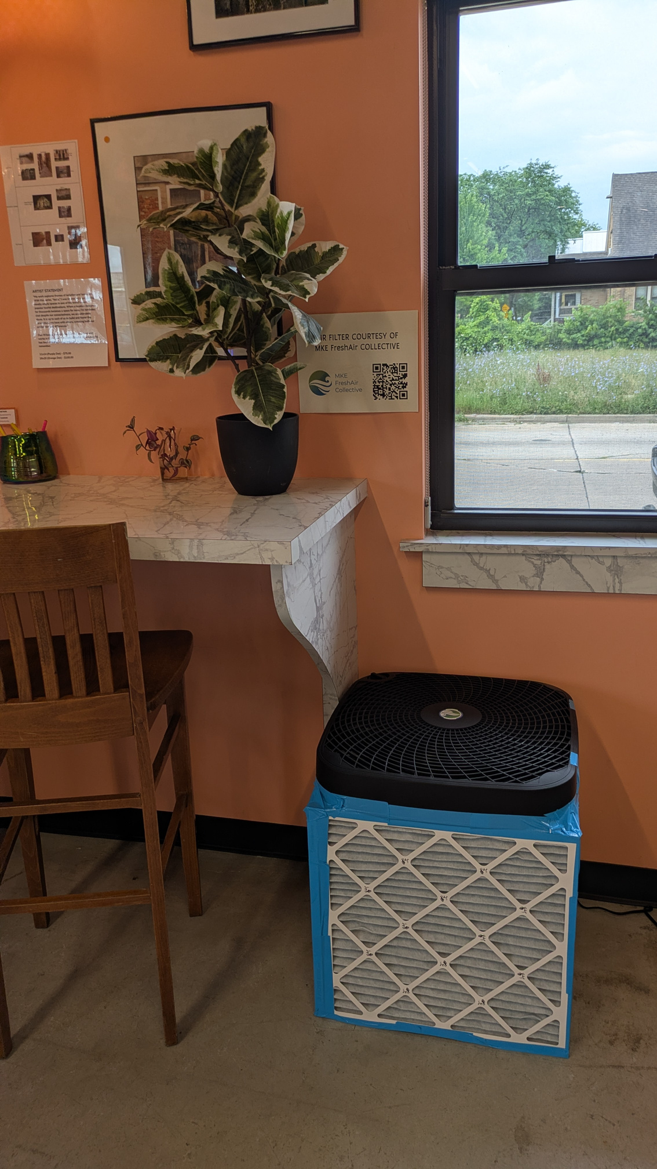
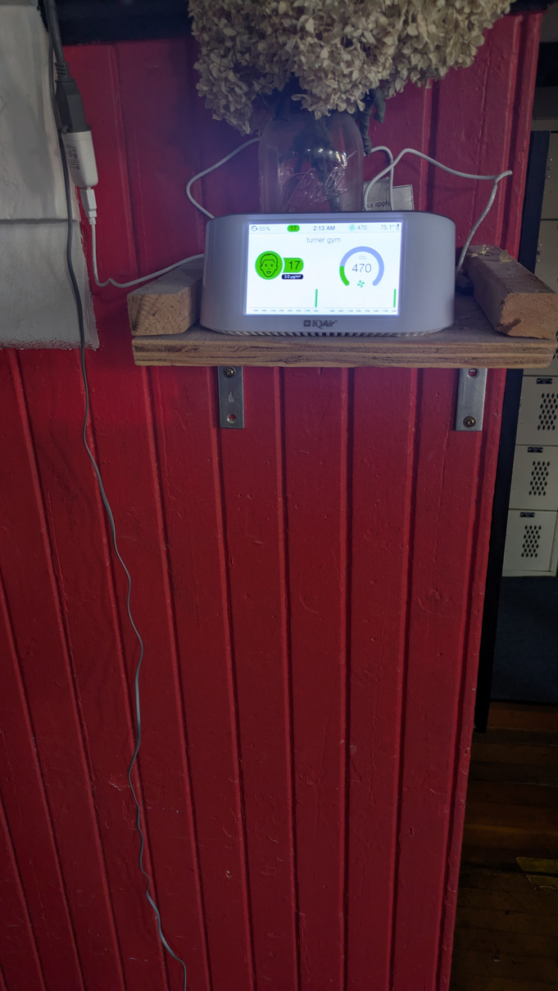
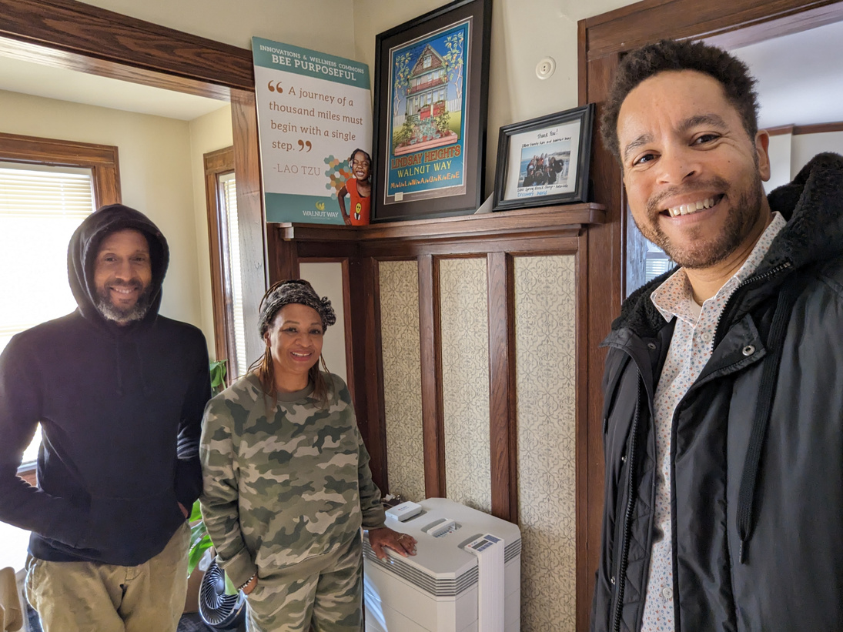
CLEAN AIR SPACES

Slide 15
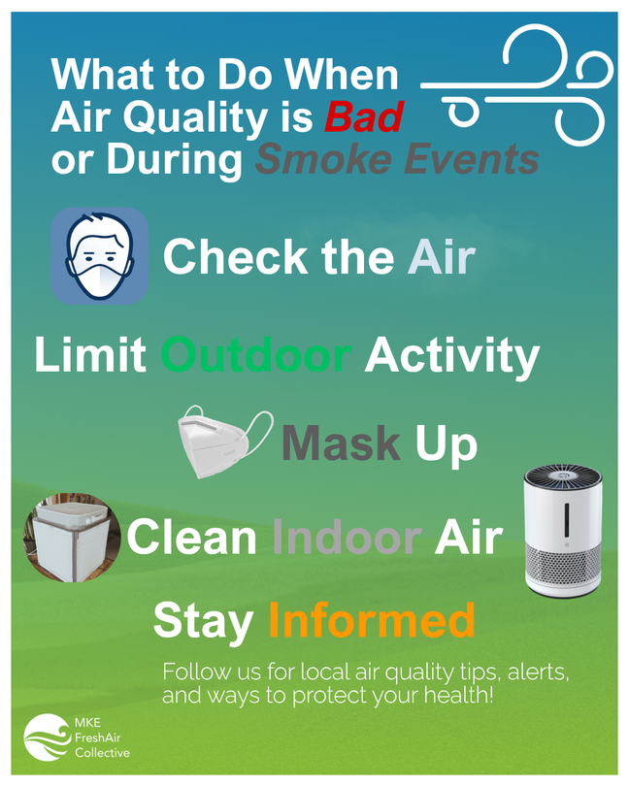
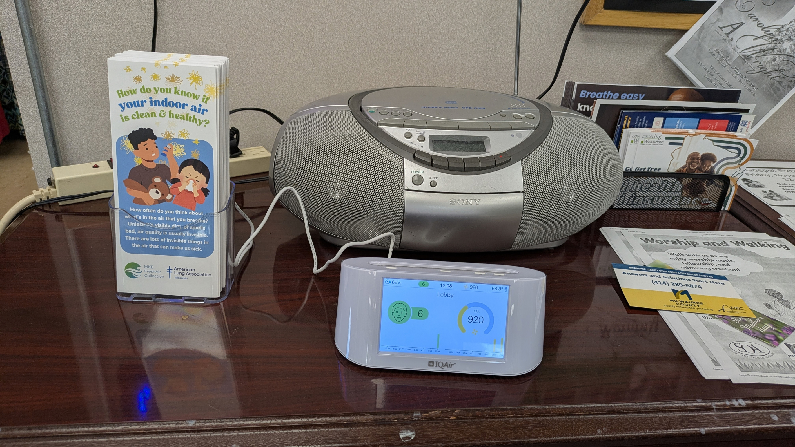
COMMUNITY SOLUTIONS:
CLEAN AIR SPACES
Messaging & Public Outreach

