Slide 1
How Data Influences Decision Making at Public Institutions
Joey McMahon
Research and Policy Coordinator
Milwaukee Public Library
Notes:
Hello everyone my name is joey mcmahon and I am the research and policy coordinator at the Milwaukee public library and today I will be presenting on how data influences decision making at public institutions. We all know that every organization collects data, but I wanted to show how the data we collect is meaningful and how it influences services that the library has to offer

Slide 2
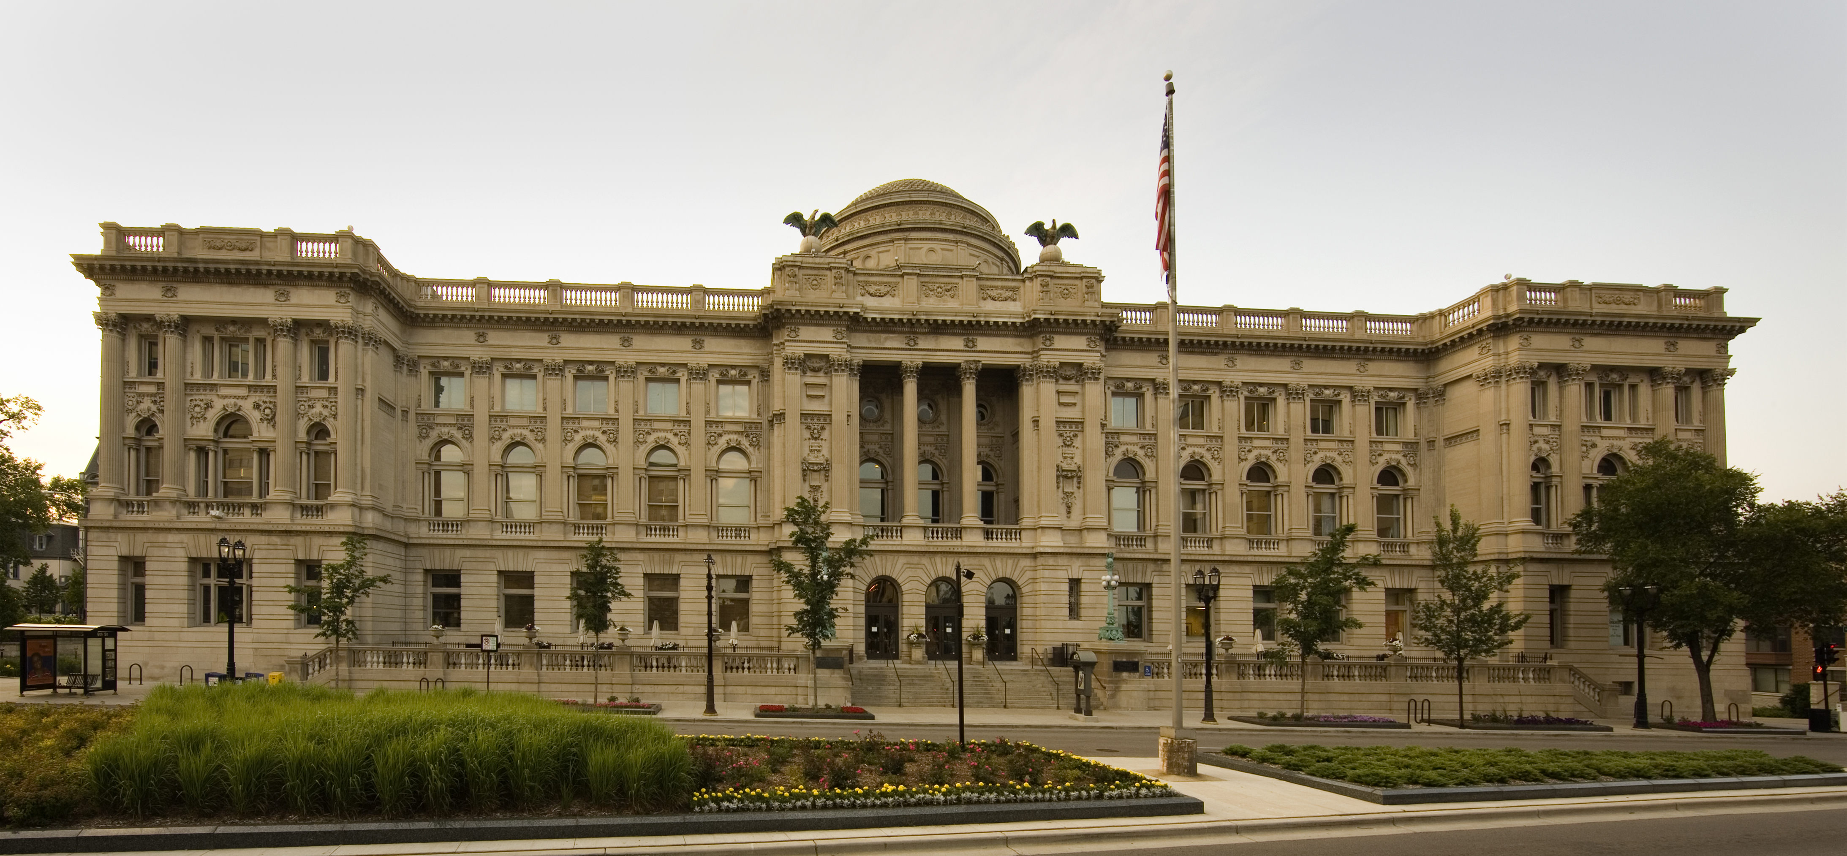
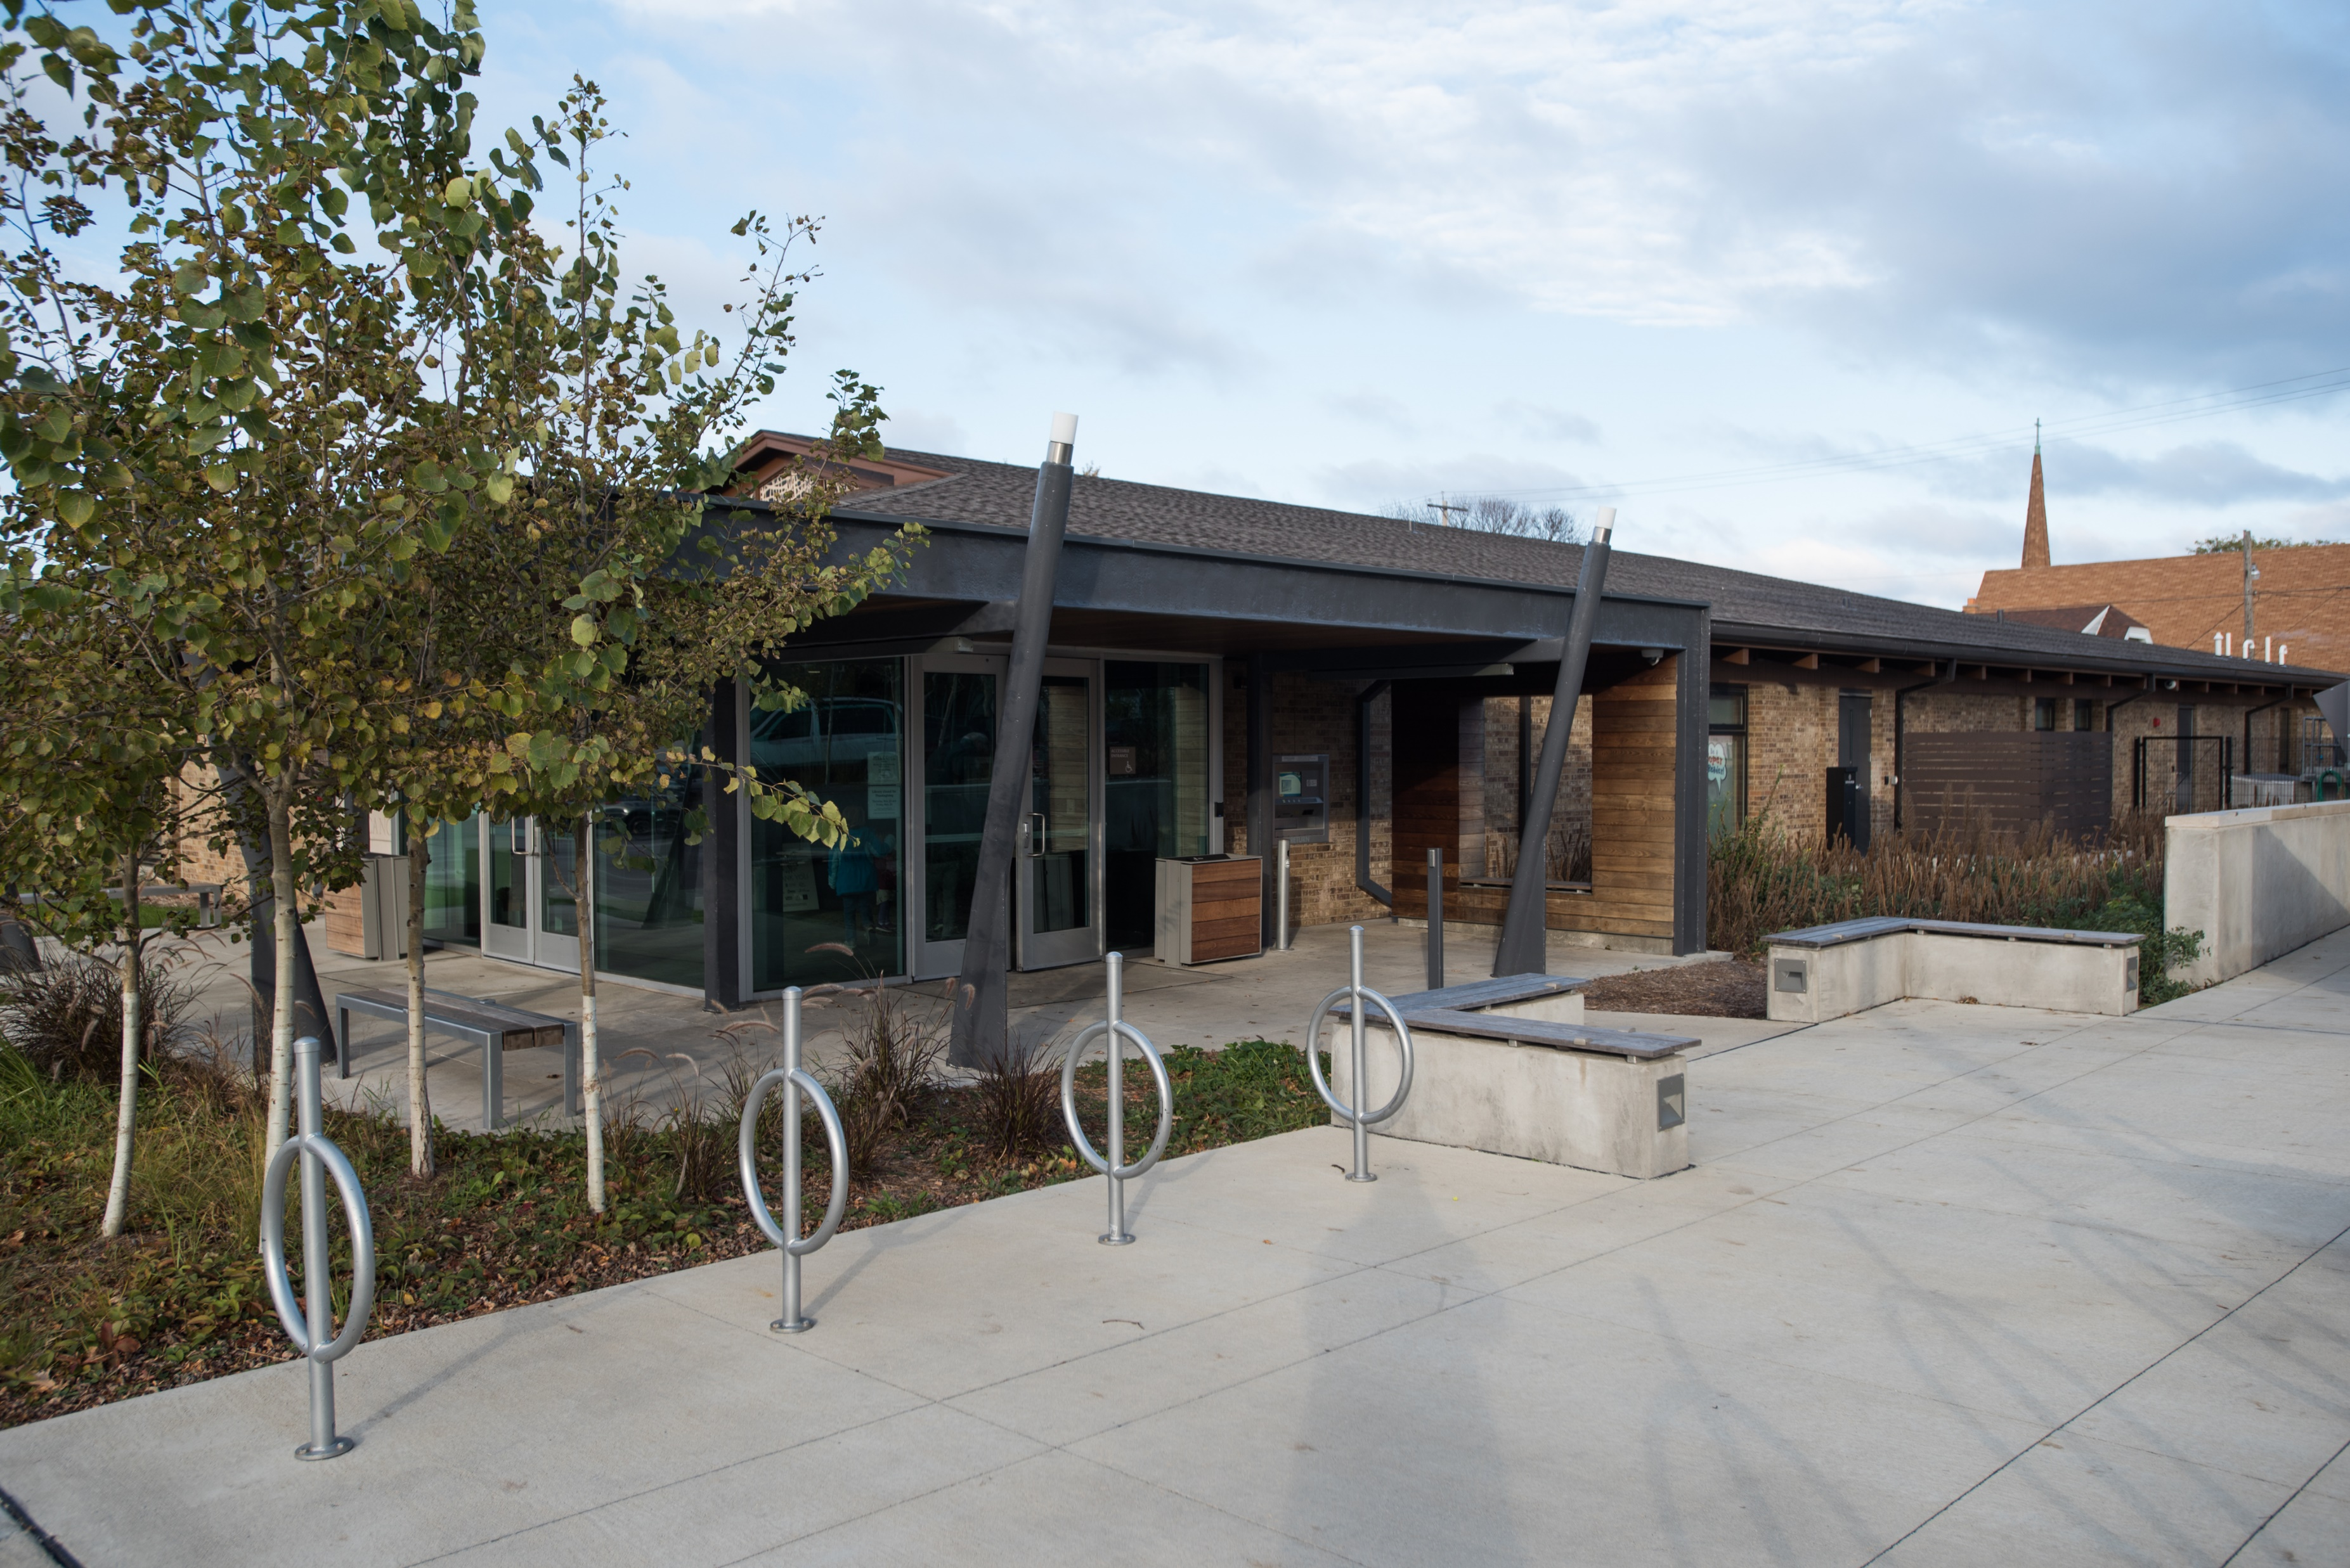
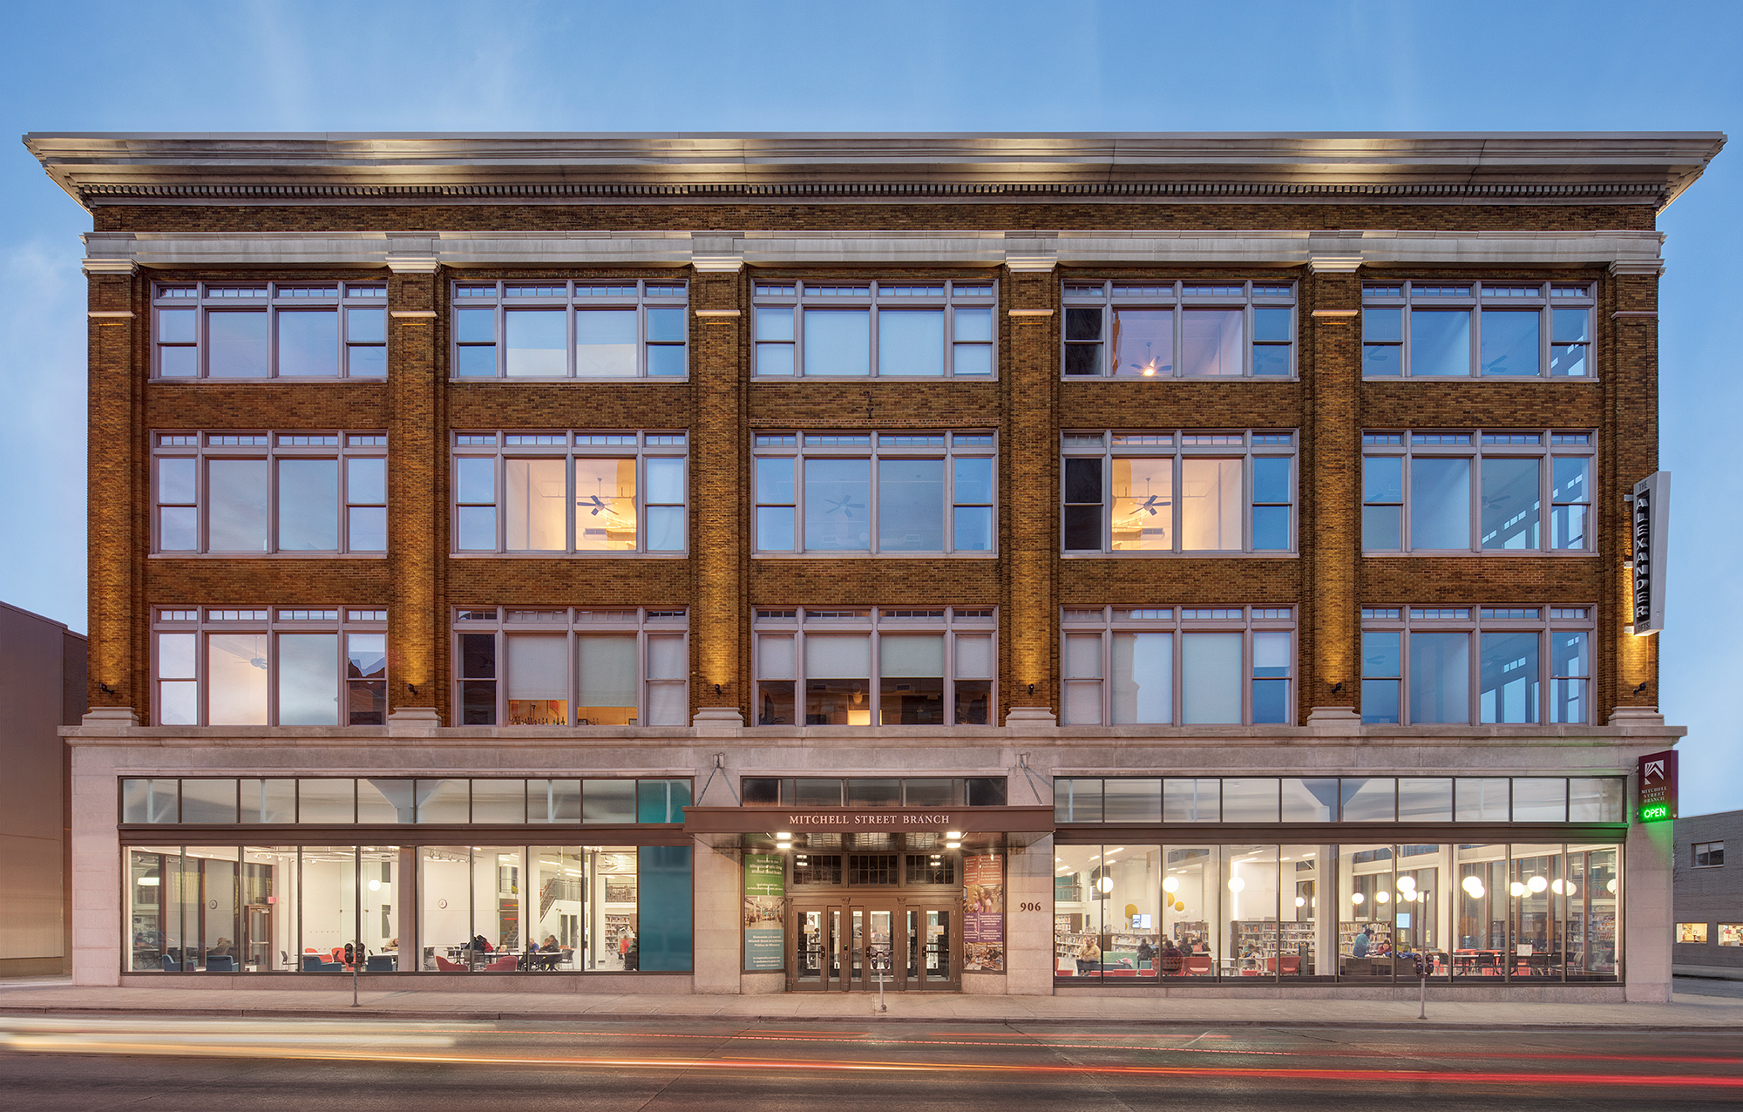
Milwaukee Public Library (MPL) History
Historic institution
  Central (built in 1898)
  12 Branches
MPL is the 3rd most followed library in the U.S. behind Los Angeles and New York public libraries
Based on a community survey, 1 out of 4 people knew all that MPL had to offer. That’s only 25%
Libraries collect so much data
Notes:
A little background of the Milwaukee Public Library. We are a historic institution in the state of Wisconsin. Central is pictured above it was built in 1898 making it the oldest branch. We do though have 12 additional branches though out the city of Milwaukee. n 2027, MPL will be celebrating it 150 year as a system

Slide 3
Milwaukee Public Library (MPL) History
Historic institution
  Central (built in 1898)
  12 Branches
MPL is the 3rd most followed library in the U.S. behind Los Angeles and New York public libraries
Based on a community survey, 1 out of 4 people knew all that MPL had to offer. That’s only 25%
Libraries collect so much data
Notes:
which is a big accomplishment. Fun fact, MPL is the 3rd most followed library account on social media behind some heavy hitters both Los Angeles and New York Public Libraries. This just goes to show the potential influence our library has. However, when we completed our community survey,

Slide 4
Milwaukee Public Library (MPL) History
Historic institution
  Central (built in 1898)
  12 Branches
MPL is the 3rd most followed library in the U.S. behind Los Angeles and New York public libraries
Based on a community survey, 1 out of 4 people knew all that MPL had to offer. That’s only 25%
Libraries collect so much data
Notes:
we found only 1 in 4 of every survey respondent knew all the services that the library provides. So there is a big opportunity here. This is just one example of how we use data to understand community needs. But the library collects a ton of data including

Slide 5
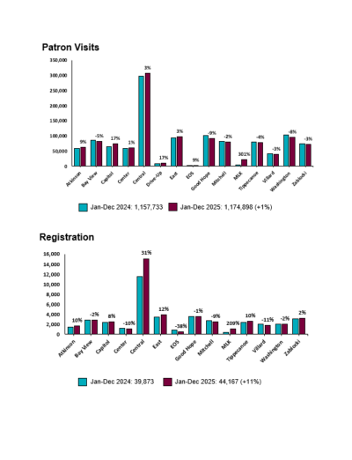
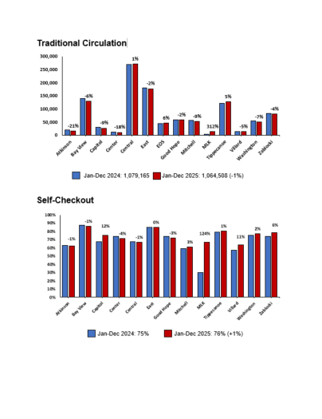
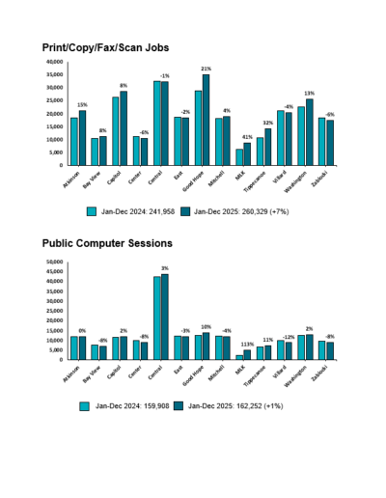
MPL Data and KPIs
Patron Visits
Circulation & eCirculation
Library Card Registrations
Equipment (Printer/Copy) Jobs
Public Computer Sessions
Room Usage
Program Attendance
THE LIST IS ENDLESS!

Slide 6




Data Ecosystem
Internal Usage Data
Community Data: INPOWER—Community Survey (completed 2023)
Raw Census Data: University of Wisconsin – Milwaukee, Master of Urban Planning (MUP)
GIS Census Maps
Notes:
But our data ecosystem is much boarder than just that. Data on the previous slide all fall under internal usage data. However we also collect data through our community partners starting with INPOWER we did a community survey back in 2023. We have also partnered with the University of Wisconsin Milwaukee’s master of urban planning students

Slide 7
Data Framing
Notes:
Now that you know some the data we collect it is important to talk about how we frame it to our team. Framing is important because when we look at the raw data it can be hard to interpret. So we create legible graphs to make it easier to see trends. Its also super important how we interpret the data.

Slide 8
Data Framing
Notes:
One thing you'll notice is that Central is an outlier. It’s a historic building and a destination for people, so its usage is always way higher than the rest of our branches. This makes it difficult to see trends so we sometimes remove Central in order to avoid comparing performance to our highest performer.

Slide 9
Data Framing (Central removed)
Notes:
So with Central removed, it is easier to see a clearer picture of what is going on at the branches. In red we have Atkinson, Capitol, Good Hope, and Villard, which makes up our North Cluster , in teal we have the four branches that make up our Central Cluster, and lastly in yellow, we have the four branches that make up our South Cluster.

Slide 10
Data Framing (Central removed)
Notes:
From this, we can see that the south cluster really functions like a typical library—high circ and high patronage. However, when we look at the North Cluster, we see a different picture. They have a much lower circulation but a high public computer and wifi usage. Why might this be?

Slide 11
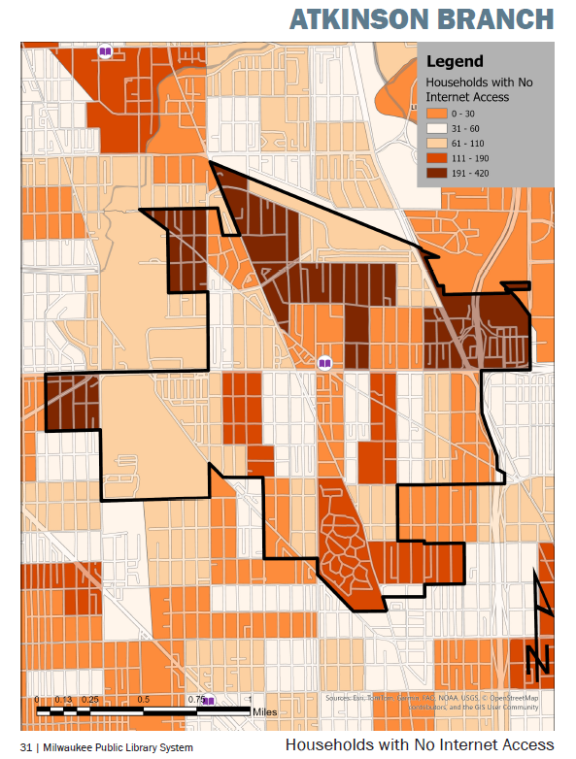
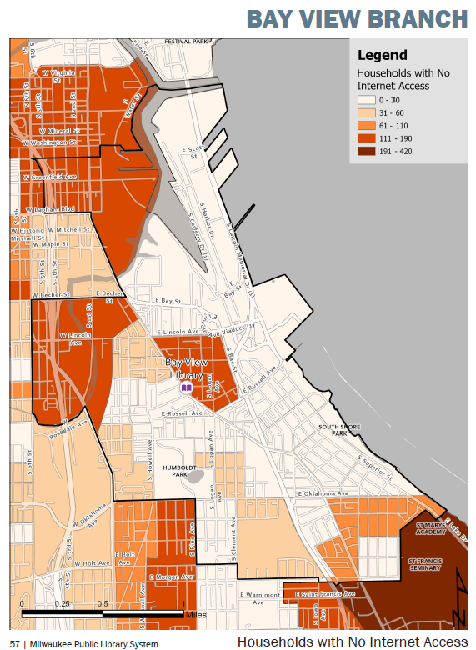
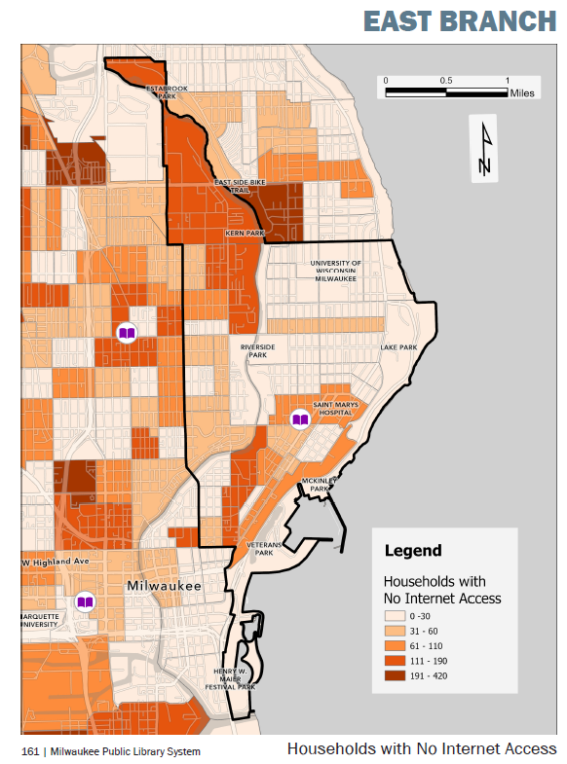
Data Framing
Notes:
Well, when we accompany these graphs with our new GIS service area maps completed by our UWM student partners, we see something very interesting. I want to direct your attention to these three maps to the right. Using census data, these all show household internet access using a gradient.

Slide 12
Data Framing
Notes:
The darker the color, the more households with no internet, the lighter the color, the less households with no internet. So what does this mean? The service areas of Bay view and East have a rather light color or high access to internet.

Slide 13
Data Framing
Notes:
When we look at the Atkinson service area, we actually see pockets of super dark red, indicating more households with no internet access. This helps explain the WHY--why we might see a higher internet and public computer usage in the North Cluster Branches.

Slide 14

Now what?
Every year, inform Branch strategic plan
  Programs, library services, and partnerships
Shared with the Mayor’s Office
Notes:
So what does this all mean? We’ve talked about various different sources; data from the community, library usage data, and census data. By combining and analyzing internally, we can determine multiple things. How branches are being used, how to inform library services, whats needed in service areas, and ultimately how to better serve the community.

Slide 15
Now what?
Every year, inform Branch strategic plan
  Programs, library services, and partnerships
Shared with the Mayor’s Office
Notes:
We took this to our team of branch managers and are working with them to determine how to best bolster their services, programs, events, and even community partnerships. We also share this data with the Mayor’s office to advocate for continued funding and support from the City of Milwaukee.
That’s all I have for today. Thank you so much for having me.

